Slide 1
Master thesis FOLLOW-up MEETING
Uncovering the economic tipping point between $H_{2}$-based GTs and CCS-enhanced GTs
Jean Bériot Jean.BERIOT@student.umons.ac.be

Slide 2
End of last presentation’s summary
Integrate an alternative to the Merit Order computation
Integrate ${CO}_{2}$ Transport and Storage Costs in the CCS model
Perform a sensitivity analysis on critical parameters
Make the online tool accessible

Slide 3
CCS-enhanced Gas Turbines

Slide 4
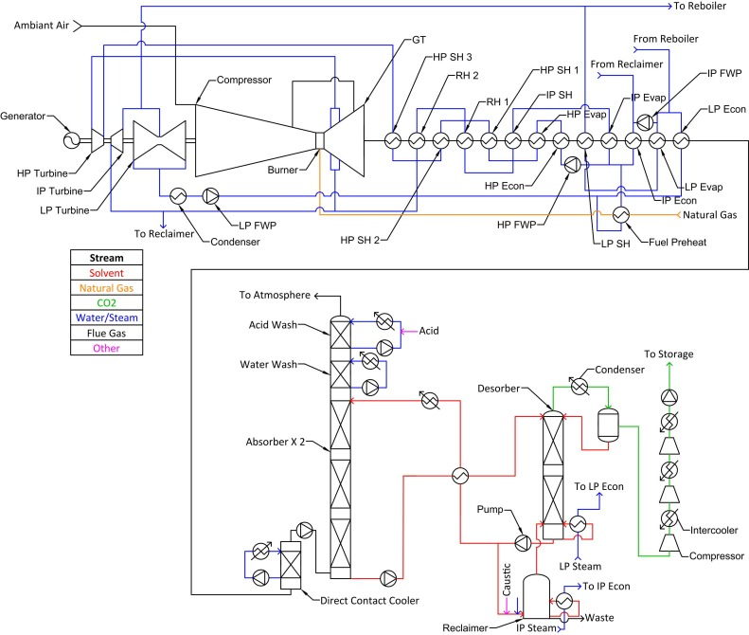
CAPEX computation
Simplified Model based on similar study
CCGT CAPEX = 420 M€
CCS 96% CAPEX = 657 M€
CCS 100% CAPEX = 699 M€
FOM = 3,5% of total CAPEX
VOM = ${CH}_{4}$, MEA, ETS, Water
Water consumption = 0,76 L/kWh (using Thermoflow)
https://www.sciencedirect.com/science/article/pii/S2352484724002713#eqn0040

Slide 5
OPEX computation
Price DATA
${CH}_{4}$: 4,5 Ct/kWh (Country dependant, Source: Eurostat)
MEA: 1,2 €/kg (Source: businessanalytiq)
ETS: 85 €/$T_{{CO}_{2}}$ (Source: sandbag)
Make-Up Water: 3,15 €/m³ (Source: SWDE)
Cooling Water: 12 Ct/m³
Transport and storage costs: 20 €/$T_{{CO}_{2}}$

Slide 6
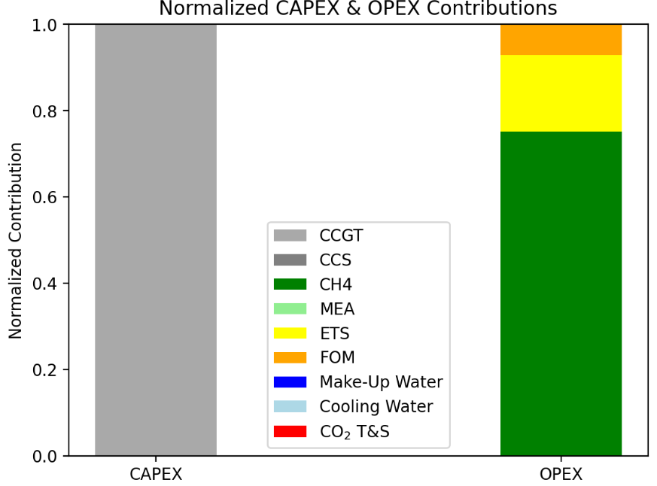
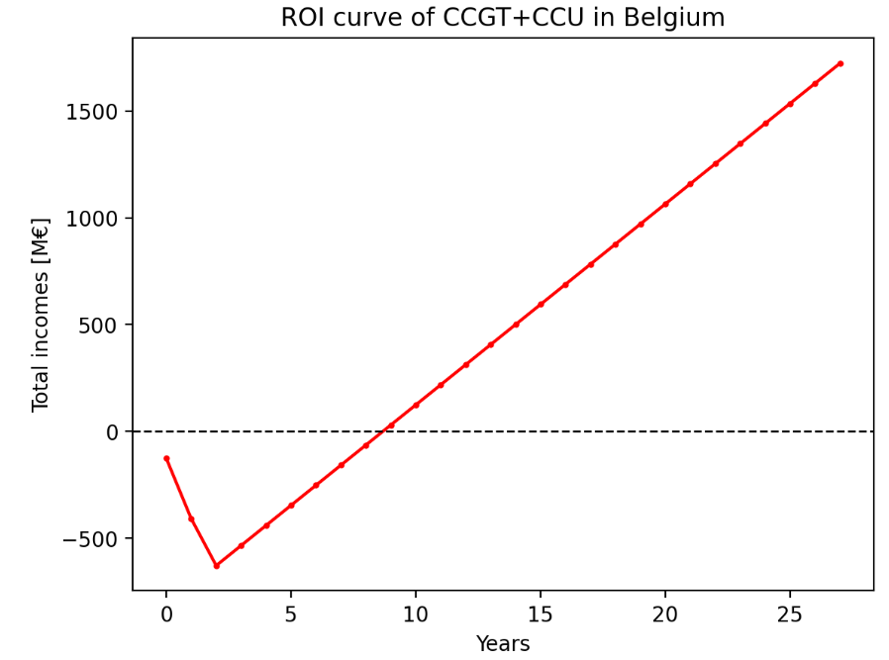
LCOE computation
Results
No Capture

Slide 7
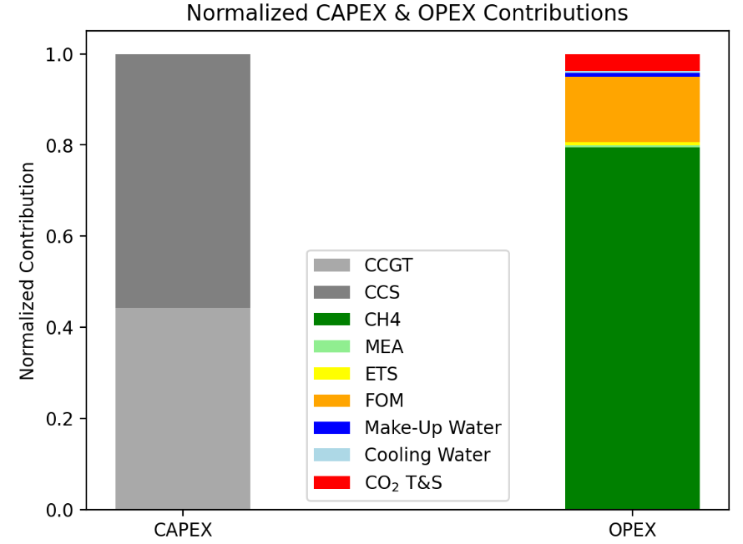
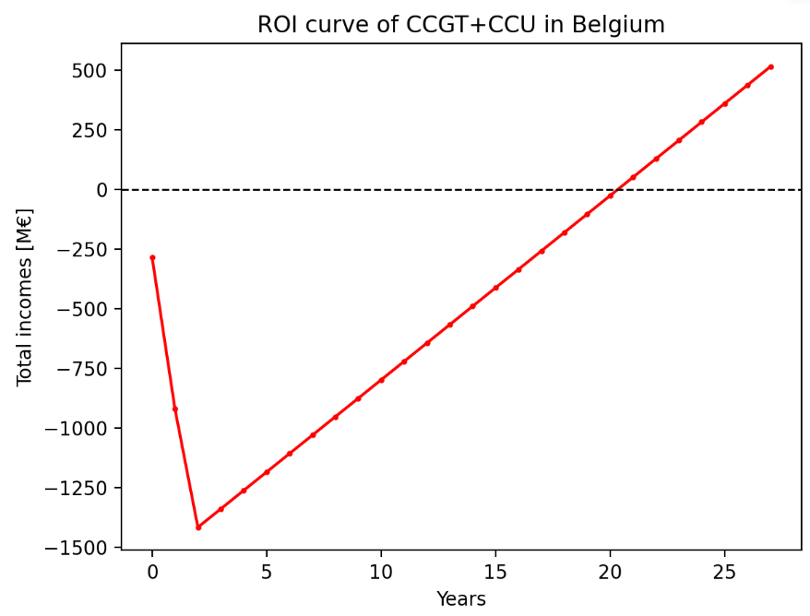
LCOE computation
LCOE ≠ ROI
Results
96% Capture

Slide 8
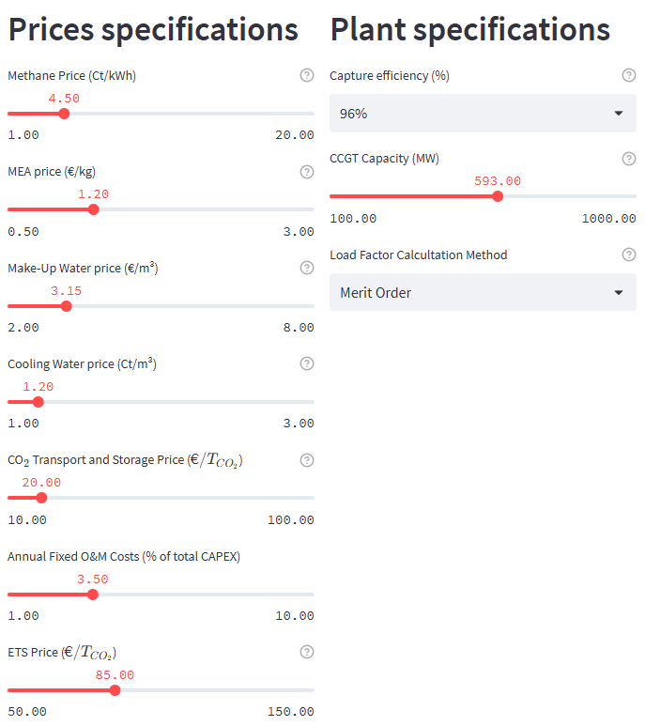
Flexibility of computation

Slide 9
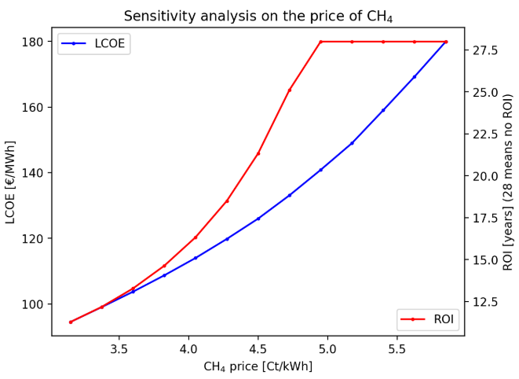
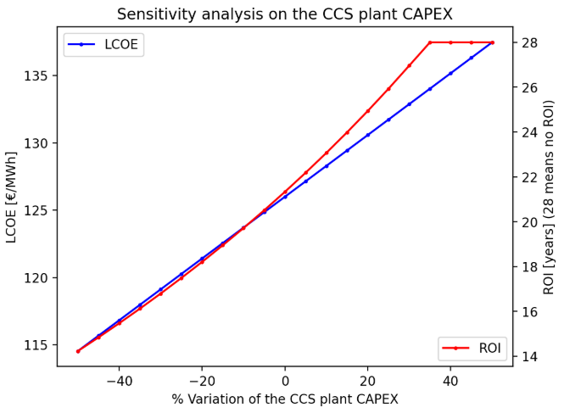
Sensitivity Analysis

Slide 10
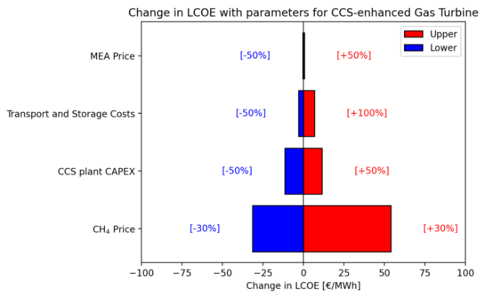
Sensitivity Analysis

Slide 11
$H_{2}$-based Gas Turbines

Slide 12
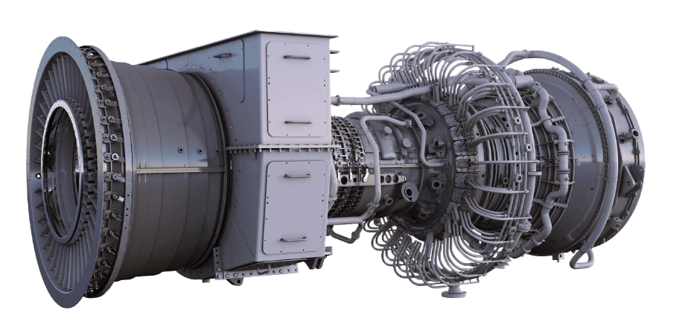
Turbine considered
LM6000PC
100% $H_{2}$ Capable
CCGT efficiency = 51,9%
1st plant 100% $H_{2}$ Capable running in 2026

Slide 13
About $H_{2}$Gas turbine
Assumptions
$H_{2}$ price: country AND type dependant (Source: https://observatory.clean-hydrogen.europa.eu/index.php/hydrogen-landscape/production-trade-and-cost/cost-hydrogen-production)
SMR with CCS: 3,62 €/kg
Green $H_{2}$: 8,08 €/kg
25% CAPEX increase for retrofit of CCGT (Source: https://www.sciencedirect.com/science/article/pii/S0360319921039768)

Slide 14
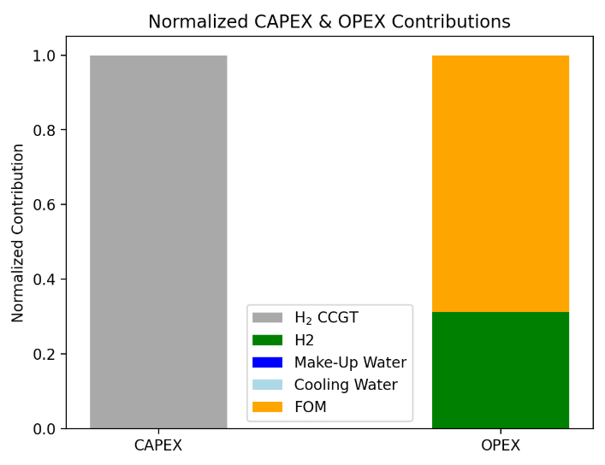
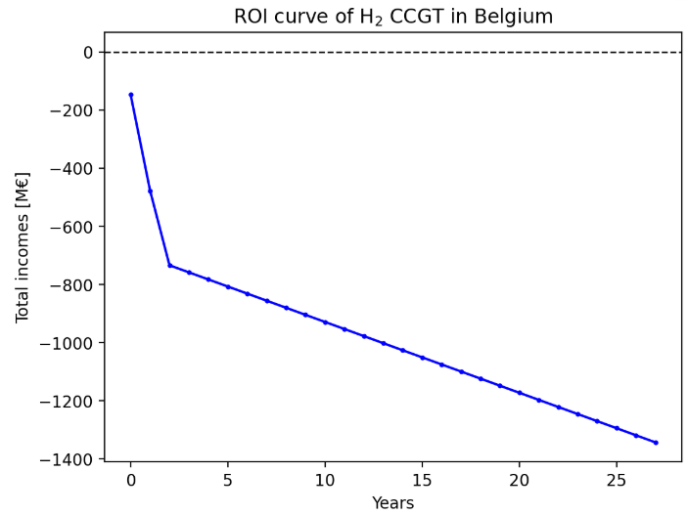
About $H_{2}$Gas turbine
Results

Slide 15
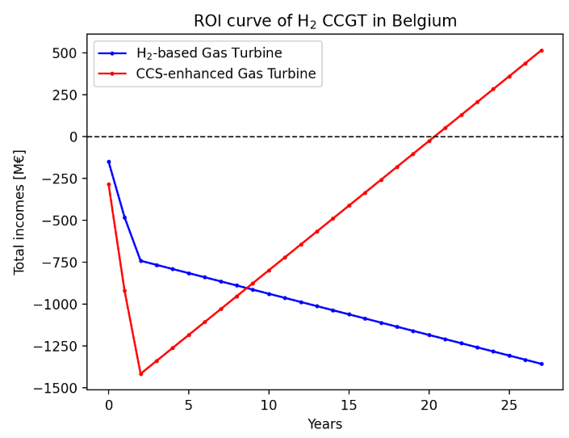
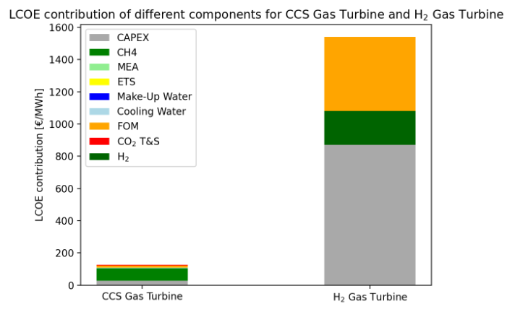
Graphical comparison
Base case (SMR+CCS $H_{2}$)

Slide 16
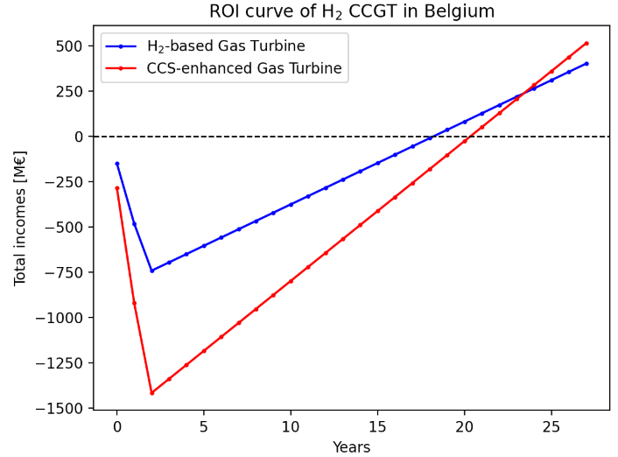
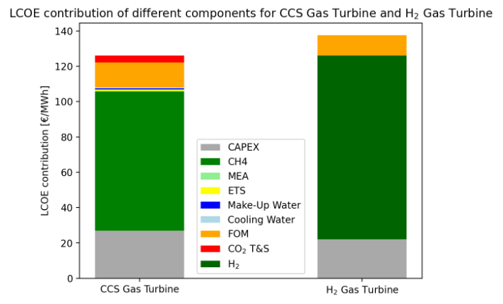
Graphical comparison
Reduced $H_{2}$ price (from 3,62 €/kg to 1,8 €/kg) ➔ 50% cutdown

Slide 17
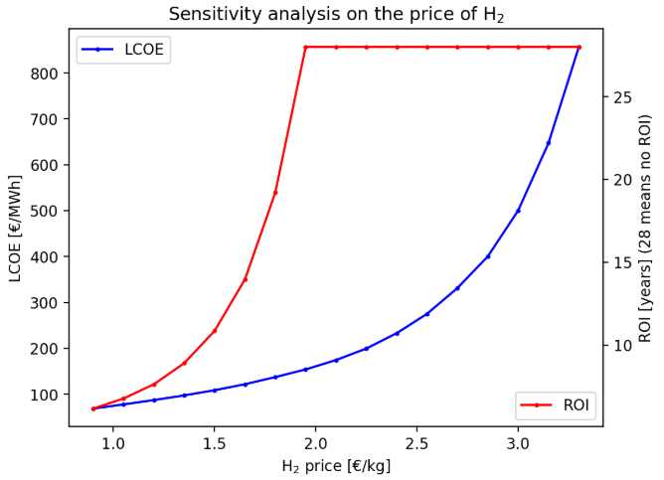
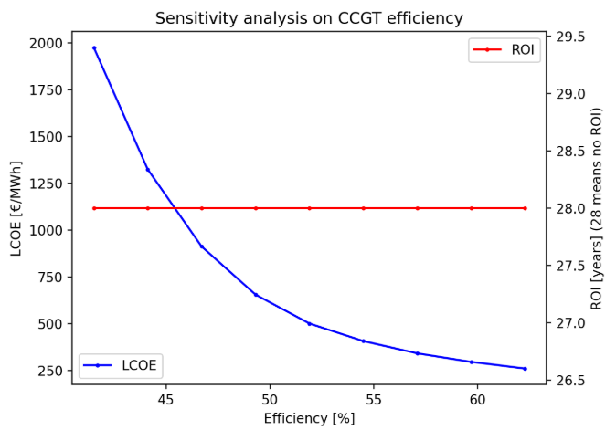
Sensitivity Analysis

Slide 18
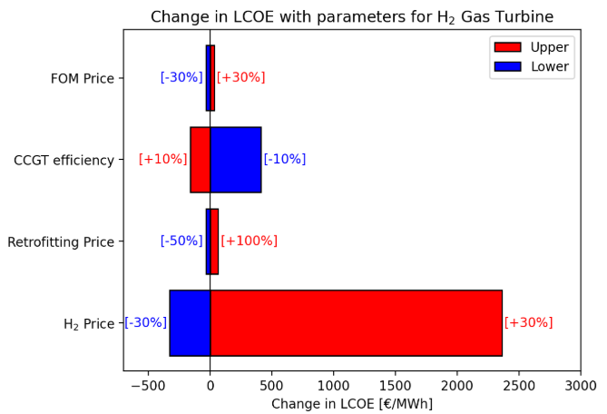
Sensitivity Analysis

Slide 19
Ongoing and future tasks
Take the CRM revenues into account
Integrate part load computation in the model
Start-ups, ramping down,…
Integrate flexibility revenues with aFRR or mFRR

Slide 20
Feel free to try it!

