Slide 1
Master thesis FOLLOW-up MEETING
Uncovering the economic tipping point between $H_{2}$-based GTs and CCS-enhanced GTs
Jean Bériot Jean.BERIOT@student.umons.ac.be

Slide 2
Overview
Reminder from last meeting
What has been achieved
What is ongoing
What are the next steps

Slide 3
Overview
Reminder from last meeting
What has been achieved
What is ongoing
What are the next steps

Slide 4
Reminder Main objectives
Technical comparison of the technologies
Determination of the efficiencies
Evaluation of the components required
Economical comparison of the technologies
Determination of CAPEX, OPEX and LCOE
Multiple cases analysis (Electricity production mix, grid profile)
Sensitivity analysis

Slide 5
Overview
Reminder from last meeting
What has been achieved
What is ongoing
What are the next steps

Slide 6
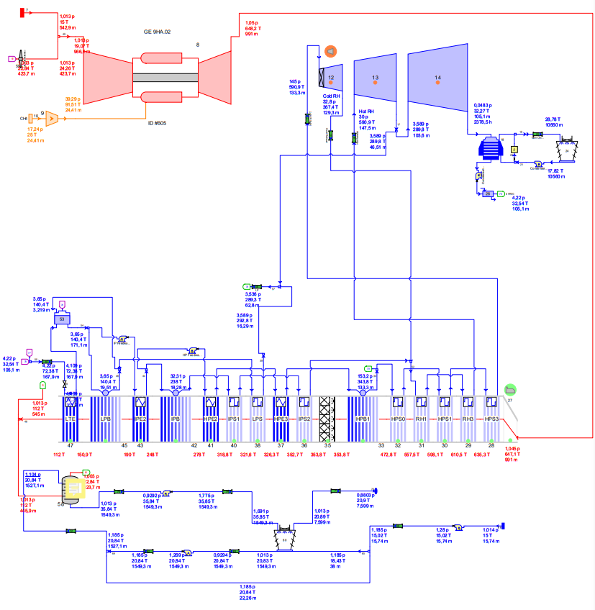
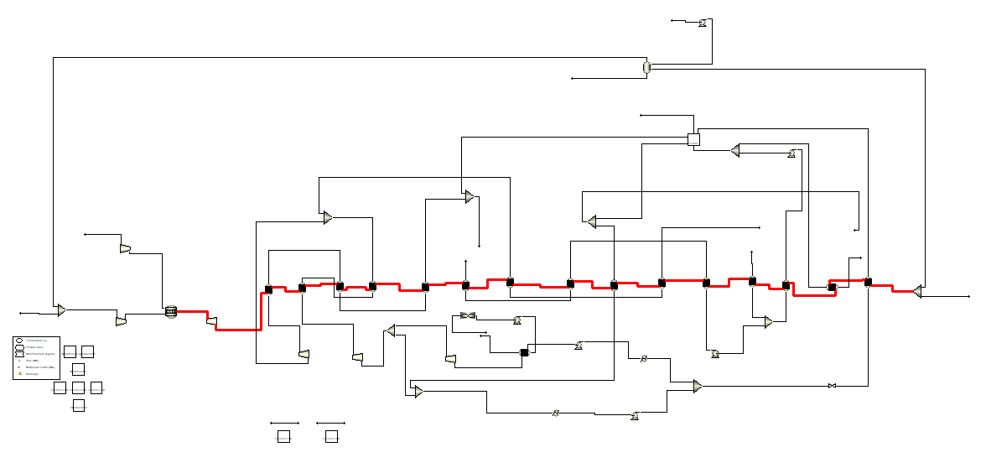
CCGT Model
Based the CCGT+CCU model on a previous study made on Thermoflow using a GE9HA …
$$P_{OCGT}=506,6 MW$$
$$P_{CCGT}=672,2 MW$$
$$η_{OCGT}=41,47\%$$
$$η_{CCGT}=55,03\%$$
… and modeled the CCGT part in Aspen

Slide 7
CCGT Model
Based the CCGT+CCU model on a previous study made on Thermoflow using a GE9HA …
$$P_{OCGT}=506,6 MW$$
$$P_{CCGT}=672,2 MW$$
$$η_{OCGT}=41,47\%$$
$$η_{CCGT}=55,03\%$$
… and modeled the CCGT part in Aspen

Slide 8
Main results
OCGT efficiency = 42,2%
Concording with previous study
CCGT efficiency = 58,6%
Including thermal integration of CCU reboiler
Excluding mechanical work induced by CCU (Additional 6% drop in efficiency estimated by (1))
(1) https://www.sciencedirect.com/science/article/pii/S0306261916308625

Slide 9
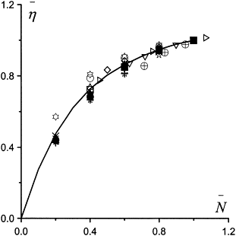
Additional finding
Part load efficiency variation of CCGT power plants follows a mathematical tendance (2)
(2) https://www.sciencedirect.com/science/article/pii/S0196890402000183

Slide 10
Overview
Reminder from last meeting
What is achieved
What is ongoing
What are the next steps

Slide 11
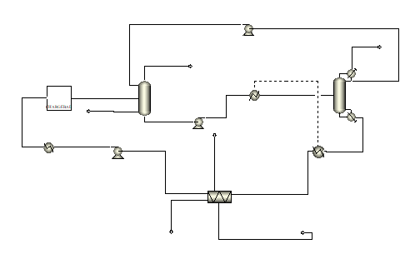
Including CCU model in Aspen
CCGT efficiency impact
Amine flow rates and types to reach 90% - 95% CC efficiency
Columns configuration

Slide 12
Overview
Reminder from last meeting
What is achieved
What is ongoing
What are the next steps

Slide 13
Work on economical model
Compute CAPEX and OPEX using Aspen Economics and crossvalidate with studies
Get electricity prices data from EpexSpot or ENTSO
Compute the LCOE of CCGT+CCU electricity

Slide 14
Master thesis FOLLOW-up MEETING
Uncovering the economic tipping point between $H_{2}$-based GTs and CCS-enhanced GTs
Jean Bériot Jean.BERIOT@student.umons.ac.be

