Slide 1
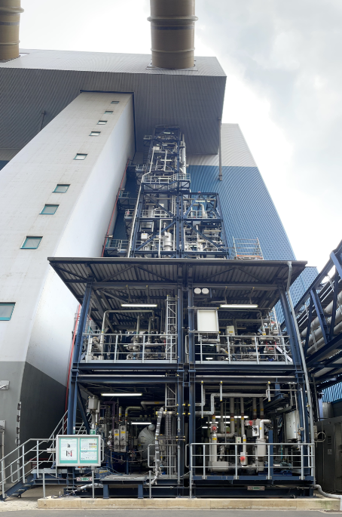
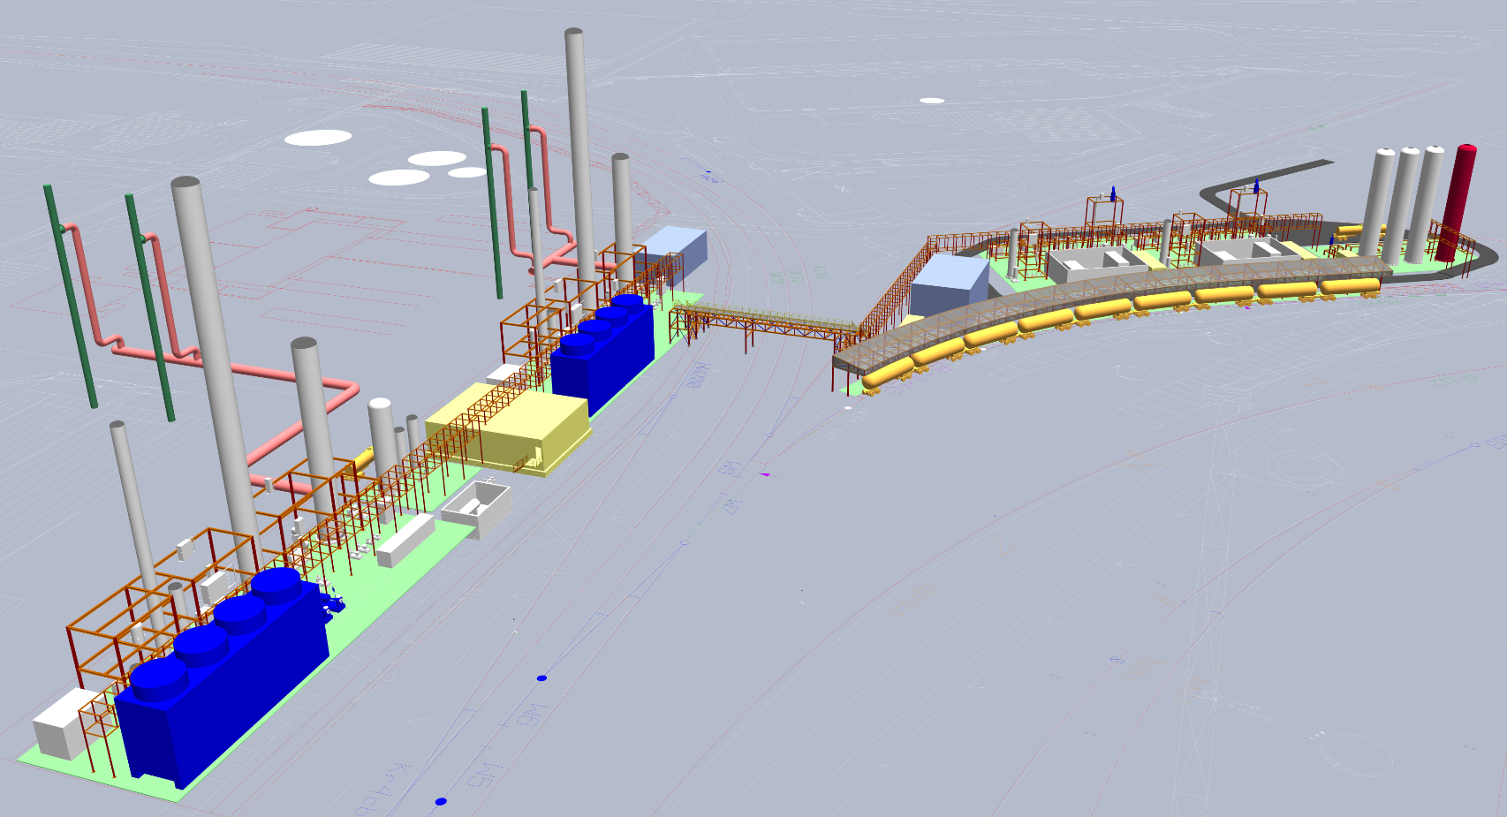
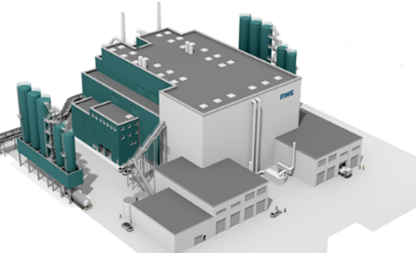
Advancing CO₂ Capture –
RWE Cutting-Edge Research for Real-World Solutions
ETN CCS Webinar Series
06th February 2025
Dr. Sandra Schmidt
RWE Power AG

Slide 2


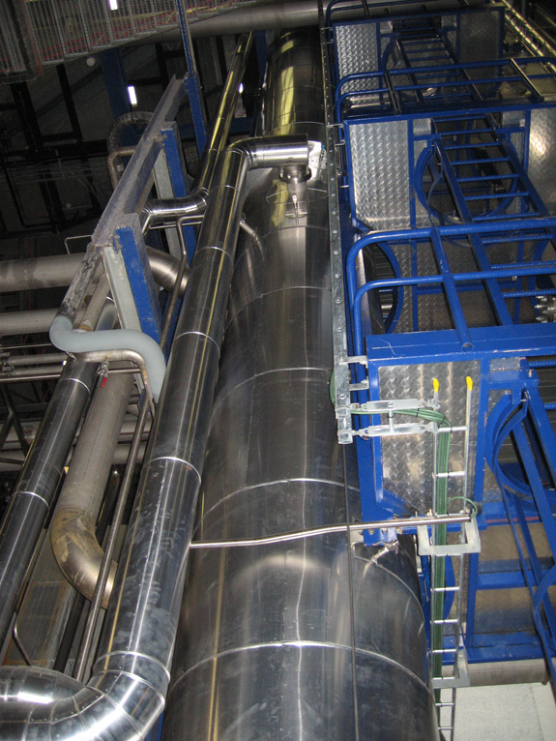
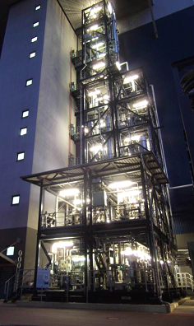
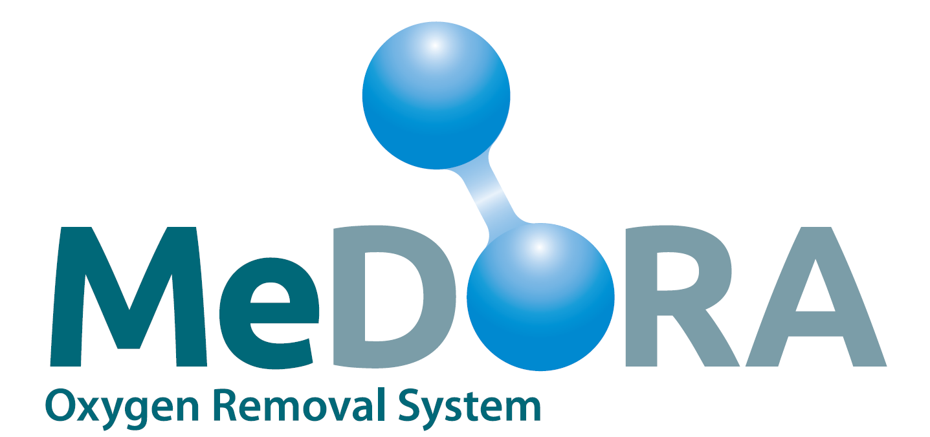
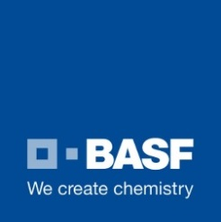

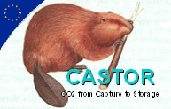




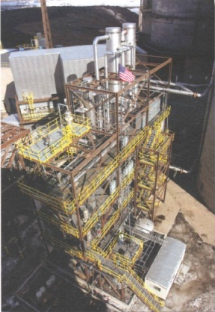
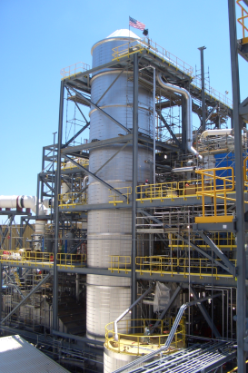
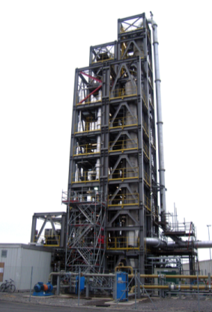
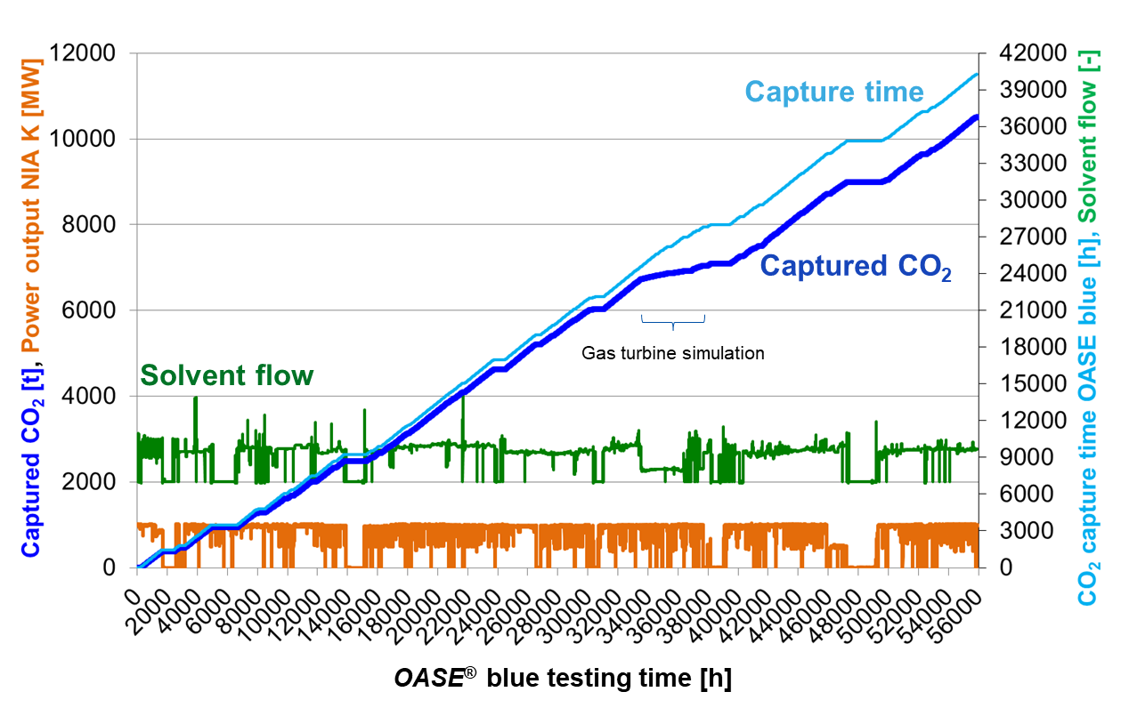
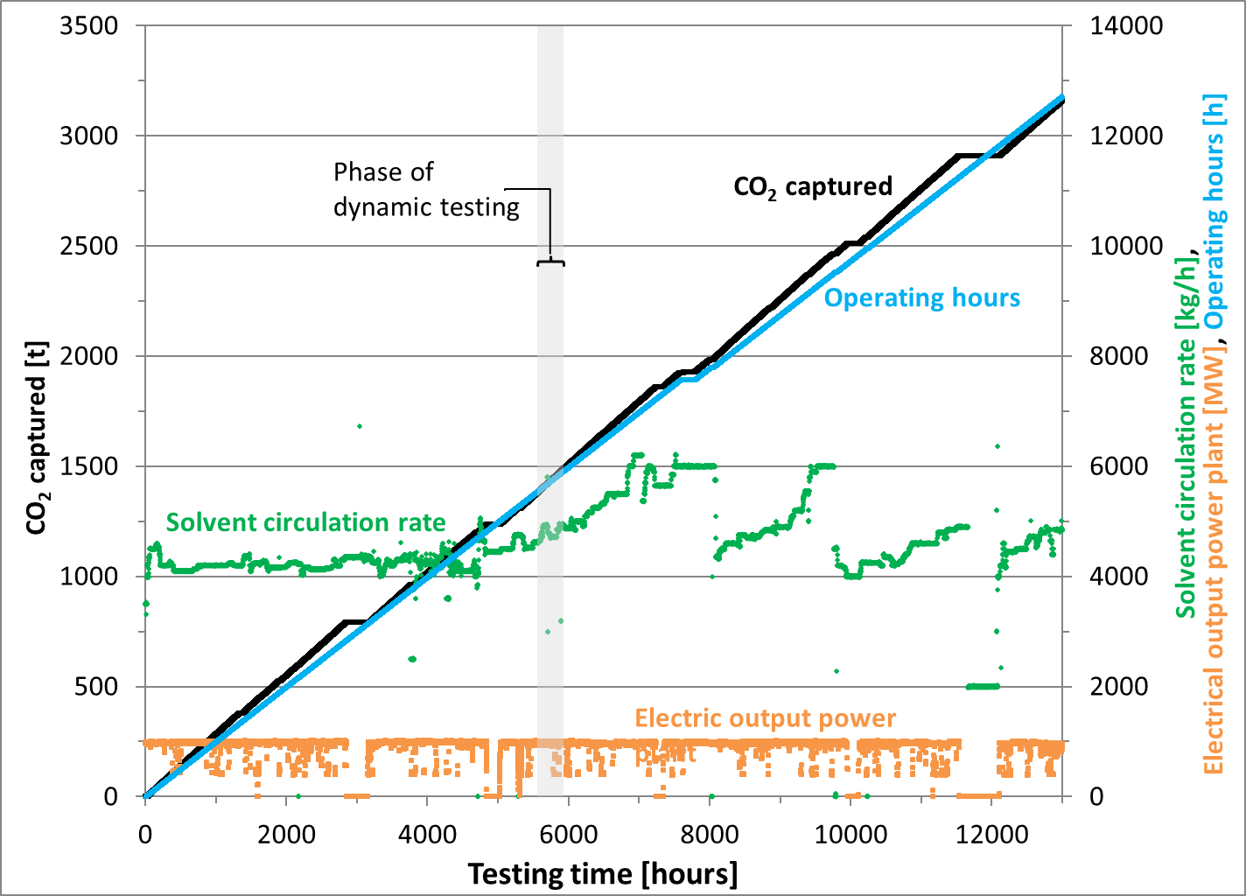
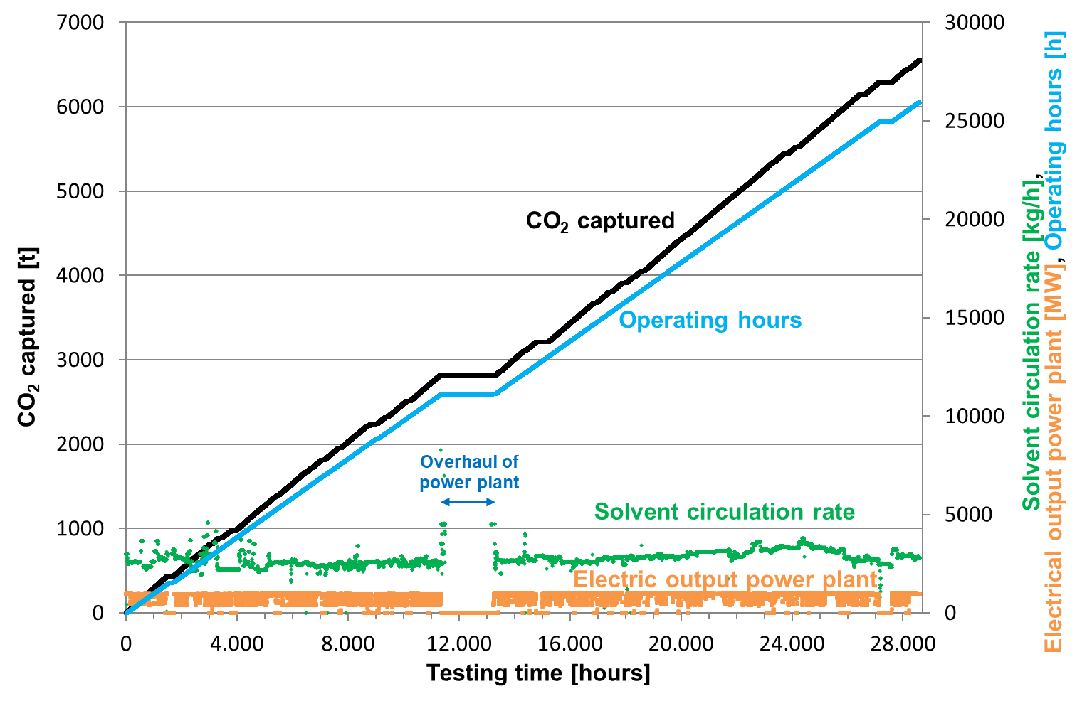

CO₂ Capture – Solid knowledge base at RWE
19 years active participation in CO₂ Post-combustion Capture Pilot and Demonstration Projects
24/7 longtime operation
under real operating conditions
CASTOR/
CESAR
Esbjerg,
Denmark
BASF‘s OASE® blue
Niederaussem
Germany
100,000 operating hours
2005
2006
2007
2008
2009
2010
2011
2012
2013
2014
2015
2016
2017
2018
2019
2020
2021
2022
2023
2024
2025
2026
Today >115,000 operating hours
Alstom‘s
Chilled Ammonia
USA
Alstom‘s
Chilled Ammonia
Mountaineer
USA
Shell’s Cansolv
Aberthaw
UK
OASE® blue
>55,000 h
MEA
>18,000 h
CESAR1
>49,000 h
06.02.2025
Advancing CO₂ Capture – RWE Cutting-Edge Research for Real-World Solutions, Sandra Schmidt, RWE Power

Slide 3
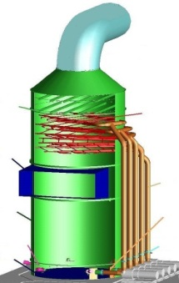
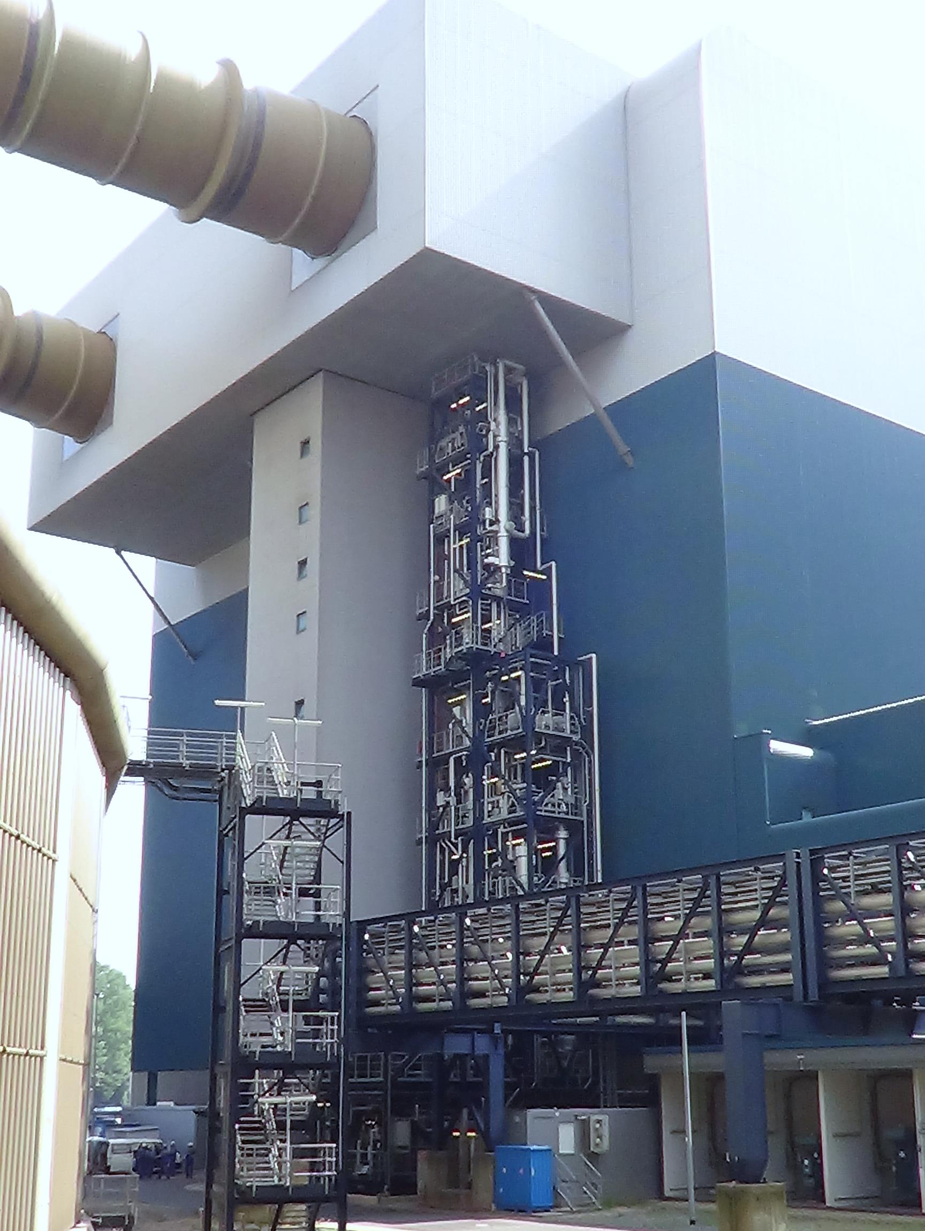

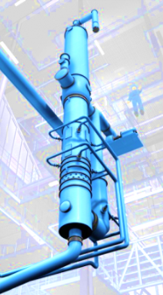
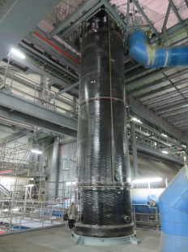
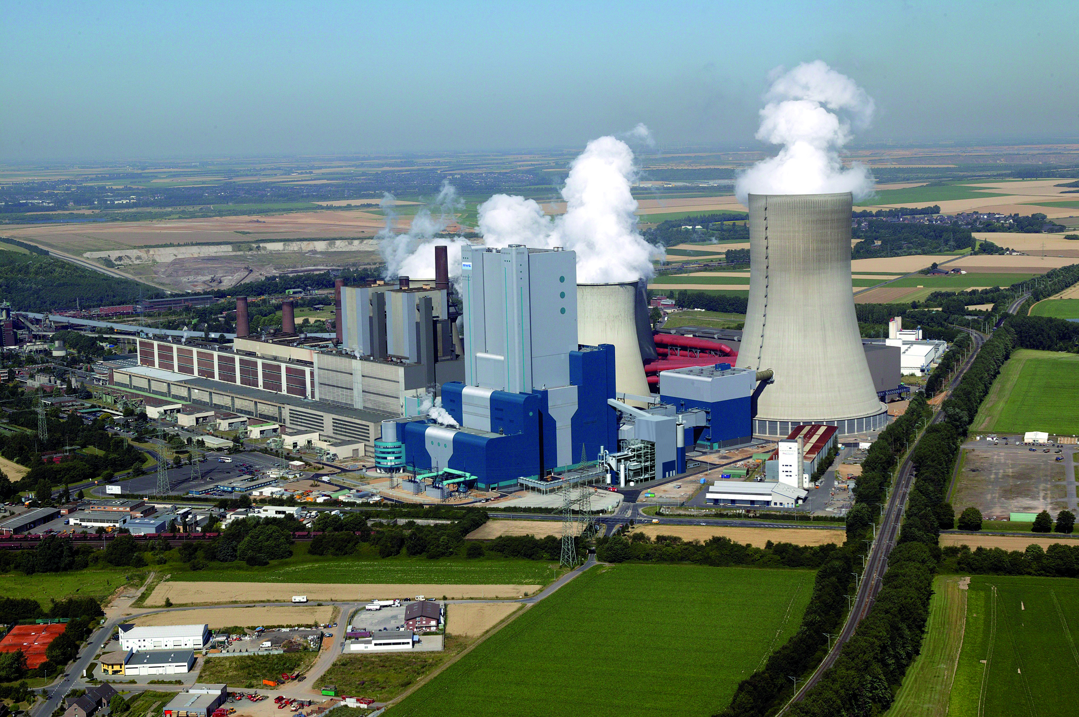
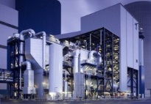
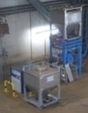
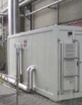
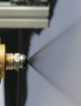
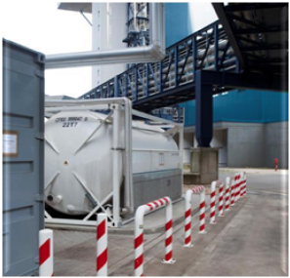
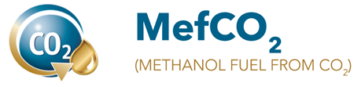


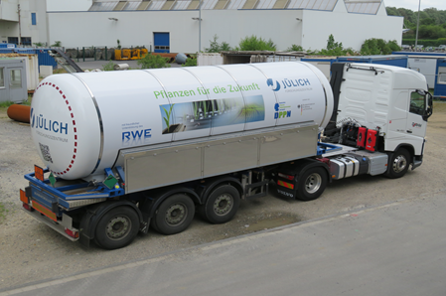


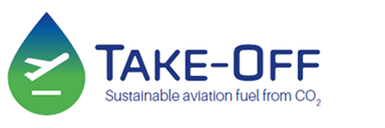
Post-Combustion Capture at RWE’s Innovation Center
Power plant
Flue gas treatment
CO₂ capture
conventional FGD
Wet ESP
Raw lignite
Flue gas, raw lignite
REAplus
Dust
SO₂/SO₃
HOK®
WTA®
Flue gas, dry lignite
All aspects of CCUS
CO₂ liquefaction
CO₂ utilisation
Solvent management
Emission mitigation and CO₂ quality
Solvent management and CO₂ quality
Highest capture rates
06.02.2025
Advancing CO₂ Capture – RWE Cutting-Edge Research for Real-World Solutions, Sandra Schmidt, RWE Power

Slide 4
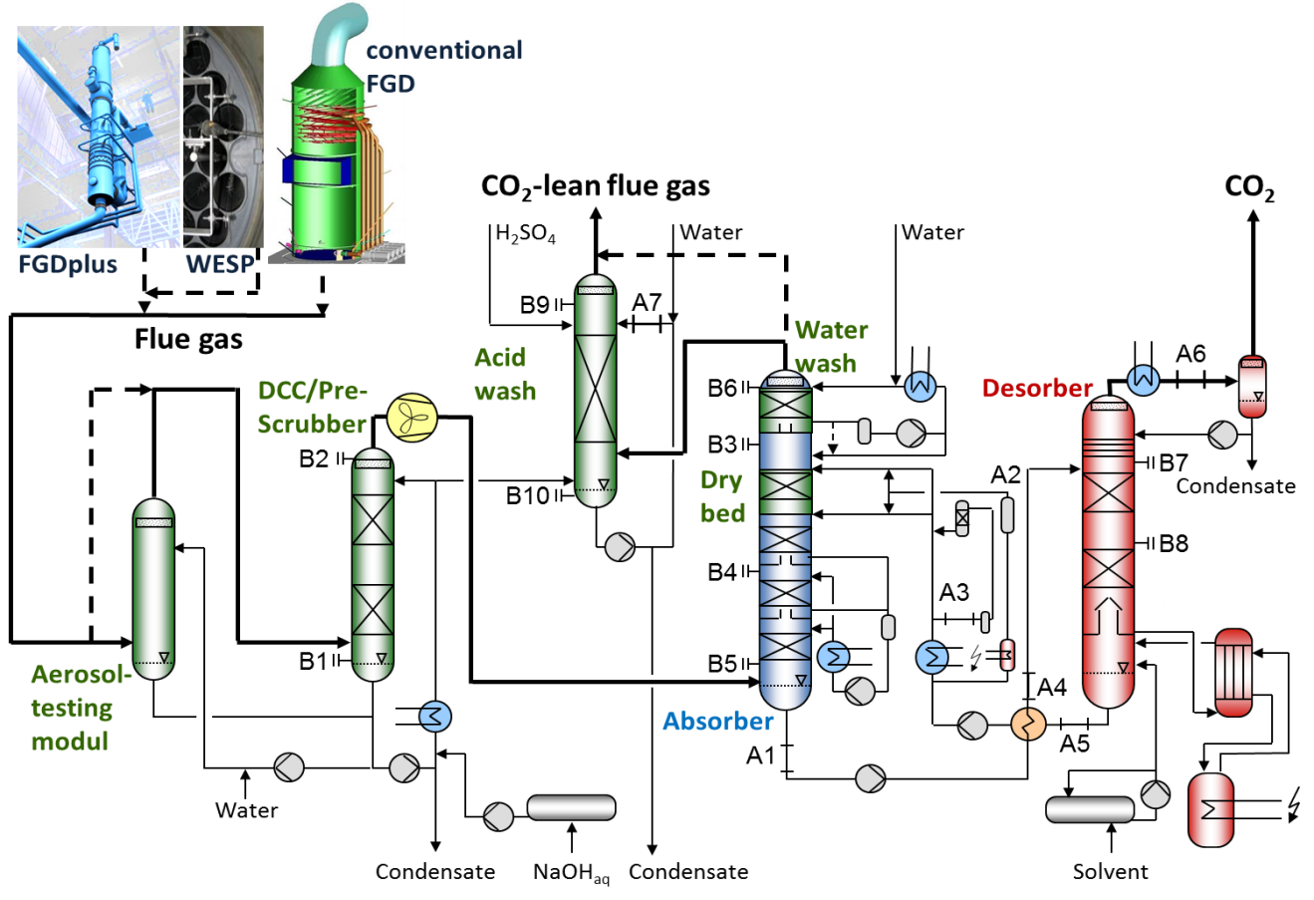
Post-Combustion Capture Pilot Plant at Niederaussem
Evaluation of the process performance needs longtime testing with real flue gas
1,550 m³_{N}/h flue gas flow
7.2 t_{CO2}/day CO₂ product
90% CO₂ capture rate
97% availability
First PCC pilot plant commissioned in Germany
Instrumentation: 285 online measurements
24/7 operation
FGD: Flue gas desulphurization
WESP: Wet electrostatic precipitator
DCC: Direct contact cooler
06.02.2025
Advancing CO₂ Capture – RWE Cutting-Edge Research for Real-World Solutions, Sandra Schmidt, RWE Power

Slide 5
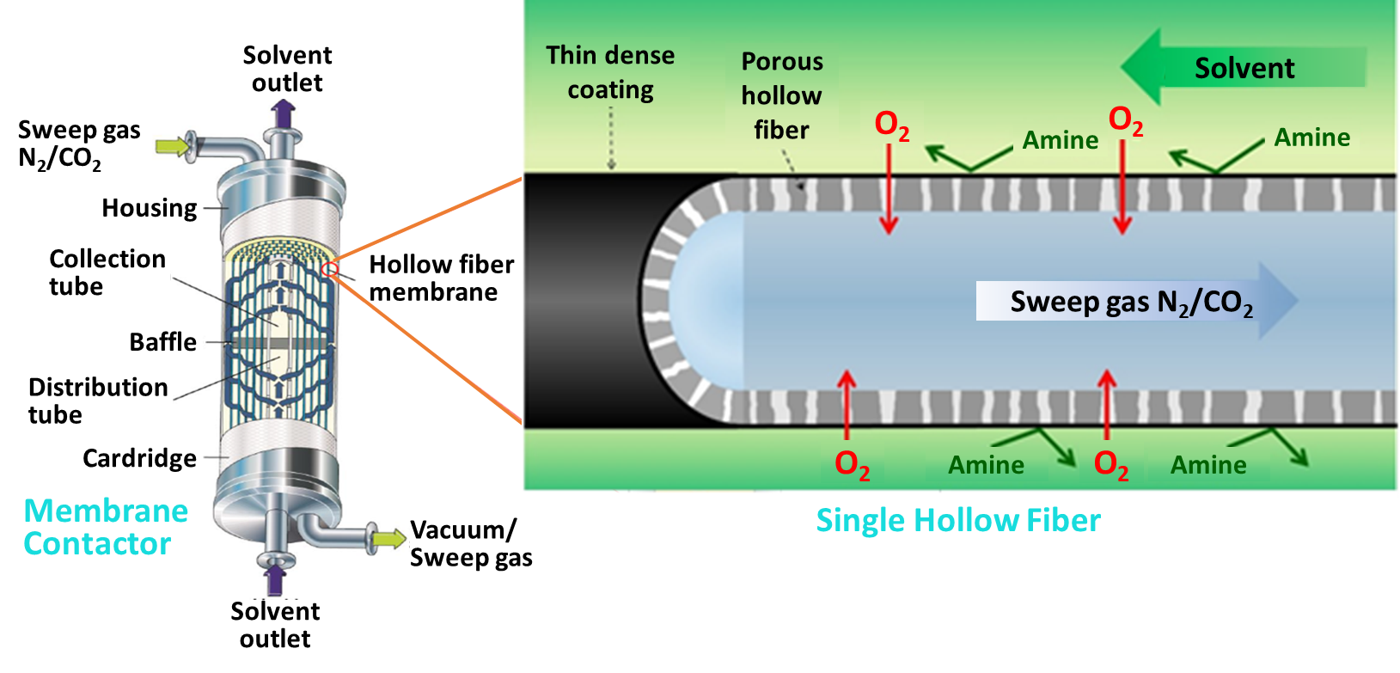
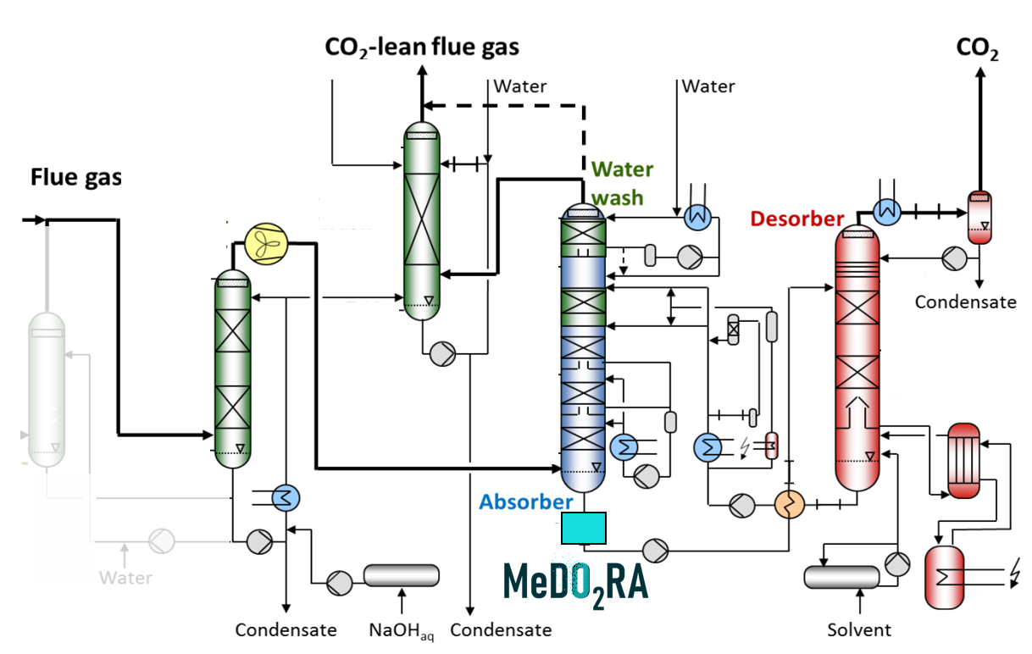
– Membrane-assisted Dissolved Oxygen Removal
from Amine solution for CO₂ capture
Reduction of the O₂-concentration in the solvent means the reduction of:
  solvent degradation, make-up demand
  solvent flow
  corrosion
  effort for CO₂ purification
Membrane
Contractor
Single Hollow Fibre
  Goals:
  90% O₂-reduction in the solvent
  50% reduction of the degradation rate
  Reduction of the O₂–concentration in the
  CO₂ product to <10 ppm
06.02.2025
Advancing CO₂ Capture – RWE Cutting-Edge Research for Real-World Solutions, Sandra Schmidt, RWE Power

Slide 6
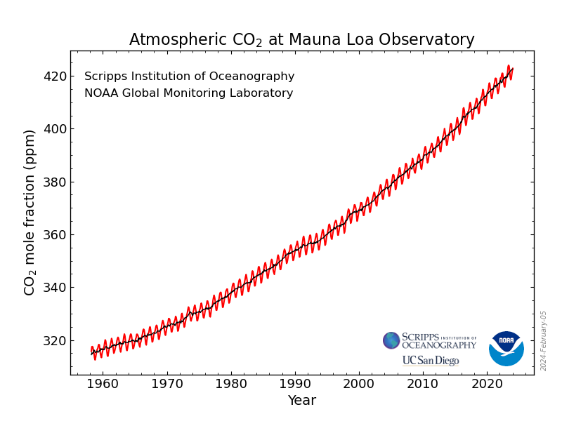

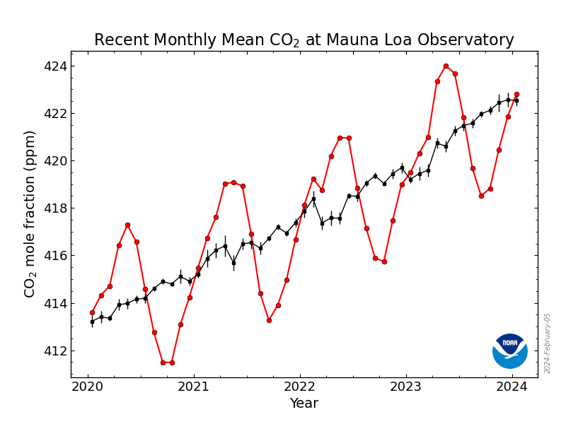

– Deep Removal of CO₂ and InnoVative Electrification concepts
Negative CO₂ emissions by highest capture rates
at amine-based capture plants and by electrochemical technologies (pH swing)
-100 ppm
First results:
CO₂ content in the CO₂-lean flue gas less than ambient air achieved
321 ppmv @ only 30% higher energy demand
99.8% capture rate
X
2024
06.02.2025
Advancing CO₂ Capture – RWE Cutting-Edge Research for Real-World Solutions, Sandra Schmidt, RWE Power

Slide 7
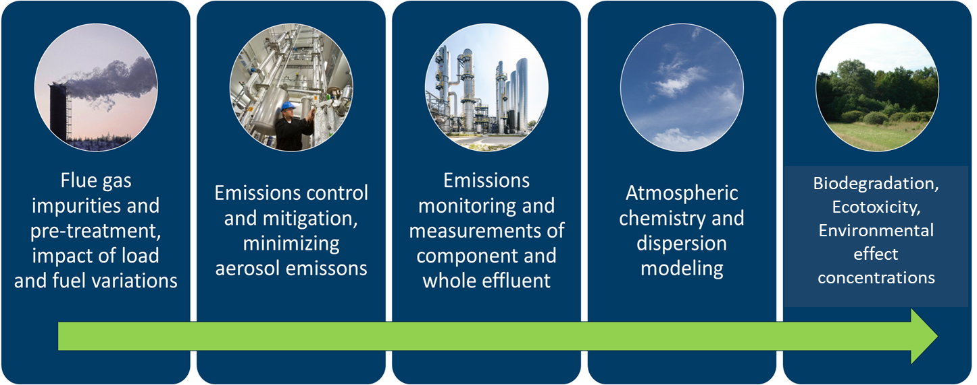




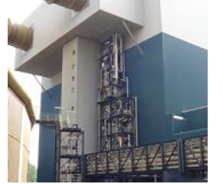
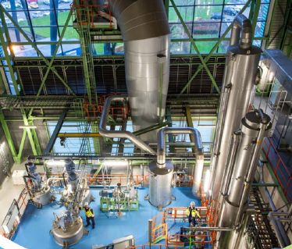
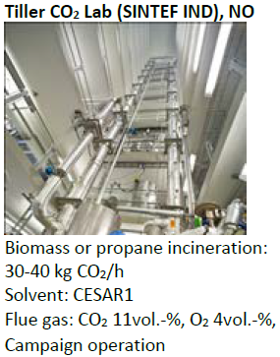
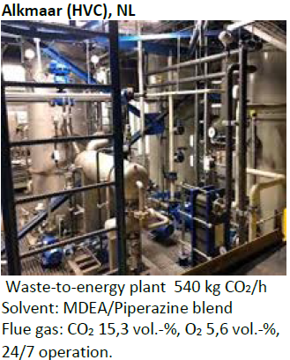
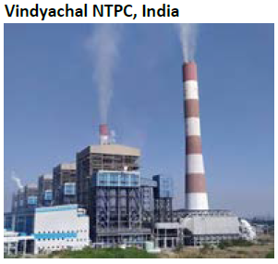
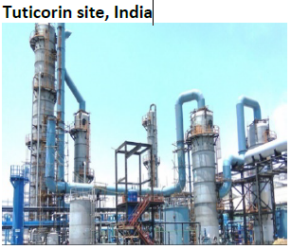
SCOPE – Sustainable OPEration of post-combustion Capture plants
Providing facts to the discussion on BAT from 24/7 longtime testing
Testing of emission mitigation technologies
Effects of solvent aging at
capture rates of 90-98%
tests on dynamic and
start/stop behaviour
Validation of simulation tools
(ASPEN, ProTreat, ML)
Mimicked off-gas of natural gas fired plants (CO₂ 4%, O₂ 15%)
Pre-treatment
Emissions control
Emissions monitoring
Atmospheric chemistry
Biodegradation
Testing - Measurement - Modeling of Emissions and Dispersion - Effects - Acceptance
Demonstration and holistic analysis of emission management technologies at Niederaussem
Niederaußem
Hengelo
Tiller CO₂ Lab
Alkmaar
Vindyachal
Tuticorin
Lignite
300
kg CO₂/h
Waste-to Engergy
500
kg CO₂/h
Biomass,
propane
30-40
kg CO₂/h
Waste-to Energy
540
kg CO₂/h
Hard
coal
830
kg CO₂/h
Chemicals
7.500
kg CO₂/h
06.02.2025
Advancing CO₂ Capture – RWE Cutting-Edge Research for Real-World Solutions, Sandra Schmidt, RWE Power

Slide 8
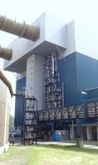
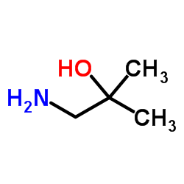
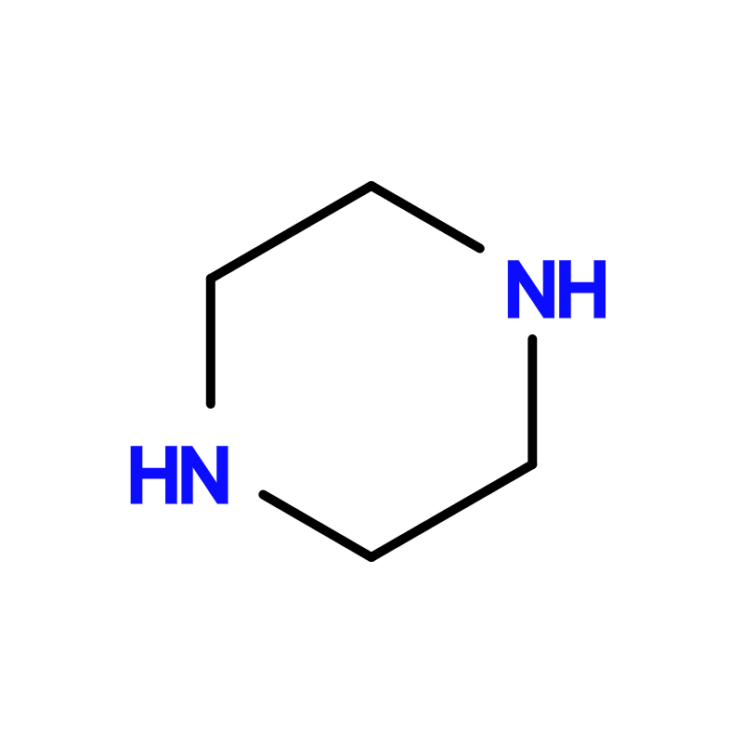
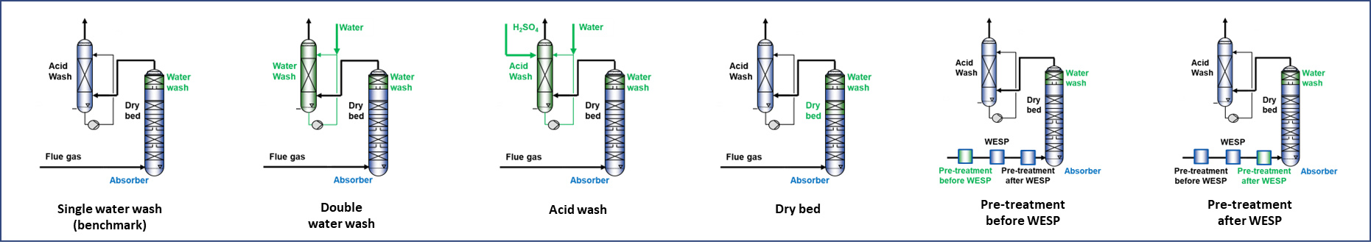
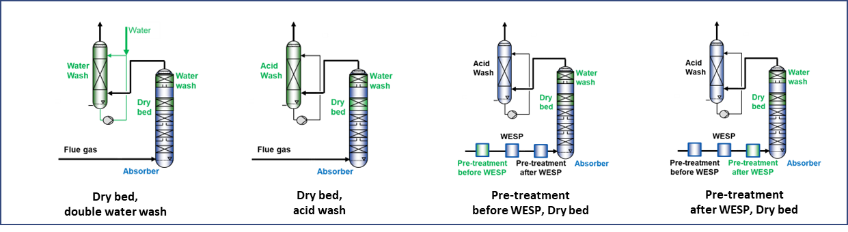
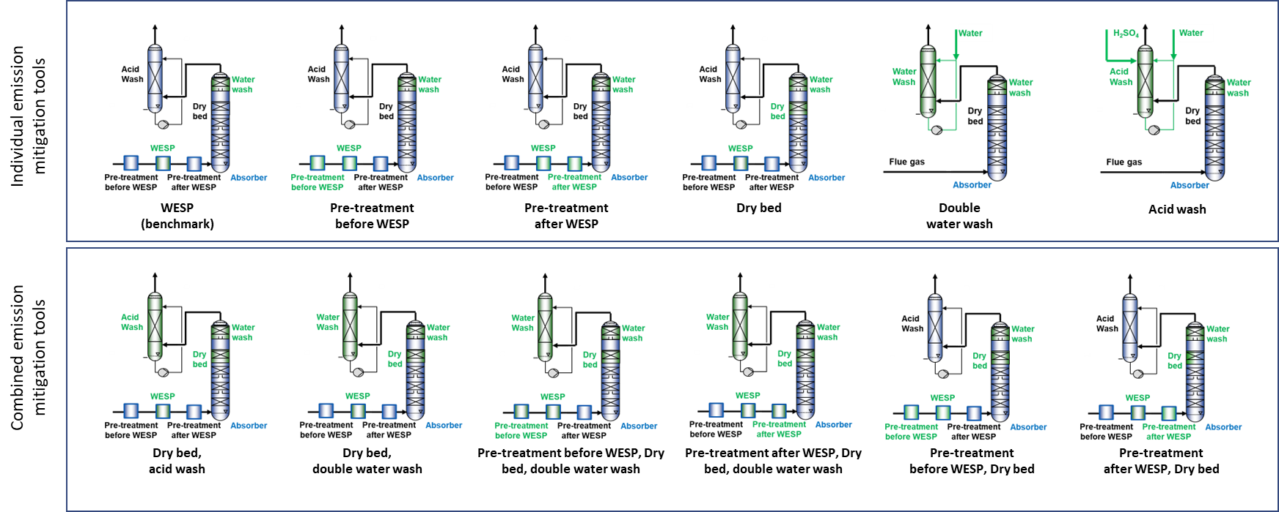

Test of emission mitigation technologies for CESAR1 at Niederaussem
Flue gas source: 1,000 MW lignite-fired power plant
Operation mode: 24/7, 300 kg_{CO2}/h@90% capture rate,
Solvent: CESAR1
Test campaigns with more than 20 configurations of emission mitigation technologies:
water wash, double water wash, acid wash, dry bed (OASE aerozone®), pretreatment.
AMP:
2-amino-2-methylpropan-1-ol
PZ:
piperazine
WESP off
volatile emissions
particle concentration
≈ 2 x 10⁴ #/cm³
FTIR
c
Pretreatment
WESP
Acid wash /
Double water
Water
wash
DCC/Pre-Scrubber
wash
c
Dry
bed
ELPI+
WESP on
aerosol-based emissions
particle concentration
≈ 2 x 10⁶ #/cm³
Pretreatment
06.02.2025
Advancing CO₂ Capture – RWE Cutting-Edge Research for Real-World Solutions, Sandra Schmidt, RWE Power

Slide 9
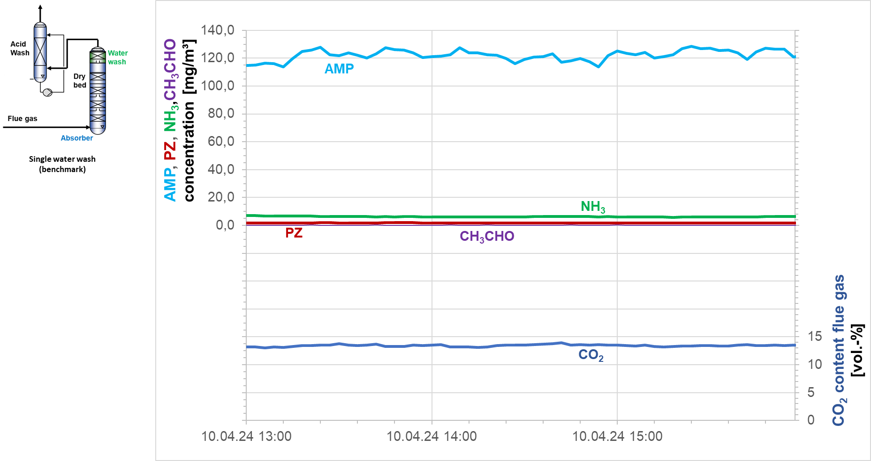
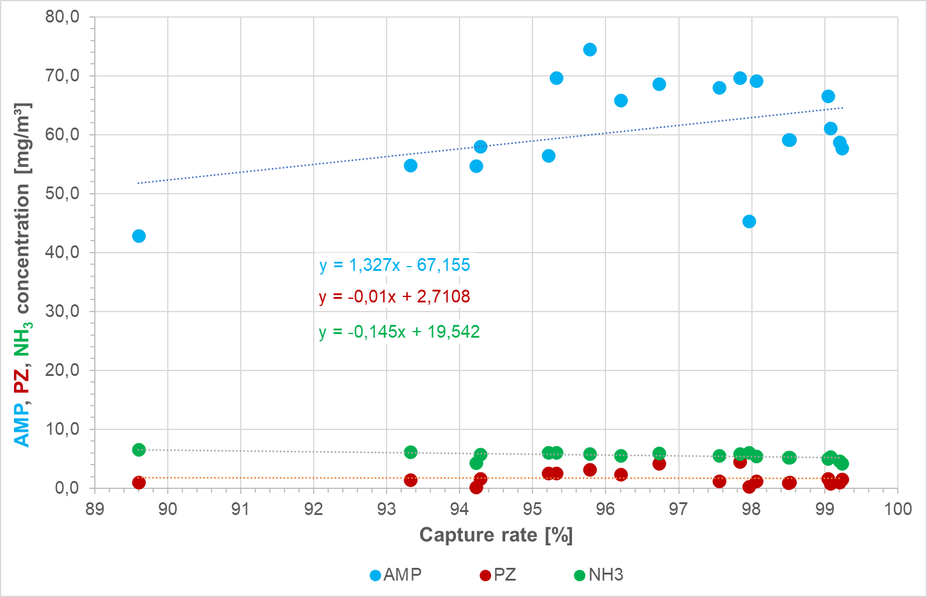
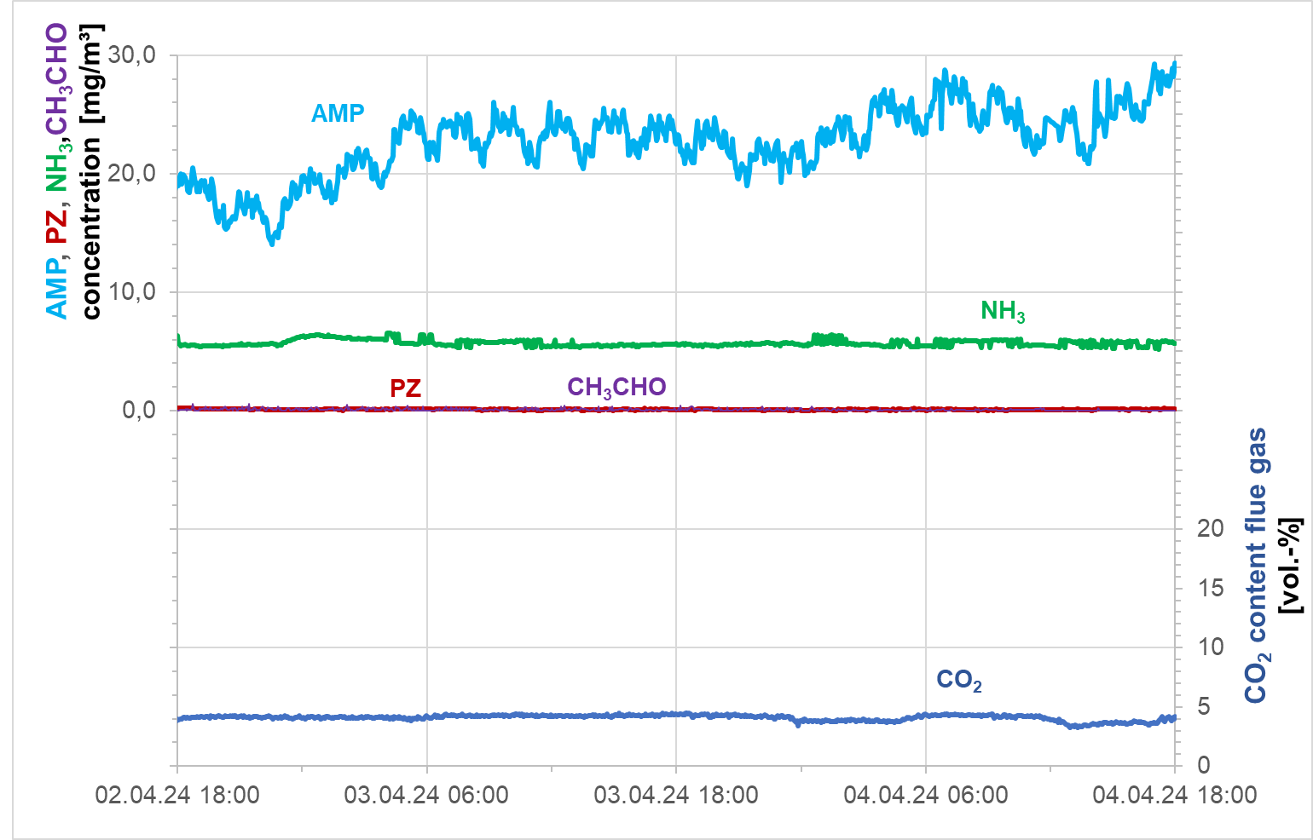
Effects of high capture rates and of CO₂/O₂ content in the flue gas
For CESAR1 only small effects of the capture rate on emissions; changes of the CO₂/O₂ concentration affect the temperature profile in the absorber and emissions
Capture rate
CO₂~15%
CO₂~5%
(Proprietary) emission mitigation technologies are available to control emissions regardless of the capture rate and the O₂ content in the flue gas
06.02.2025
Advancing CO₂ Capture – RWE Cutting-Edge Research for Real-World Solutions, Sandra Schmidt, RWE Power
Page 9

Slide 10
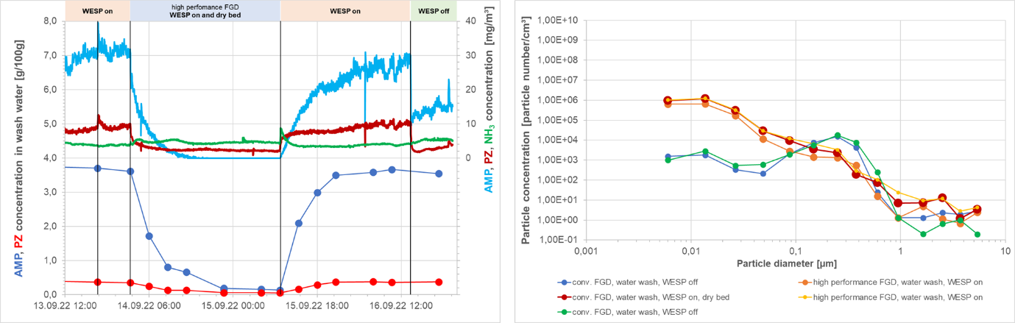
Emission management
Aerosol and vapor-based emissions – solvent CESAR1
Solid particles in the flue gas with diameter <100 nm can cause aerosol formation
(Proprietary) emission mitigation technologies are available to control emissions regardless of the particle number concentration and size distribution
06.02.2025
Advancing CO₂ Capture – RWE Cutting-Edge Research for Real-World Solutions, Sandra Schmidt, RWE Power

Slide 11
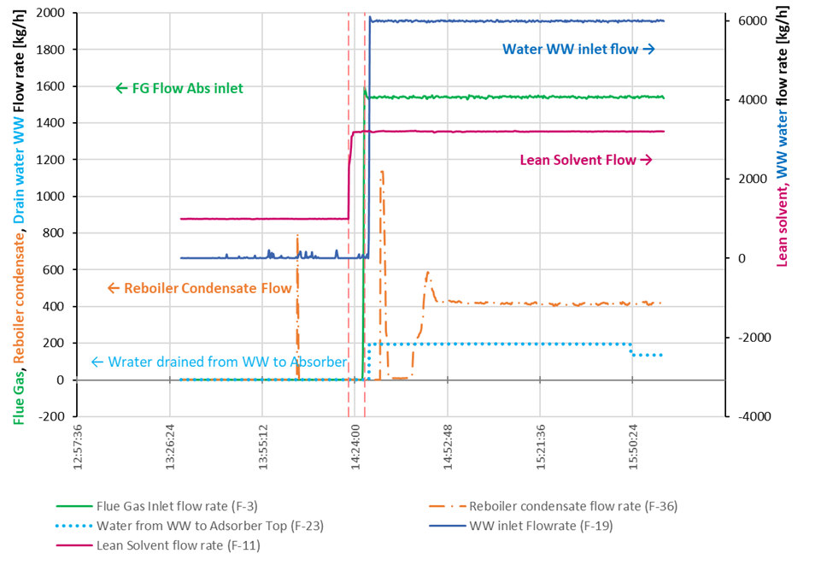
Dynamic operation of CO₂ capture plants
Load changes, Start/Stop behaviour – not only important for capture rate and
thermodynamics, but also regarding emissions
Until now, the dynamic behaviour of capture plants cannot be simulated.
But real-world data are available for model validation and for the prognosis of trends.
06.02.2025
Advancing CO₂ Capture – RWE Cutting-Edge Research for Real-World Solutions, Sandra Schmidt, RWE Power

Slide 12
The Post-Combustion Capture Project at Knapsacker Hügel I
From R&D to use
Flue gas from sewage sludge combustion
2 x 96,000 t_{CO2}/a (2 x 288 t_{CO2}/day) CO₂ product
95% CO₂ capture rate
8,000 h/a in operation
Specific energy demand: ≤ 3.0 GJ/t_{CO2}
CO₂ transport to storage site: train, ship
CO₂ usage projects under discussion
06.02.2025
Advancing CO₂ Capture – RWE Cutting-Edge Research for Real-World Solutions, Sandra Schmidt, RWE Power
Page 12

Slide 13
The Post-Combustion Capture Project at Knapsacker Hügel II
From R&D to use
Optimized emission mitigation technology
Absorber with approved 3-step purification for the CO₂-lean flue gas
Optimized solvent and water management to minimize solvent loss and waste water
Stable and highly efficient solvent
Low specific energy demand because of solvent and process optimizations
06.02.2025
Advancing CO₂ Capture – RWE Cutting-Edge Research for Real-World Solutions, Sandra Schmidt, RWE Power
Page 13

Slide 14




Conclusion
Experience of more than 115,000 operating hours of the CO₂ capture pilot plant at Niederaussem and 20 years of CCUS projects
Project development, Design, Funding, Permitting, Construction, Commissioning
Solvent Management
Process chain, Plant configuration, Integration, Operation, Measurement technologies
CO₂
Mitigation of Wastes and Emissions, Health & Safety & Environment
€
De-Risking and Minimisation of CAPEX and OPEX, Use of Synergies
Consultancy and Supporting Work for RWE’s BECCUS projects
(Technology Provider, Authorities, Networks)
06.02.2025
Advancing CO₂ Capture – RWE Cutting-Edge Research for Real-World Solutions, Sandra Schmidt, RWE Power
Page 14

Slide 15

































































Acknowledgements
ACT SCOPE Project No 327341
This project has received funding from RVO (NL), FZJ/PTJ (DE), RCN (NO), BEIS (UK), DST (IN), and DOE (USA) through the ACZ initiative. www.scope-act.org
ACT MeDORA
This project has received funding from The RCN (no 308765), FZJ/PTJ (no 03EE5160) and PPS-toeslag TKI-Energie (TKI 2023 MeDORA, program: Nieuw Gas/CCS) www.sintef.no/en/
projects/2023/medora-membrane-assisted-dissolved-
oxygenremoval-from-amine-solution-for-co2-capture/
DRIVE
This Project has been funded by partners of the CETpartnership (https://cetpartnership.eu) and FZJ/PTJ-MWIKE (no EFO-0216),
https://DRIVE-co2.eu/
This project has received funding from the European Union‘s Horizon 2020 research and innovation programme under grant agreement No 101006799. www.takeoff-project.eu
This project has received funding from the European Union‘s Horizon 2020 research and innovation programme under grant agreement No www. eco2fuel-project.eu
06.02.2025
Advancing CO₂ Capture – RWE Cutting-Edge Research for Real-World Solutions, Sandra Schmidt, RWE Power

