Slide 1

Smart integRation Of local energy sources and innovative storage for flexiBle, secure and cost efficIent eNergy Supply ON industrialized islands
Name and Last Name:
Óscar Ansótegui Adarve
Date: 11/12/2024
Organisation: FUNDITEC

Slide 2

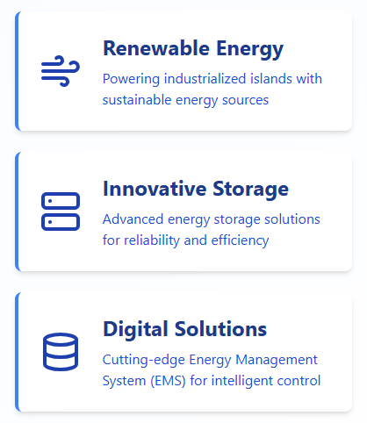
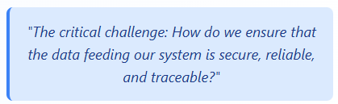
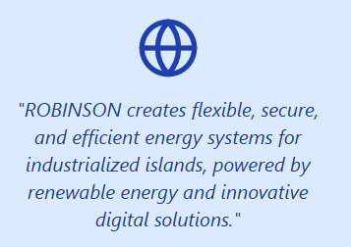

1. Introduction to ROBINSON
Notes:
Good morning, everyone.
We all know the ROBINSON project and the concept of the EMS.
But if there’s someone here who isn’t directly involved, you’re more than welcome, and let me sum it up for you in one sentence:
ROBINSON is about creating flexible, secure, and efficient energy systems for industrialized islands, powered by renewable energy, innovative storage, and cutting-edge digital solutions like the EMS.
Now, the key question: How do we ensure that the data feeding this system is secure, reliable, and traceable?“
FUNDITEC’s Contribution:
At FUNDITEC, our mission has been to strengthen the foundations of the EMS by ensuring that the data it processes is not only secure but also transparent and trustworthy. Through innovative approaches and advanced technologies, we’ve focused on providing a robust framework for data traceability and cybersecurity that aligns with ROBINSON’s ambitious goals.
Transition:
These efforts are critical to ensuring that ROBINSON’s EMS remains resilient against threats while delivering transparent and reliable energy management. Let’s dive deeper into how cybersecurity and blockchain play a key role in achieving this.

Slide 3
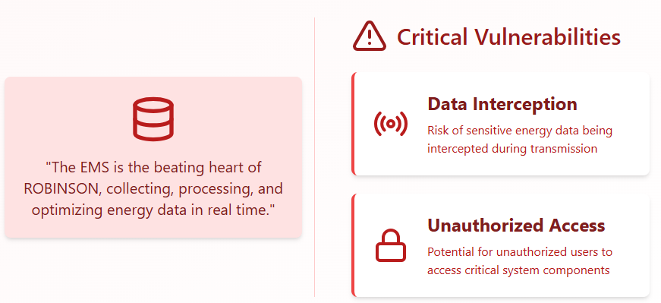
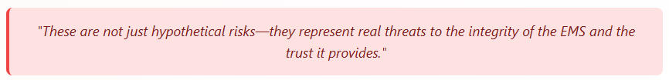
2. Cybersecurity Basics
Notes:
Opening Statement:
"In ROBINSON, the Energy Management System, or EMS, is the beating heart of operations. It collects, processes, and optimizes energy data in real time, enabling efficient energy management across the system."
Key Problem:
"However, this constant flow of data also introduces vulnerabilities, and our team couldn’t ignore the critical questions this raised:
What happens if the data is intercepted or manipulated during transmission?
What if unauthorized users gain access to critical systems or modify logs?"
Transition to Solution:
"These are not just hypothetical risks—they represent real threats to the integrity of the EMS and the trust it provides. To address them, we implemented a tailored cybersecurity strategy based on the P.A.S.T.A methodology: a proactive, structured approach to identifying and mitigating potential attack scenarios."

Slide 4



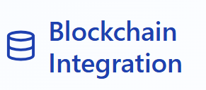


2. Cybersecurity Basics
A risk-centric framework designed to:
Identify potential attack scenarios
Evaluate their impact
Develop tailored solutions
Immutability
Mitigate Key Risks
Transparency
Access Control
Notes:
Opening Statement:
"To address the vulnerabilities, we identified in the EMS, we turned to the P.A.S.T.A methodology—an advanced, risk-centric framework for analyzing and mitigating cybersecurity threats."
Purpose of P.A.S.T.A:
"P.A.S.T.A is designed to help teams identify potential attack scenarios, evaluate their impact, and develop tailored solutions. In ROBINSON, it allowed us to model real-world threats to the EMS, from tampering with energy data to unauthorized access to critical systems."
Connecting to Blockchain:
"Through P.A.S.T.A, we determined that one of the most effective ways to mitigate key risks was to integrate blockchain technology into the EMS. Why? Because blockchain provides:
Immutability: Data, once recorded, cannot be altered.
Transparency: All stakeholders can verify the integrity of energy data independently.
Access Control: Blockchain's cryptographic mechanisms ensure only authorized users can interact with sensitive data."
Transition to Blockchain:
"By combining the proactive risk assessment of P.A.S.T.A with the inherent security and traceability of blockchain, we’ve built a system that not only defends against threats but also enhances trust and collaboration among all stakeholders. Let’s take a closer look at how blockchain is used in ROBINSON."

Slide 5
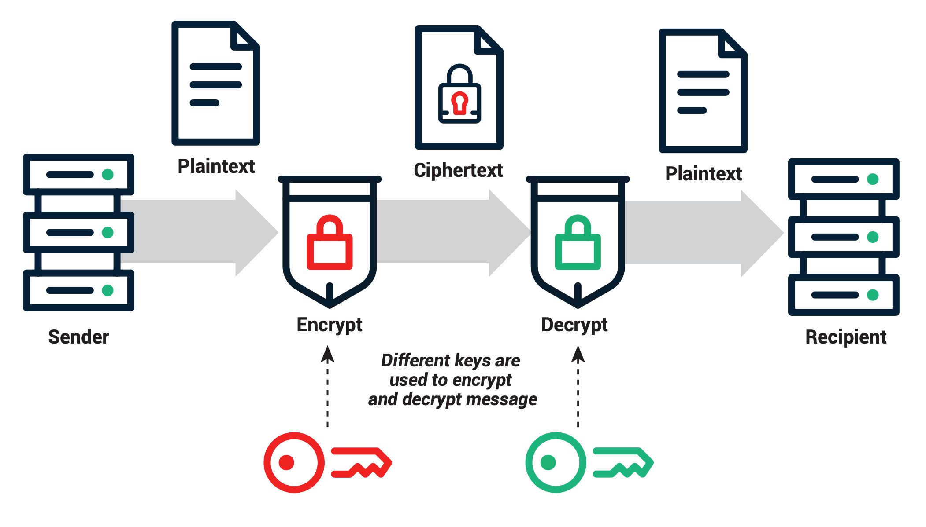
3. Cryptography: The Foundation of Blockchain
Asymmetric Encryption
Public Key
encrypts data
shared openly.
Private Key:
decrypts data
kept secret.
Notes:
Opening Statement:
"Before we dive into how blockchain strengthens the EMS in ROBINSON, let’s take a step back and talk about the fundamental building blocks of its security: cryptography and public-key encryption. These are the tools that make it possible to protect and validate data within the system."
Cryptography: The Backbone of Security
"At its core, cryptography ensures that data remains secure, authentic, and untampered with. In ROBINSON, it’s used to:
Create unique digital fingerprints of data using hash functions, ensuring integrity.
Protect sensitive information during transmission with encryption.“
Public-Key Encryption:
"One of the most powerful cryptographic tools we use is public-key encryption. Here’s how it works:
The public key is like an open mailbox—anyone can encrypt data and send it in.
The private key is the only key that can unlock and decrypt that data, ensuring that only authorized recipients can access it."
Example:
"Imagine the EMS logs a piece of energy data, like 'Hydrogen Storage: 80%.' It’s encrypted using a public key, and only the private key—held by authorized stakeholders—can decrypt and access it. This guarantees both confidentiality and authenticity."

Slide 6

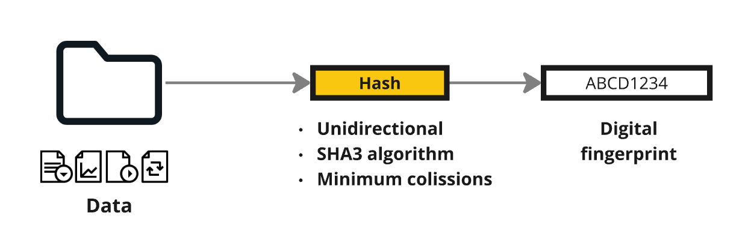


3. Cryptography: The Foundation of Blockchain
Hashing
File
Hash
Let’s see an example!
Store original document
https://coding.tools/sha256
Immutable register
Compare
Hash
Notes:
Explain Hashing:
"Hashing is the process of converting data into a fixed-length digital fingerprint. No matter how large or small the input is, the output—a hash—will always have the same length. Let’s break this down using the diagram on the slide."
Input Data:
"On the left, we have different types of data—files, logs, or even simple text strings. This is the input to the hashing process."
Example: “Hydrogen Storage: 80%.”
Hashing Process:
"The data is passed through a cryptographic hashing algorithm like SHA-3. This algorithm processes the input and generates a unique hash value."
"Hashing is unidirectional, meaning you cannot reverse-engineer the original data from the hash. This makes it ideal for verifying data integrity without revealing sensitive information."
Output: Digital Fingerprint:
"The result is a fixed-length string, or hash, which serves as a digital fingerprint of the input data."
Example Output: ABCD1234
"If even a single character in the input changes, the hash will look completely different, making it highly sensitive to modifications.“
Let’s see this in action. I’ll show you how hashing works using a simple online demo.
Transition to Blockchain:
"These cryptographic principles are the foundation of blockchain technology. They ensure that every block in the chain is secure, verified, and tamper-proof. Now, let’s see how blockchain leverages these mechanisms to enhance the EMS in ROBINSON."

Slide 7
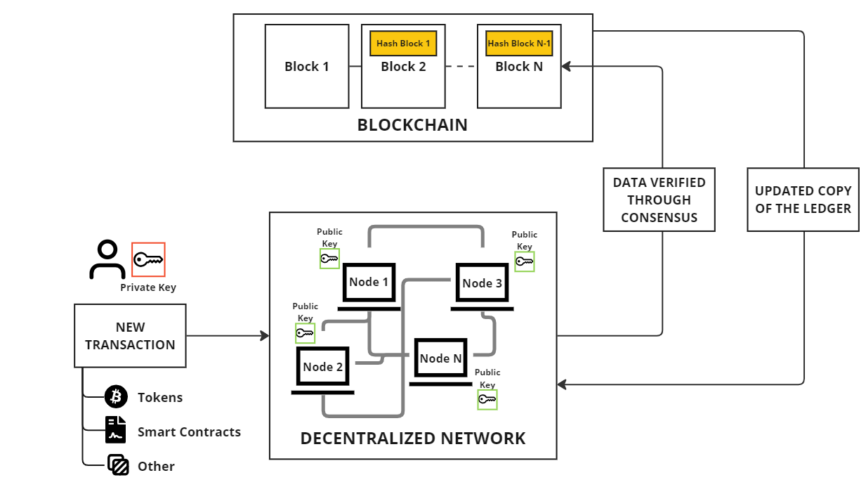
4. Blockchain Fundamentals
Hashing
Blocks: Secure linked transactions.
Hashes: Unique cryptographic identifiers.
Network: Nodes validate independently.
Consensus: Nodes confirm transactions.
Private Keys: Secure transaction initiators.
Smart Contracts: Automated agreements.
Notes:
Opening Statement:
"Now that we’ve covered hashing and cryptography, let’s take a closer look at blockchain, the technology that secures and verifies data in ROBINSON’s EMS. This diagram provides a clear overview of how blockchain works."
Explanation of the Diagram:
The Concept of Blockchain (Top Section):
"At the top, we see the blockchain itself, which is essentially a chain of blocks. Each block contains data, a unique hash, and the hash of the previous block.
For example, Block 2 references the hash of Block 1. This linking ensures that if any block is tampered with, the chain is broken, immediately signaling an issue.“
"This creates an immutable ledger, where data cannot be altered without detection.“
How Transactions Are Processed (Bottom Left):
"A new transaction is initiated using a private key, which acts as a digital signature. This ensures the transaction is authenticated and originated from a legitimate user.“
"The transaction can represent a variety of data types:
Tokens: Like cryptocurrencies.
Smart Contracts: Self-executing contracts with pre-set conditions.
Other Data: In ROBINSON, this is energy data from the EMS.“
The Decentralized Network (Bottom Right):
"The transaction is broadcast to a decentralized network of nodes, each with a copy of the ledger.
Each node uses a public key to verify the transaction and validate its authenticity.
This ensures that no single entity controls the ledger, making it resistant to tampering or failure.“
Consensus and Ledger Updates (Right Side):
"The nodes work together to reach a consensus on the transaction’s validity. Once verified, the new data is added as a block to the chain.
This process updates the copy of the ledger on all nodes, ensuring every participant has the latest and most accurate data."
Key Takeaways:
"Blockchain is:
Decentralized, meaning no single point of failure.
Immutable, ensuring data integrity.
Transparent, as all transactions are verifiable by the network.“
Transition:
"Now let’s see how ROBINSON uses blockchain to secure EMS data and provide transparency to stakeholders."

Slide 8
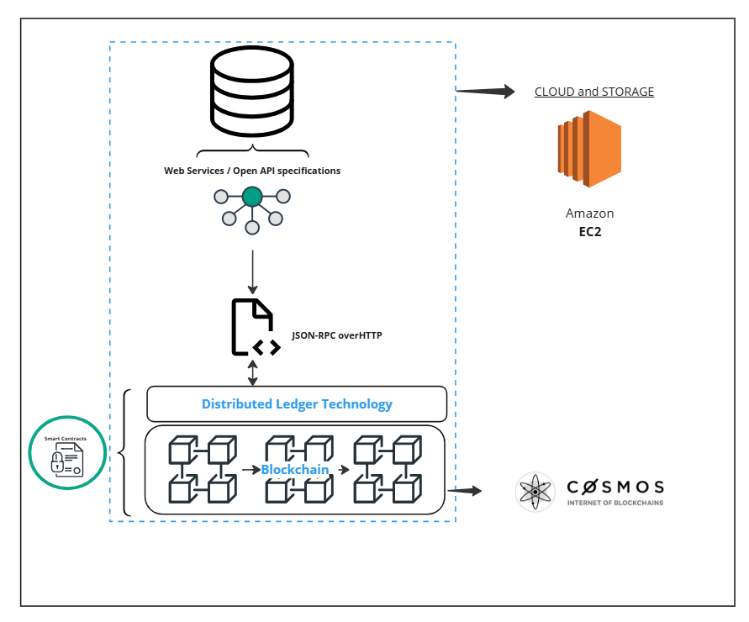






4. Blockchain Fundamentals
Blockchain Architecture in Robinson
Database: Source of data that feeds services and APIs.
Web Services/APIs: Access point for applications interacting with the blockchain.
JSON-RPC over HTTP: Communication protocol connecting web services to the blockchain.
Blockchain (Cosmos SDK): Core of the blockchain that manages and records all transactions.
Smart Contract: Program executed on the blockchain that automates agreements and operations.
Cloud Storage (Amazon EC2): Provides computational resources to run and scale blockchain applications.
Notes:
Opening Statement:
"In ROBINSON, we carefully evaluated different blockchain options to meet the specific needs of the EMS. This diagram illustrates the architecture and the decisions we made to ensure scalability, security, and efficiency."
Explaining the Diagram:
Public vs. Private Blockchain:
"The first decision was choosing between a public and a private blockchain.
Public Blockchains: These are open to anyone but come with higher energy costs, slower transaction speeds, and limited control over participants.
Private Blockchains: These are more controlled, faster, and energy-efficient but lack the decentralized openness of public networks.
Our Choice: A permissioned consortium blockchain that balances decentralization with control. This ensures only trusted participants, like consortium members, can interact with the system while maintaining efficiency.“
Distributed Ledger Technology (DLT):
"At the core of our blockchain, we use Cosmos SDK for its modular and scalable design. Cosmos enables:
Interoperability with other blockchains through the Internet of Blockchains.
High throughput, critical for managing the EMS's real-time data.
Customizable modules tailored to ROBINSON’s specific needs.“
Smart Contracts:
"Smart contracts, seen on the left, allow us to automate processes like validating data integrity or enforcing business rules. These contracts execute automatically when predefined conditions are met, ensuring transparency and efficiency.“
Cloud and Storage Integration:
"The blockchain is hosted on Amazon EC2 for cloud-based storage and scalability. This ensures that the infrastructure can handle the increasing data flow as the EMS scales.“
API and Data Flow:
"Data from the EMS interacts with the blockchain using JSON-RPC over HTTP, ensuring secure and efficient communication between the layers.“
Key Takeaways:
"By using a permissioned consortium blockchain with Cosmos SDK, we’ve achieved:
Scalability to handle the growing EMS data.
Security through a controlled network of trusted participants.
Interoperability for future expansions into other systems or blockchains."
Transition:
"Now let’s dive into how this architecture strengthens ROBINSON’s EMS and ensures secure, auditable energy data."

Slide 9

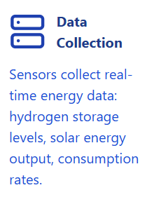
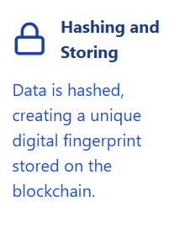
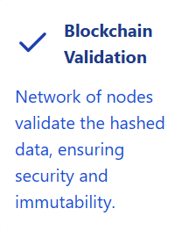
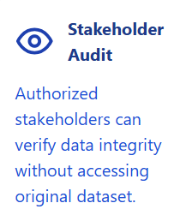
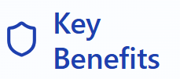



5. How ROBINSON Uses Blockchain
Notes:
Opening Statement:
"Now that we’ve explored the blockchain architecture, let’s look at how this technology is applied within ROBINSON’s EMS to enhance security, transparency, and efficiency. It’s important to note that our approach integrates blockchain without altering the original energy data, ensuring the system remains fully aligned with the project’s requirements."
Explaining the Flow of Data in ROBINSON’s EMS:
Data Collection:
"Sensors within the EMS collect real-time energy data, such as hydrogen storage levels, solar energy output, or consumption rates.“
Hashing and Storing in Blockchain:
"The collected data is hashed, creating a unique digital fingerprint that represents the data without storing the original data on the blockchain. This ensures:
Data Integrity: Any tampering with the original data would invalidate the hash.
Privacy Compliance: The blockchain contains only the hash, not the raw energy data, maintaining compliance with data protection regulations.“
Validation by Blockchain:
"Once hashed, the data is added to the blockchain, where it’s validated by the network of nodes. This ensures the data is secure and tamper-proof.“
Auditable by Stakeholders:
"Authorized stakeholders, such as project partners or regulators, can access the blockchain to verify the integrity and authenticity of the data. This process is seamless and does not alter the original data stored within the EMS.“
Highlighting the Importance of Keeping the Original Data Intact:
"A key element of this design is that the original data remains unaltered in the EMS. The blockchain acts as a secondary layer of security and traceability, complementing the existing data architecture without introducing redundancies or conflicts.“
Key Benefits of Blockchain in ROBINSON:
"Here’s what this approach delivers:
Immutability: The blockchain ensures data cannot be tampered with once stored.
Transparency: Stakeholders can audit data directly, building trust and accountability.
Security: Sensitive energy data is protected by cryptographic hashing and decentralized validation."
Transition:
"With this integration, blockchain adds an extra layer of security and reliability to ROBINSON’s EMS. Now, let’s explore how this system is monitored and audited in real-time."

Slide 10
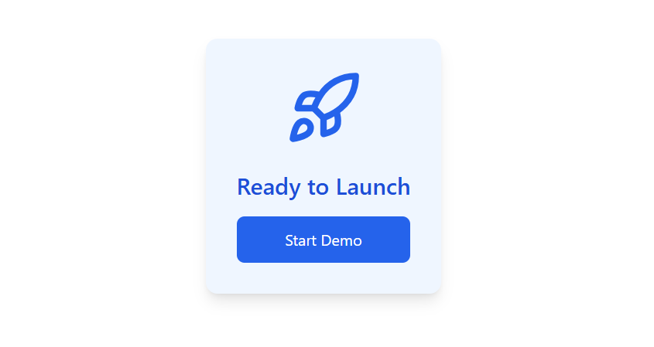
5. How ROBINSON Uses Blockchain
Notes:
Let’s take a look at the frontend we’ve developed:
Here, you can see real-time energy data logged and validated on the blockchain.
If tampering is attempted, the blockchain flags it immediately as the hash won’t match.
This ensures complete transparency and trust for all stakeholders involved
Our work in ROBINSON has provided insights that go beyond the project itself:
Scalable Solutions: The blockchain and cybersecurity framework can be applied to other energy systems, such as smart grids and industrial parks
Proactive Threat Management: Using methodologies like P.A.S.T.A ensures vulnerabilities are addressed before they become real threats.
Stakeholder Trust: Transparent data builds confidence, whether it’s for policymakers, investors, or local communities

Slide 11

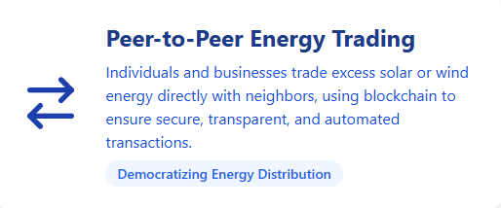
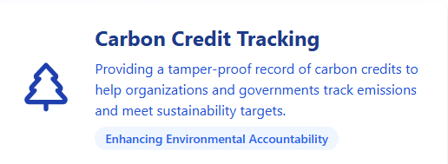
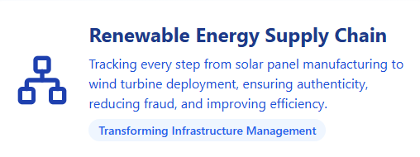
6. Broader Applications
Revolutionizing Industries Through Innovative Technology
Notes:
Opening Statement:
"While blockchain is already transforming ROBINSON’s EMS, its potential extends far beyond this project. The same principles of transparency, immutability, and decentralized validation can revolutionize other industries and applications. ROBINSON is just the beginning.“ And with more complex Smart Contracts the possibilities are unlimited.
Broader Applications of Blockchain:
Peer-to-Peer Energy Trading in Smart Cities:
"Imagine a future where individuals and businesses can trade excess solar or wind energy directly with their neighbors, bypassing intermediaries. Blockchain ensures these transactions are secure, transparent, and automated through smart contracts.“
Tracking Carbon Credits to Ensure Sustainability:
"Blockchain can provide a tamper-proof record of carbon credits, helping organizations and governments track emissions and meet sustainability targets. This level of transparency builds trust and accountability.“
Managing Supply Chains for Renewable Energy Infrastructure:
"From manufacturing solar panels to deploying wind turbines, blockchain can track every step of the supply chain, ensuring authenticity, reducing fraud, and improving efficiency."
Key Message:
"By addressing challenges like transparency and trust, blockchain has the potential to redefine how industries operate, from energy to sustainability and beyond."
Transition:
"ROBINSON demonstrates what’s possible when blockchain and energy systems converge. The lessons learned here are paving the way for a more secure, sustainable, and interconnected future."

Slide 12
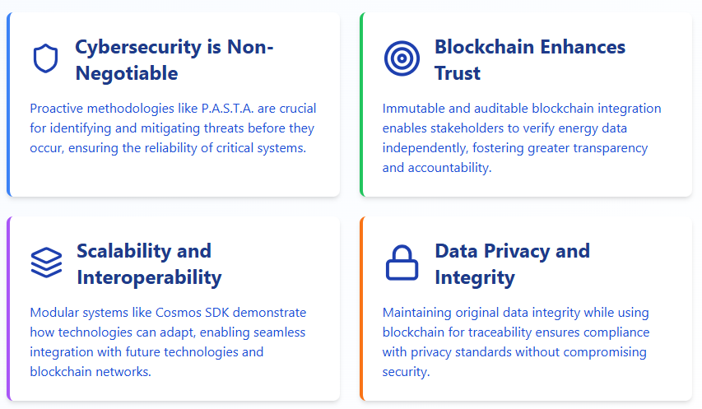
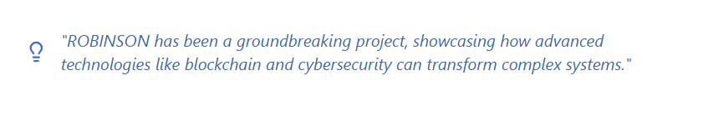
7. Conclusion and Lessons Learned
Notes:
Opening Statement:
"ROBINSON has been a groundbreaking project, not just in energy management but in showcasing how advanced technologies like blockchain and cybersecurity can transform complex systems. Let’s reflect on the key lessons we’ve learned and what they mean for the future.“
Lessons Learned:
Cybersecurity is Non-Negotiable:
"Protecting critical systems like the EMS requires proactive methodologies like P.A.S.T.A. By identifying and mitigating threats before they occur, we’ve ensured the reliability of ROBINSON’s data flow."
Blockchain Enhances Trust and Transparency:
"By integrating blockchain, we’ve created an immutable and auditable system, enabling stakeholders to verify energy data independently and fostering greater trust."
Scalability and Interoperability are Key:
"The use of Cosmos SDK has shown how modular, scalable, and interoperable systems can adapt to future needs, enabling seamless integration with other technologies or blockchain networks."
Data Privacy and Integrity Can Coexist:
"Our approach to keeping the original EMS data intact while leveraging blockchain for traceability ensures compliance with privacy standards without compromising security."

Slide 13
Notes:
Conclusion:
"ROBINSON is more than a project—it’s a blueprint for the future of secure and sustainable energy systems. The combination of innovative technologies and robust design principles has not only addressed current challenges but also set the stage for broader applications across industries."
Final Thought:
"As we look ahead, the lessons learned here remind us of the importance of collaboration, innovation, and adaptability. Together, we can continue to lead the way in building smarter, safer, and more transparent systems."
Closing Message:
"Thank you for being part of this journey. ROBINSON may be the beginning, but the future is ours to shape."

