Slide 1



Retroffiting existing Combined Cycle Gas Turbines with Post-Combustion Carbon Capture: carbon capture energy penalty reduction
ETN Webinar – 06/12/24
Antoine Verhaeghe
antoine.verhaeghe@umons.ac.be

Slide 2
CCGT plants will continue to play a significant role in the next decades

Slide 3
Post-combustion carbon capture is the best option to retrofit existing assets
  Post-Combustion
  Carbon Capture
  E-fuels
NOT YET READY

Slide 4
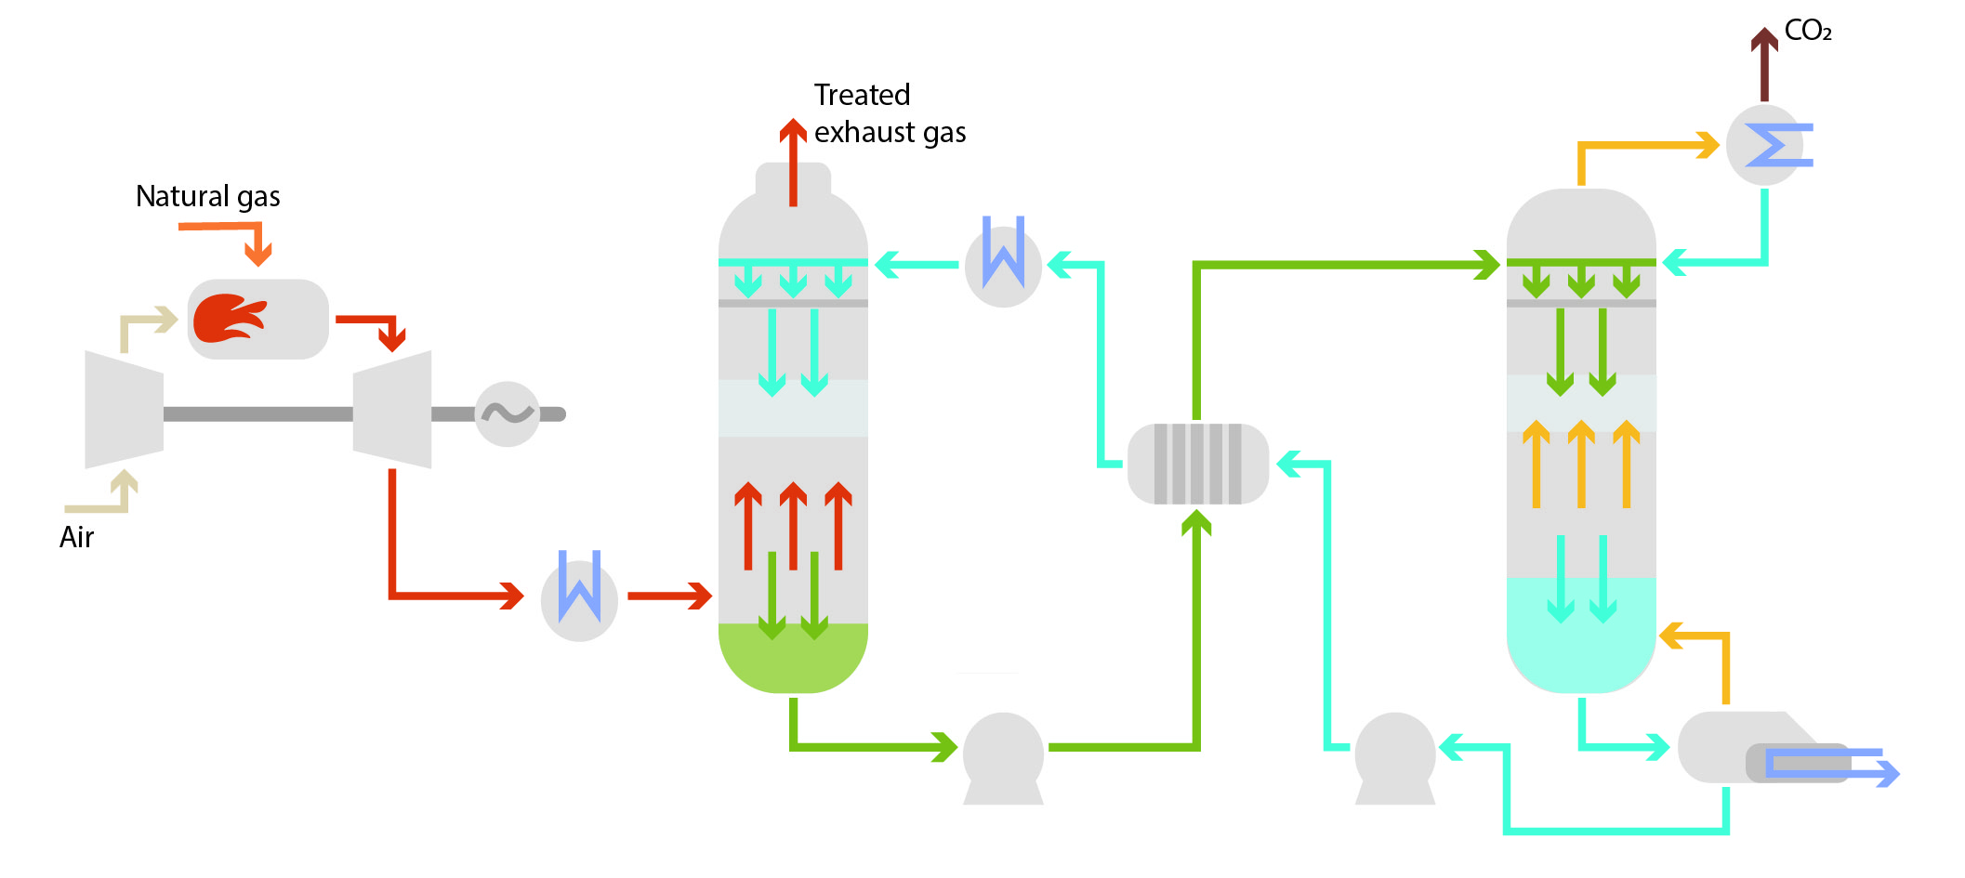
The amine(s)-based carbon capture process is energy intensive
Absorber
Stripper
1-5 vol.% CO₂
Heat
Efficiency ?

Slide 5
Applying carbon capture to gas turbines is challenging
Gas turbines are not ideal for carbon capture application
Low CO₂ content in flue gases (4-5 vol.%)
Large flue gas flow rate (6900 m³/s for 500 MWe)
Gas turbines are increasingly used as peaking units
Mainly part-load operation
Increased transient phases (start-up, shut-down, load variation)

Slide 6
Research questions
To what extent applying carbon capture penalizes plant performance and flexibility ?
How to reduce the carbon capture energy penalty?

Slide 7
Research questions
To what extent applying carbon capture penalizes plant performance and flexibility ?
How to reduce the carbon capture energy penalty?

Slide 8
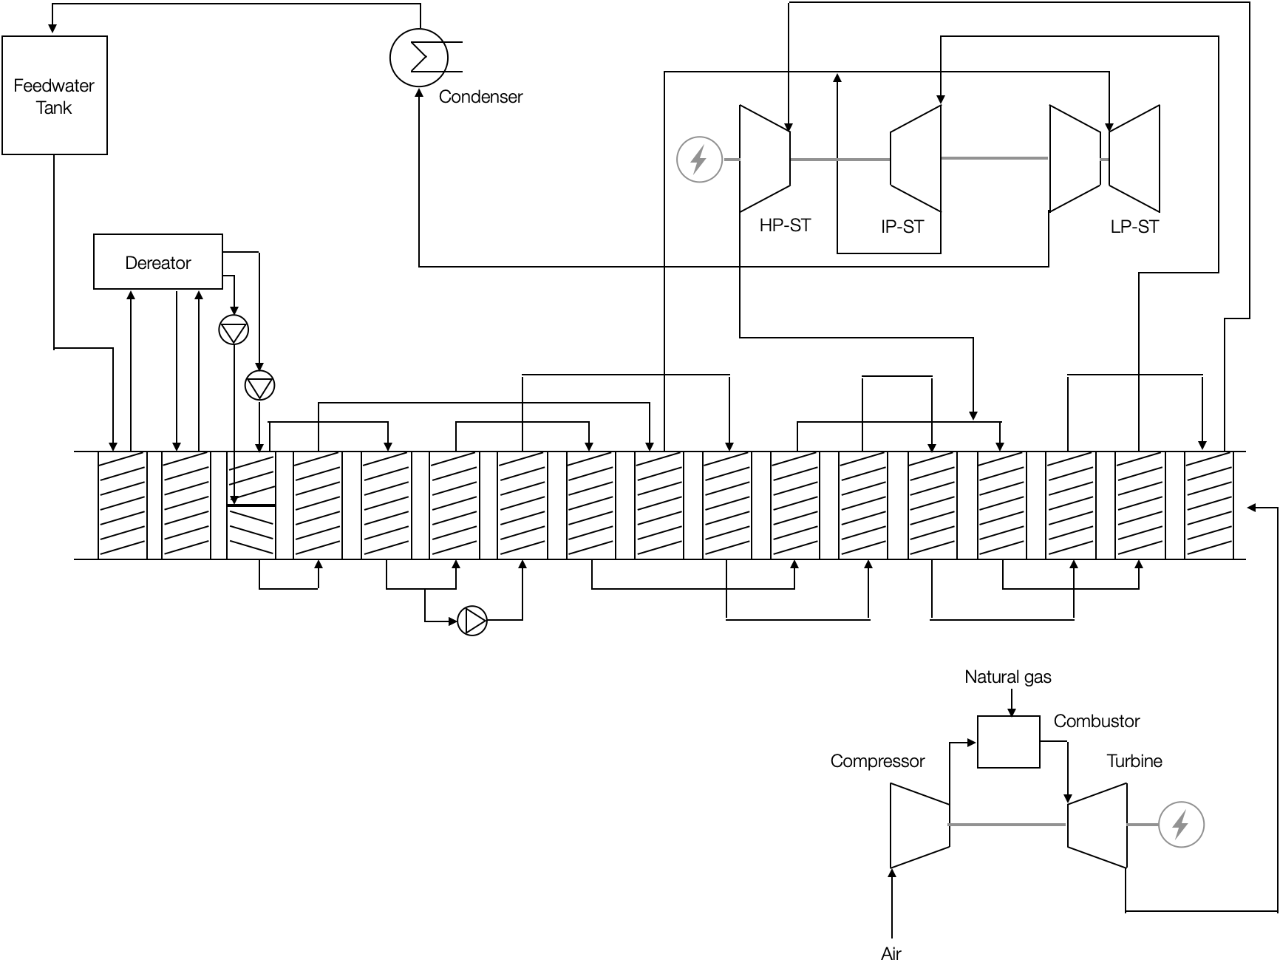

A conventional 580 MWe CCGT plant has been studied
Heat recovery steam generator
Steam cycle
P_{el} = 580 MW
Gas turbine
η_{el} = 60.7 %

Slide 9


What is the carbon capture penalty on the CCGT ?
$$η_{CCGT}=60.7\%$$
$$η_{CCGT}= ?$$
CCGT
CCGT
560 MWe
4.6% CO₂
4.6% CO₂
Carbon capture
Heat
Electricity
- 90% CO₂

Slide 10


The carbon capture plant has been designed and modelled for the CCGT application
Absorber
Stripper
 | Absorber | Stripper
Diameter (m) | 18 | 8.5
Packed height (m) | 30 | 30

Slide 11



-13.5% in efficiency with carbon capture
$$η_{CCGT}=60.7\%$$
$$η_{CCGT}=47.2\%$$
CCGT
CCGT
560 MWe
4.6% CO2
4.6% CO2
$$326 kg_{CO_{2}}/MWh_{e}$$
Carbon capture
MEA
$$35 kg_{CO_{2}}/MWh_{e}$$

Slide 12
The CCGT performance without/with CC were assessed for different GT loads
Plant load
Energy input [kWh/kWhe]
1.64
100%
2.12
0.48
2.75
1.71
75%
2.22
0.51
3.07
1.86
50%
2.44
0.58

Slide 13
Adding a carbon capture unit reduces significantly plant performance
Plant load
Energy input [kWh/kWhe]
1.64
100%
2.12
0.48
2.75
1.71
75%
2.22
0.51
3.07
1.86
50%
2.44
0.58

Slide 14
Part-load operation increases the CC energy penalty
Plant load
Energy input [kWh/kWhe]
1.64
100%
2.12
0.48
2.75
1.71
75%
2.22
0.51
+6.3%
3.07
1.86
50%
2.44
0.58
+20.8%

Slide 15
Research questions
To what extent applying carbon capture penalizes plant performance and flexibility ?
How to reduce the carbon capture energy penalty?

Slide 16
How to reduce the carbon capture penalty?
Performing Exhaust Gas Recirculation (EGR) on the mGT
CCGT
Improvement of the carbon capture process (solvent, configuration)
Carbon capture
Energy integration between the mGT and the CC plant

Slide 17
How to reduce the carbon capture penalty?
Performing Exhaust Gas Recirculation (EGR) on the mGT
CCGT
CO₂
Improvement of the carbon capture process (solvent, configuration)
Carbon capture
Energy integration between the mGT and the CC plant

Slide 18
How to reduce the carbon capture penalty?
EGR
Performing Exhaust Gas Recirculation (EGR) on the CCGT
CCGT
CO₂
Improvement of the carbon capture process (solvent, configuration)
Carbon capture
Energy integration between the mGT and the CC plant

Slide 19
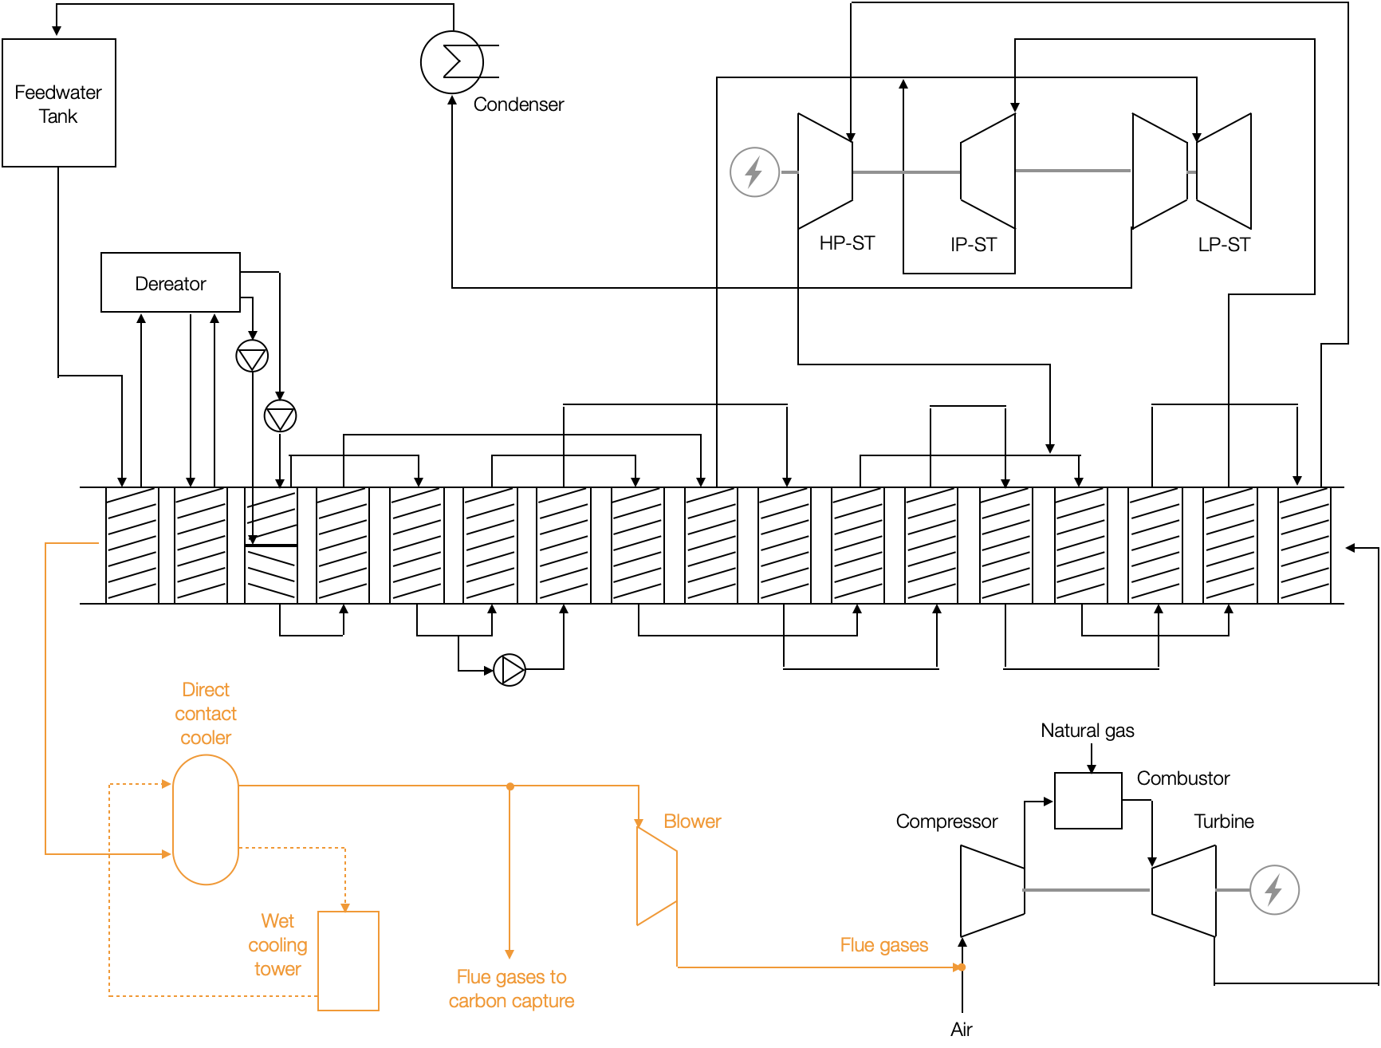
An EGR loop has been added to the CCGT model
EGR ratio = 35%

Slide 20
Applying EGR allows to reduce the size and the cost of the carbon capture unit
Absorber
Stripper
 | Absorber | Stripper
Diameter (m) | 18 15 | 8.5 8
Packed height (m) | 30 | 30

Slide 21
How to reduce the carbon capture penalty?
35% EGR
Performing Exhaust Gas Recirculation (EGR) on the CCGT
CCGT
7.1 vol.% CO₂
Improvement of the carbon capture process (solvent, configuration)
Carbon capture
Energy integration between the mGT and the CC plant

Slide 22
How to reduce the carbon capture penalty?
35% EGR
Performing Exhaust Gas Recirculation (EGR) on the CC
GT
CCGT
7.1 vol.% CO₂
Improvement of the carbon capture process (solvent, configuration)
Carbon capture
Heat
Electricity
Energy integration between the mGT and the CC plant

Slide 23
How to reduce the carbon capture penalty?
35% EGR
Performing Exhaust Gas Recirculation (EGR) on the CCGT
CCGT
7.1 vol.% CO₂
Improvement of the carbon capture process (solvent, configuration)
Carbon capture
MEA
MDEA/PZ
Energy integration between the mGT and the CC plant

Slide 24
The reboiler duty is lower using MDEA/PZ instead of MEA
Absorber
Stripper
Reboiler duty [MW_{th}]
Q_{reboiler}
MEA
MDEA/PZ
Stripper pressure [bar]

Slide 25
How to reduce the carbon capture penalty?
35% EGR
Performing Exhaust Gas Recirculation (EGR) on the CCGT
CCGT
Steam
7.1 vol.% CO₂
Improvement of the carbon capture process (solvent, configuration)
Carbon capture
MEA
MDEA/PZ
Energy integration between the CCGT and the CC plant

Slide 26
Steam is extracted from the IP/LP crossover to supply heat to the reboiler
3.8 bar
278.3°C

Slide 27





The CC penalty is reduced from 13.5 to 6.8 abs.% by performing EGR and extracting steam
35% EGR
CCGT
CCGT
Steam
CCGT
560 MWe
4.6% CO₂
4.6% CO₂
7.1% CO₂
$$326kg_{CO_{2}}/MWh_{e}$$
Carbon capture
Carbon capture
MEA
$$35kg_{CO_{2}}/MWh_{e}$$
MEA
$$η_{CCGT}=53.9\%$$
$$η_{CCGT}=60.7\%$$
$$η_{CCGT}=47.2\%$$

Slide 28

The CC penalty can be further reduced by 0.5 abs.% by replacing MEA with MDEA/PZ
35% EGR
CCGT
CCGT
Steam
CCGT
560 MWe
4.6% CO₂
4.6% CO₂
7.1% CO₂
$$326kg_{CO_{2}}/MWh_{e}$$
Carbon capture
Carbon capture
MEA
$$35kg_{CO_{2}}/MWh_{e}$$
MEA
$$η_{CCGT}=53.9\%$$
$$η_{CCGT}=60.7\%$$
$$η_{CCGT}=47.2\%$$
$$η_{CCGT}=54.4\%$$
MDEA/PZ

Slide 29
Conclusions
Implementing CC to CCGTs without adaptations strongly degrades plant performance, and even more during part-load operations
The negative impact can be strongly reduced through some adaptations without modifying existing components of the plant
By performing EGR and extracting steam, the energy penalty is reduced from 13.5 abs.% to 6.8 abs.% using MEA
Replacing MEA with MDEA/PZ results in a CCGT efficiency increase of 0.5 abs.%
Further investigations on part-load and transient operations are required
A techno-economic analysis is required to assess the viability of theses adaptations

Slide 30
Retroffiting existing Combined Cycle Gas Turbines with Post-Combustion Carbon Capture: carbon capture energy penalty reduction
ETN Webinar – 06/12/24
Antoine Verhaeghe
antoine.verhaeghe@umons.ac.be

