Slide 1

Part-load performance of Natural Gas Combined Cycles integrated with post-combustion CO₂ capture
Master thesis – Design and part-load results with sliding pressure part-load operation
Simona Calenda
Prof. Emanuele Martelli
Ing. Lorenzo Pilotti
Ing. Andrea Zelaschi
Dept. Of Energy

Slide 2
NGCC with Post-combustion CO₂ capture
Modelling

Slide 3
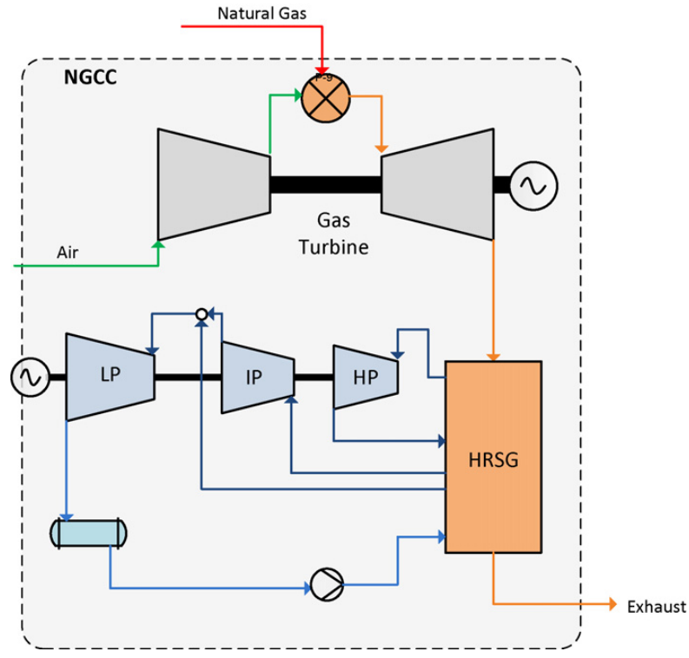
NGCC design
State-of-the-art Natural Gas Combined Cycle (NGCC) with three-pressure level HRSG
H-class Gas Turbine technological level (different sizes may be considered starting from a large-size model)
Two approaches considered for the design of the NGCC:
  Retrofit of H-class NGCC (conventional design)
  Greenfield H-class NGCC with post-combustion CO₂ capture and storage
Software: Thermoflex 31
Fig.1 Process layout, natural gas combined cycle (NGCC), without CO2 capture. [1]

Slide 4
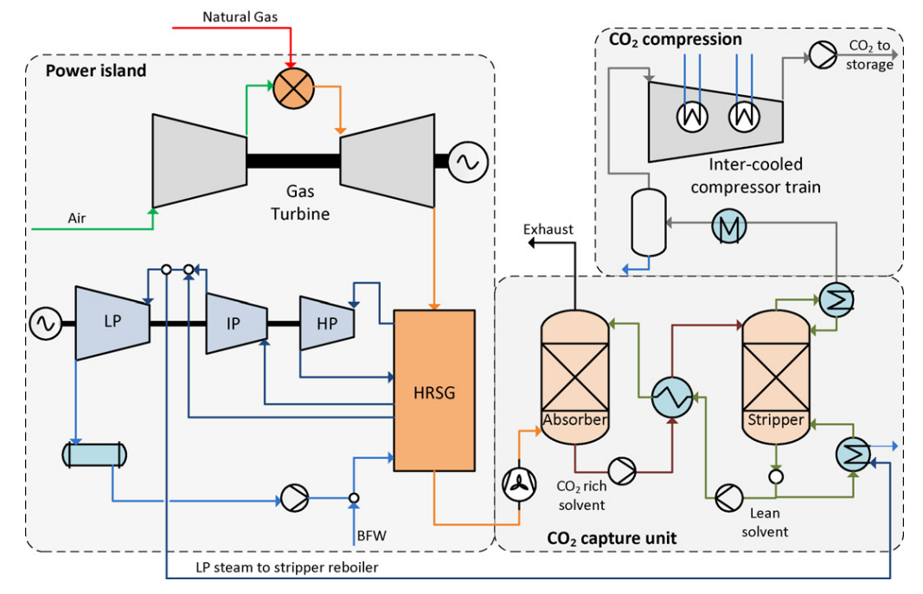
CO₂ capture and compression section design
State-of-the-art absorption process using monoethanolamine (MEA) as solvent
Model validated by researchers of GECOS group of Politecnico di Milano
Pressure needed for solvent regeneration: 2.7 bar (evaporation temperature: 130°C)
Software: Aspen Plus 14
Fig.2 NGCC with steam extraction for CO2 capture from the crossover between IP and LP steam turbines. [1]

Slide 5
Strategies for steam extraction
For both the retrofit and greenfield case, sliding pressure part-load operation of the HRSC (design LP pressure level of 6 bar) is followed
In case the steam cycle can not meet the reboiler duty at part-load condition, different strategies that allow to guarantee a part-load operation until the minimum load of the gas turbine (30% of the nominal load) may be considered:
  Increased design pressure for LP pressure level (example: 10 bar)
  Throttling-valve at crossover section (fixed LP pressure level)
  Controlled admission for LP turbine
  Steam compressor
  Steam ejector
The retrofit case will be considered only for large and medium size gas turbines

Slide 6
Greenfield Natural Gas Combined Cycle with CCS
Modelling assumptions
Design point results

Slide 7
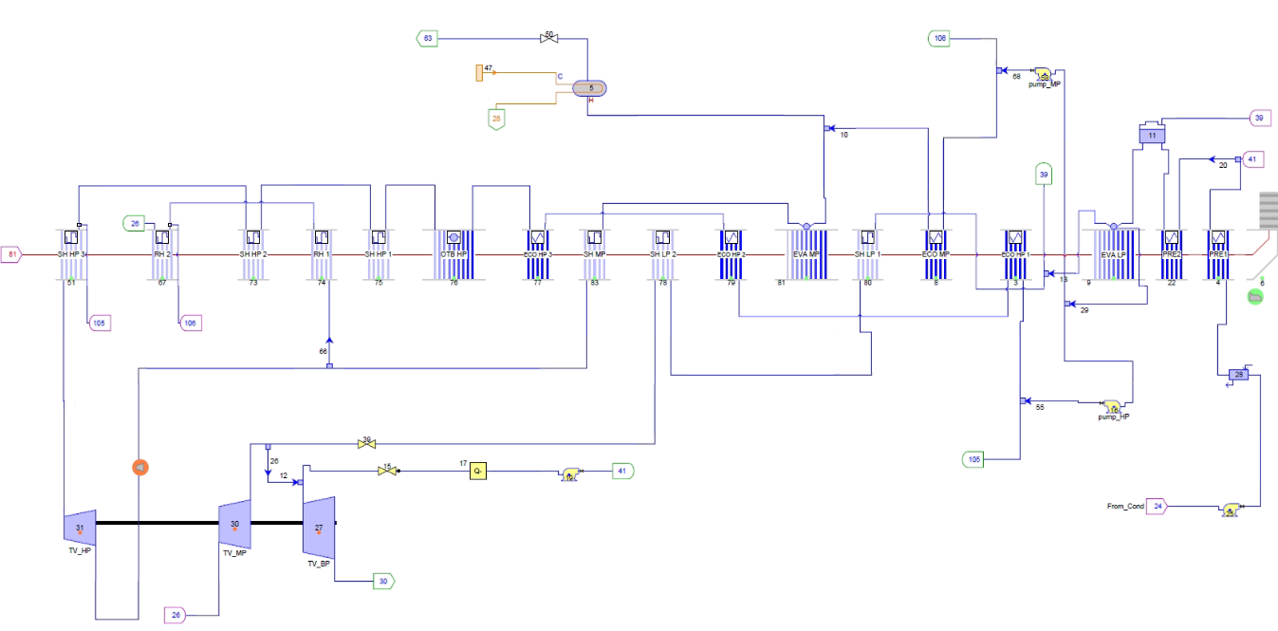
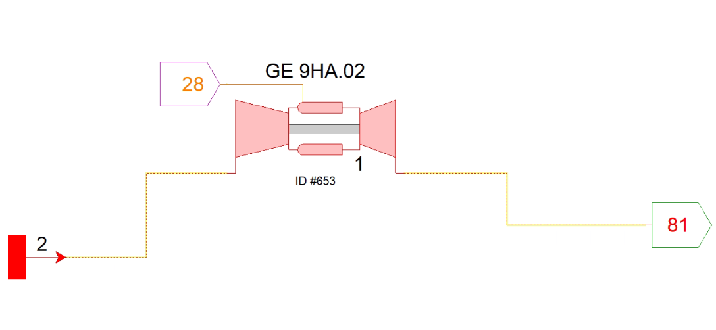
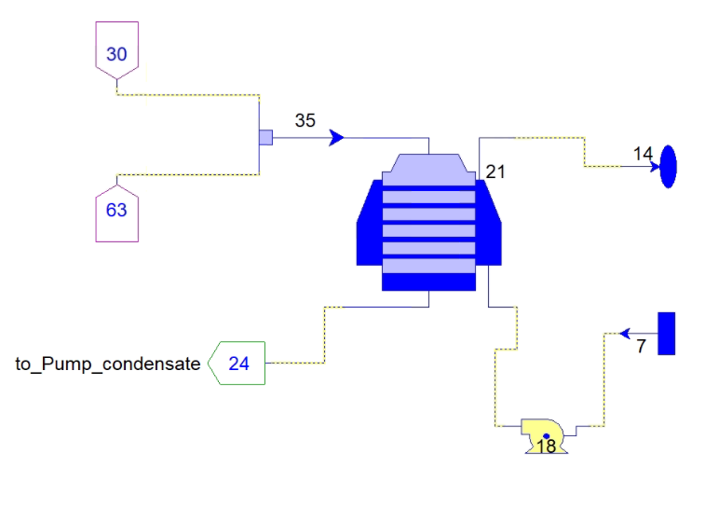
Power plant layout

Slide 8
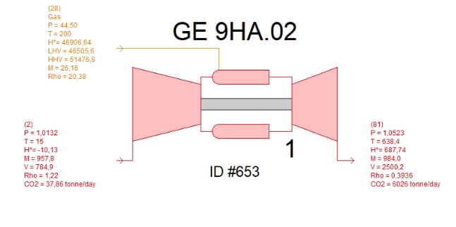
Input data Gas Turbine
H-class Gas Turbine model | GE 9HA.02
Rotational GT speed [rpm] | 3000
Inlet air temperature [°C] | 15
Inlet air pressure [bar] | 1.013
Inlet air R.H [%] | 60
Fuel composition [mol%] CH₄ C₂H₆ C₃H₈ C₄H₁₀ C₅H₁₂ CO₂ N₂ | 89.0 7.0 1.0 0.1 0.01 2.0 0.89
Fuel LHV [MJ/kg] | 46.506
Fuel inlet temperature [°C] | 15
Fuel inlet pressure [bar] | 45
Fuel temperature [°C] | 200
Nominal Power output: 528 MW
Nominal exhaust gas mass flow rate: 984 kg/s

Slide 9
HRSG layout

Slide 10
HRSG layout
LP level: 1 EVA, 2 SH

Slide 11
HRSG layout
LP level: 1 EVA, 2 SH
IP level: 1 ECO, 1 EVA, 1 SH, 2 RH sections

Slide 12
HRSG layout
LP level: 1 EVA, 2 SH
IP level: 1 ECO, 1 EVA, 1 SH, 2 RH sections
HP level: 3 ECO, 1 EVA (Once Through Boiler), 3 SH sections

Slide 13
HRSG layout
Saturated liquid from the reboiler directly sent to first preheater
Reboiler of regeneration column
Fuel preheated with IP water from ECO IP 2
LP level: 1 EVA, 2 SH
IP level: 1 ECO, 1 EVA, 1 SH, 2 RH sections
Deaerator
HP level: 3 ECO, 1 EVA (Once Through Boiler), 3 SH sections

Slide 14
Input data for HRSG
P condensation [bar] | 0.04
HRSG pressure drop [Pa] | 3500
Rotational ST speed [rpm] | 3000
HP pressure [bar] | 185
IP pressure [bar] | 43
LP pressure [bar] | 6
HP SH outlet temperature [°C] | 605
RH outlet temperature [°C] | 602
LP SH outlet temperature [°C] | 325
ΔT approach point [°C] | 25
ΔT pinch point [°C] | 8
ΔT sub cooling [°C] | 5
Some steam/water side outlet temperatures of HRSG banks have been assumed
Part-load regulation: sliding pressure
Steam turbines and pumps performance maps from Thermoflex
Water-cooled condenser
Reboiler design:
Inlet Pressure [bar] | 2.7
Condensation Temperature [°C] | 130
Outlet condition hot side | Saturated liquid
Evaporation temperature cold side [°C] | 120

Slide 15
Design NGCC (reference plant, no CCS) – Main output data
Parameter | Value
Fuel mass flow rate [kg/s] | 26.19
Fuel LHV input (25°C) [MW] | 1217.91
Exhaust gas mass flow rate [kg/s] | 984
TOT [°C] | 639.7
T stack [°C] | 79.27
Condensate mass flow rate [kg/s] | 175.4
HP steam generated [kg/s] | 122.3
IP steam generated [kg/s] | 19.75
LP steam generated [kg/s] | 20.21
Exhaust gas composition [mol%] O₂ CO₂ H₂O N₂ Ar | 11.11 4.569 9.488 74.942 0.89
Parameter | Value
Gas turbine power output [MW] | 527
Gas turbine LHV efficiency [%] | 43.27
Steam turbine power output [MW] | 248.65
Steam cycle efficiency [%] | 39.99
Plant gross power [MW] | 775.65
Total auxiliaries losses of NGCC [MW] | 18.31
Plant net power [MW] | 757.35
Net electric LHV efficiency NGCC [%] | 62.18

Slide 16
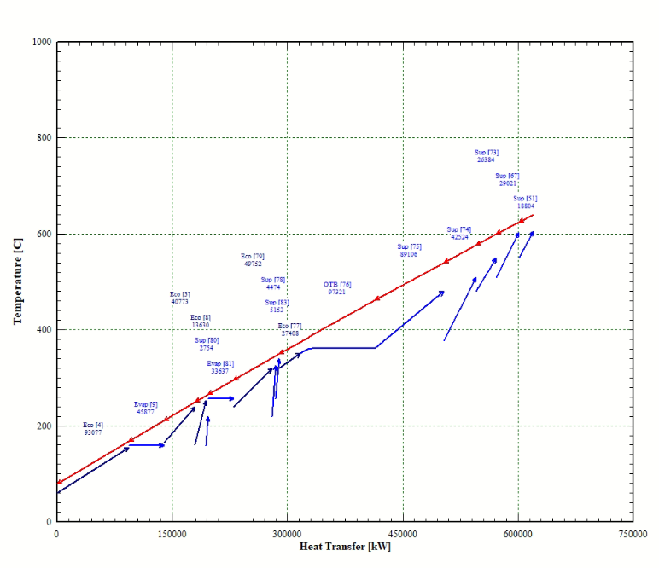
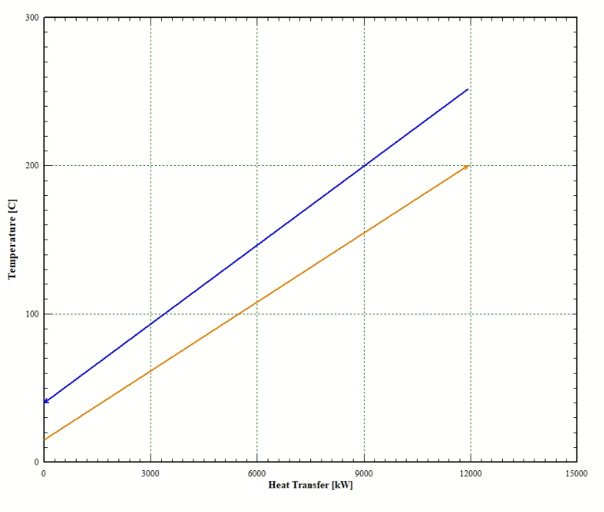
Design Results – Plots
Fig.4 Fuel heater T-Q diagram
Fig.3 HRSG T-Q diagram

Slide 17
CO₂ capture and compression section
Modelling assumptions

Slide 18
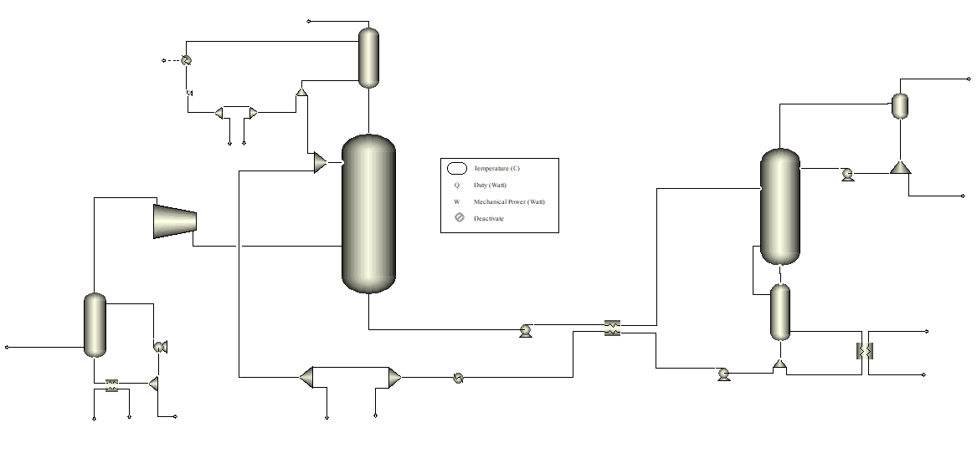
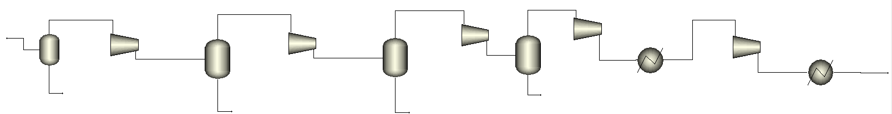
Power plant layout

Slide 19
Power plant layout
W
W
W
W
Direct Contact Cooler
W
W
W
W
Absorption column
C
N
D
C
N
D
C
N
D
C
N
D
Water wash section
Regeneration column
R
G
N
R
G
N
A
B
S
A
B
S
R
G
N
R
G
N
Reboiler
A
B
S
A
B
S
BLOWER
BLOWER
BLOWER
BLOWER
Condenser
CO₂ compression section
DC
C
DC
C
R
B
R
B
DC
C
DC
C
R
B
R
B
Blower

Slide 20
Input data CO₂ absorption process
Requirements |  | Target
DCC | Delta T water in/gas out [°C] | 3
 | Water intet T - cooling water [°C] | 8
 | Outlet gas T at ISO conditions [°C] | 33
 | Pressure drop [Pa] | 750
 | Simulation approach | equilibrium based
 | water mass flow rate [kg/s] | -
Blower | Pressure increase [bar] | 0.054
 | efficiency [%] | 75
Absorber | Height [m] | -
 | Gas velocity [m/s] | 1.5 / 2
 | Diameter [m] | *avoid flooding
 | Simulation approach | rate based
 | Pressure drop [Pa] | 2500
 | Solvent inlet temperature [°C] | 36
 | Solvent composition | H2O+MEA 30% (w%)
CCR |  | 95%
L/G |  | 1.2
Model validated replicating three experimental runs from the Technology Centre Mongstad (TCM) [2], [3], [4].
e-NRTL thermodynamic model used for the electrolyte system
Requirements |  | Target
Water wash section | MEA emissions max [ppm] | 25
 | water mass flow rate [kg/s] | -
 | Water intet T - cooling water [°C] | 8
 | Pressure drop [Pa] | 150
 | Diameter [m] | *avoid flooding
Lean-rich HX | Minimum T diff [°C] | 5
Stripper | Simulation approach | rate based
 | Internal pressure [bar] | 1,8
 | Pressure drop [bar] | 0.3
 | Diameter [m] | *avoid flooding
 | Reboiler temperature [°C] | 120
 | Height [m] | -

Slide 21
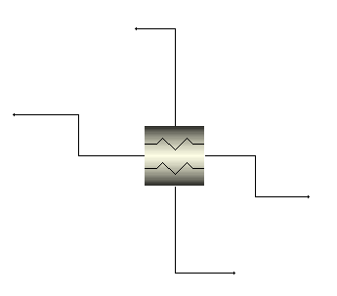
Input data CO₂ compression section and stack gas-gas HX
Compression section
Gas-gas HX at stack
Fluid model | Peng-Robinson EOS
Number of intercooled compressors | 4
Compressor isentropic efficiency [%] | 85
Intercooler outlet temperature [°C] | 40
CO₂ delivery pressure [bar] | 110
Cold-inlet | Treated gas from capture section
Hot-inlet | Exhaust gas from HRSG
Stack temperature [°C] | 70
COLD-INLET (treated gas)
HOT-OUTLET (exhaust gas to the DCC of the capture section)
CPR-1
CPR-2
CPR-3
CPR-4
HOT-INLET (exhaust gas from HRSG)
COLD-OUTLET (treated at stack)

Slide 22
Design Results NGCC+CCS – Main output data
Parameter | Value
Gas turbine power output [MW] | 527.48
Gas turbine LHV efficiency [%] | 43.35
Steam turbine power output [MW] | 173.28
Steam cycle efficiency [%] | 29.97
Plant gross power [MW] | 700.76
Total auxiliary losses of power block [MW] | 15.99
Power block net power [MW] | 684.77
Total auxiliaries consumption of CCS [MW] | 27.77
Total net plant power [MW] | 657.0
Net total electric efficiency [%] | 53.99
Parameter | Value
Fuel mass flow rate [kg/s] | 26.16
Fuel LHV input (25°C) [MW] | 1216.81
Exhaust gas mass flow rate [kg/s] | 984
TOT [°C] | 638.4
T stack [°C] | 119.3
Exhaust gas composition [mol%] O₂ CO₂ H₂O N₂ Ar | 11.120 4.565 9.480 74.945 0.890

Slide 23
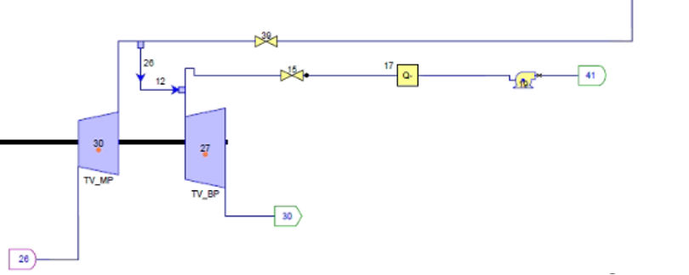
Design Results NGCC+CCS – Main output data
CO₂ capture and compression results
Steam cycle operation
Parameter | Value
L/G | 1.2
Qreb [MW] | 251.31
Qspec [MJ/kgCO₂] | 3.793
CCR [%] | 95
Mass flow rate to reboiler [kg/s] | 98.55
20.28 kg/s
139.8 kg/s
98.55 kg/s
61.48 kg/s
 | Low pressure steam | Intermediate Pressure steam | High pressure steam
Temperature [°C] | 325 | 340.4 | 605
Pressure [bar] | 6 | 44.51 | 185
Mass flow rate [kg/s] | 20.28 | 19.98 | 121.6

Slide 24
Comparison with reference NGCC (w/o CCS) – Design results
Reference NGCC (w/o CCS)
No reboiler for steam production to feed regeneration column
No capture section
NGCC with post-combustion CCS
Power block layout reported in slide 9 (with reboiler)
Capture and compression section reported in slides 18
Parameter | Reference NGCC (w/o CCS) | NGCC with post-combustion CCS
Plant net power [MW] | 757.35 | 657.0
Net total electric efficiency [%] | 62.18 | 53.99
Difference in net electric efficiency [%] | 8.19
CO₂ Emission [kgCO₂/MWhel] | 329.75 | 18.94
SPECCA [MJ LHV/kgCO₂] | 2.824
Specific primary energy for CO2 avoided

Slide 25
Part-load Analysis
Modelling assumptions
Part-load point results

Slide 26
Part-load 80% NGCC+CCS – Main output data
Parameter | Value
Gas turbine power output [MW] | 424.65
Gas turbine LHV efficiency [%] | 40.92
Steam turbine power output [MW] | 157.89
Steam cycle efficiency [%] | 30.28
Plant gross power [MW] | 582.54
Total auxiliary losses of power block [MW] | 14.0
Power block net power [MW] | 568.54
Total auxiliaries consumption of CCS [MW] | 23.86
Total net plant power [MW] | 544.67
Net total electric efficiency [%] | 52.48
Parameter | Value
Fuel mass flow rate [kg/s] | 22.32
Fuel LHV input (25°C) [MW] | 1037.84
Exhaust gas mass flow rate [kg/s] | 864.1
TOT [°C] | 647.9
T stack [°C] | 114.3
Exhaust gas composition [mol%] O₂ CO₂ H₂O N₂ Ar | 11.391 4.437 9.241 74.04 0.891

Slide 27
Part-load 80% NGCC+CCS – Main output data
CO₂ capture and compression results
Steam cycle operation
Parameter | Value
L/G | 1.2
Qreb [MW] | 212.9
Qspec [MJ/kgCO₂] | 3.766
CCR [%] | 95
Mass flow rate to reboiler [kg/s] | 82.82
Parameter | LP steam | IP steam | HP steam
Temperature [°C] | 322.6 | 339.7 | 605.0
Pressure [bar] | 5.93 | 44.47 | 184.8
Mass flow rate [kg/s] | 11.65 | 9.30 | 75.08
Comparison with reference NGCC at 80%
Parameter | Reference NGCC (w/o CCS) | NGCC with post-combustion CCS
Plant net power [MW] | 629.42 | 544.67
Net total electric efficiency [%] | 60.70 | 52.48
CO₂ Emission [kgCO₂/MWhel] | 337.81 | 19.60
SPECCA [MJ LHV/kgCO₂] | 2.919

Slide 28
Part-load 60% NGCC+CCS – Main output data
Parameter | Value
Gas turbine power output [MW] | 316.631
Gas turbine LHV efficiency [%] | 31.77
Steam turbine power output [MW] | 145.89
Steam cycle efficiency [%] | 31.77
Plant gross power [MW] | 462.52
Total auxiliary losses of power block [MW] | 15.99
Power block net power [MW] | 446.53
Total auxiliaries consumption of CCS [MW] | 17.56
Total net plant power [MW] | 428.97
Net total electric efficiency [%] | 50.31
Parameter | Value
Fuel mass flow rate [kg/s] | 18.34
Fuel LHV input (25°C) [MW] | 852.71
Exhaust gas mass flow rate [kg/s] | 738.7
TOT [°C] | 660.9
T stack [°C] | 110.8
Exhaust gas composition [mol%] O₂ CO₂ H₂O N₂ Ar | 11.749 4.269 8.926 74.164 0.893

Slide 29
Part-load 60% NGCC+CCS – Main output data
CO₂ capture and compression results
Steam cycle operation
Parameter | Value
L/G | 1.2
Qreb [MW] | 173.7
Qspec [MJ/kgCO₂] | 3.739
CCR [%] | 95
Mass flow rate to reboiler [kg/s] | 68.59
Parameter | LP steam | IP steam | HP steam
Temperature [°C] | 323.0 | 340 | 605
Pressure [bar] | 5.45 | 44.51 | 184.9
Mass flow rate [kg/s] | 15.31 | 12.83 | 99.35
Comparison with reference NGCC at 60%
Parameter | Reference NGCC (w/o CCS) | NGCC with post-combustion CCS
Plant net power [MW] | 501.64 | 428.97
Net total electric efficiency [%] | 58.6 | 50.31
CO₂ Emission [kgCO₂/MWhel] | 349.92 | 20.43
SPECCA [MJ LHV/kgCO₂] | 3.074

Slide 30
Part-load 30% NGCC+CCS – Main output data
Parameter | Value
Gas turbine power output [MW] | 158.61
Gas turbine LHV efficiency [%] | 28.18
Steam turbine power output [MW] | 114.17
Steam cycle efficiency [%] | 32.87
Plant gross power [MW] | 272.78
Total auxiliary losses of power block [MW] | 7.519
Power block net power [MW] | 265.26
Total auxiliaries consumption of CCS [MW] | 13.59
Total net plant power [MW] | 251.67
Net total electric efficiency [%] | 44.79
Parameter | Value
Fuel mass flow rate [kg/s] | 12.08
Fuel LHV input (25°C) [MW] | 561.854
Exhaust gas mass flow rate [kg/s] | 555.6
TOT [°C] | 663
T stack [°C] | 106
Exhaust gas composition [mol%] O₂ CO₂ H₂O N₂ Ar | 12.847 3.751 7.959 74.546 0.897

Slide 31
Part-load 30% NGCC+CCS – Main output data
CO₂ capture and compression results
Steam cycle operation
Parameter | Value
L/G | 1.2
Qreb [MW] | 114.2
Qspec [MJ/kgCO₂] | 3.725
CCR [%] | 95
Mass flow rate to reboiler [kg/s] | 45.12
Parameter | LP steam | IP steam | HP steam
Temperature [°C] | 322.6 | 339.7 | 605
Pressure [bar] | 5.358 | 44.47 | 184.8
Mass flow rate [kg/s] | 11.65 | 9.297 | 75.08
Comparison with reference NGCC at 30%
Parameter | Reference NGCC (w/o CCS) | NGCC with post-combustion CCS
Plant net power [MW] | 295.44 | 251.67
Net total electric efficiency [%] | 52.64 | 44.79
CO₂ Emission [kgCO₂/MWhel] | 389.57 | 20.89
SPECCA [MJ LHV/kgCO₂] | 3.25

Slide 32
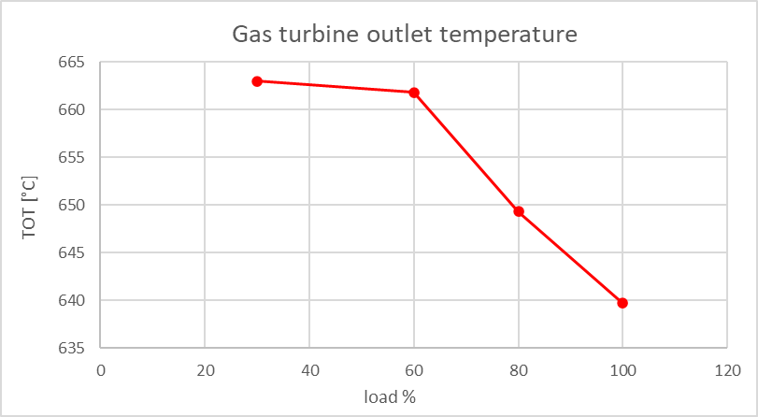
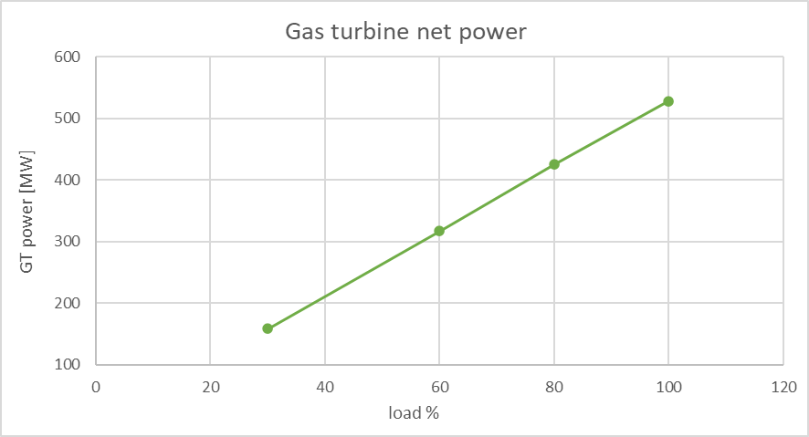
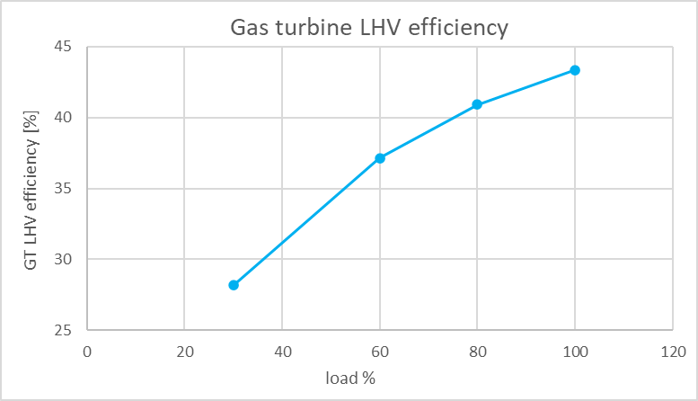
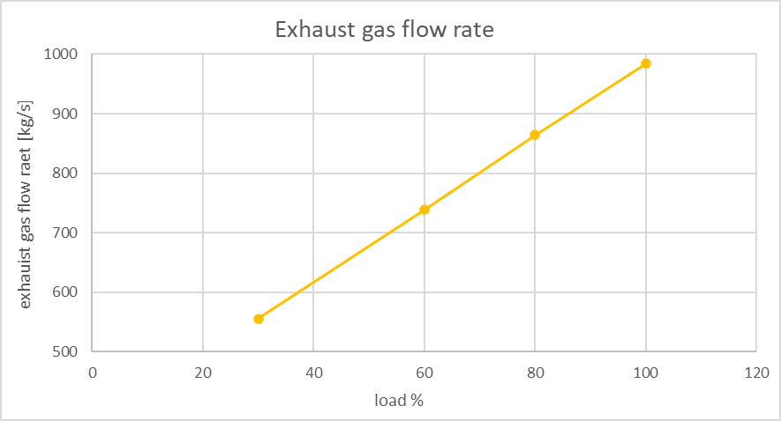
Gas turbine performance plots

Slide 33
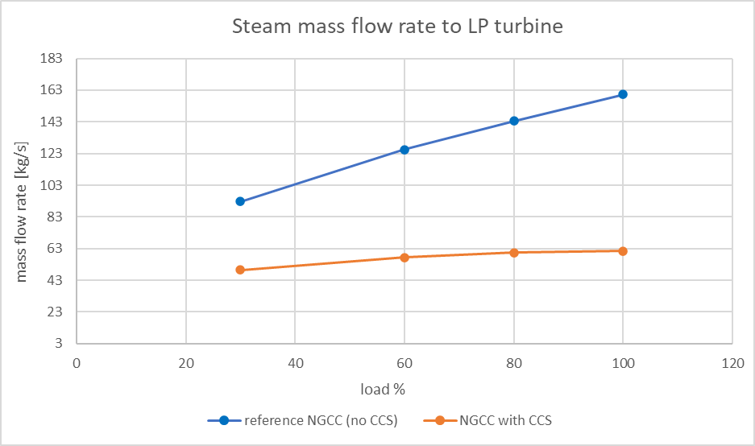
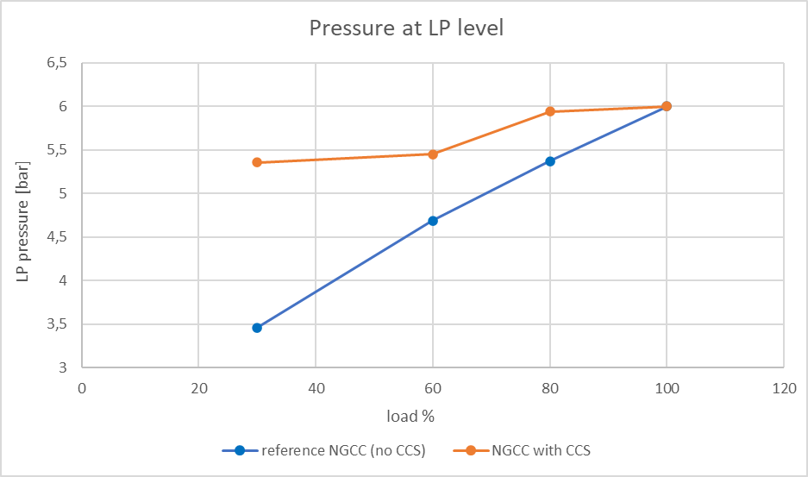
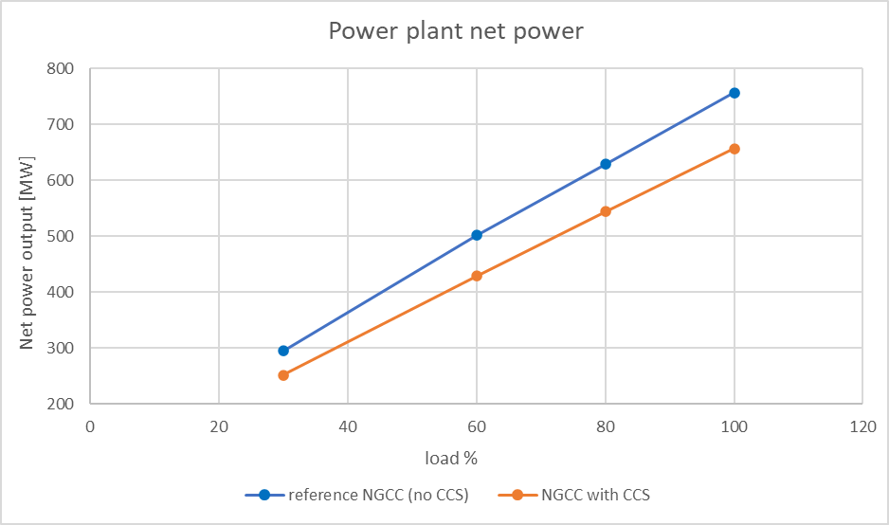
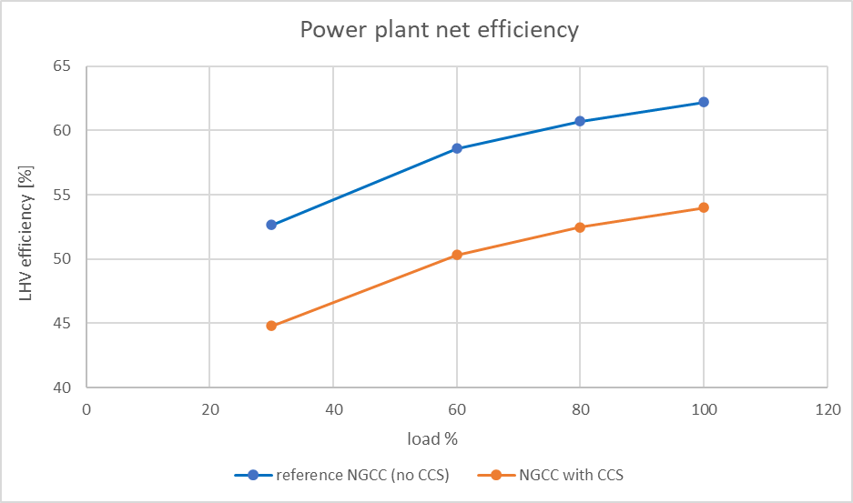
Power plant performance plots

Slide 34
Next steps
Full-load and part-load analysis of the large-size NGCC with post-combustion CO₂ capture (retrofit case)
In case the mnimum load of the gas turbine can not be reached for the retrofit case, evaluation of the possible strategies to reach 30%
Full-load and part-load analysis of the medium-size NGCC with post-combustion CO₂ capture (both greenfield and retrofit case)
Full-load and part-load analysis of the small-size NGCC with post-combustion CO₂ capture (only greenfield case)

Slide 35
Thank you for your attention!

Slide 36
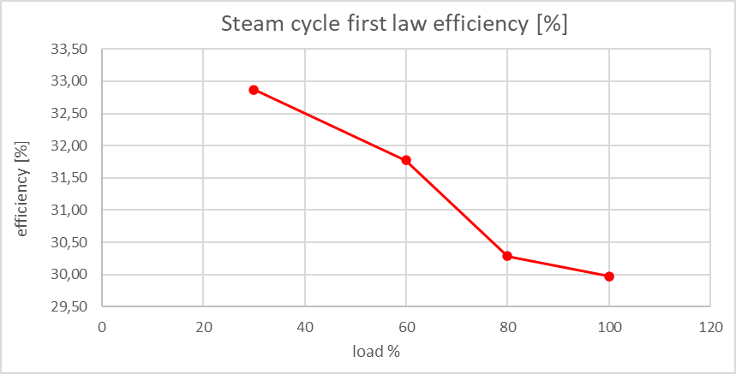
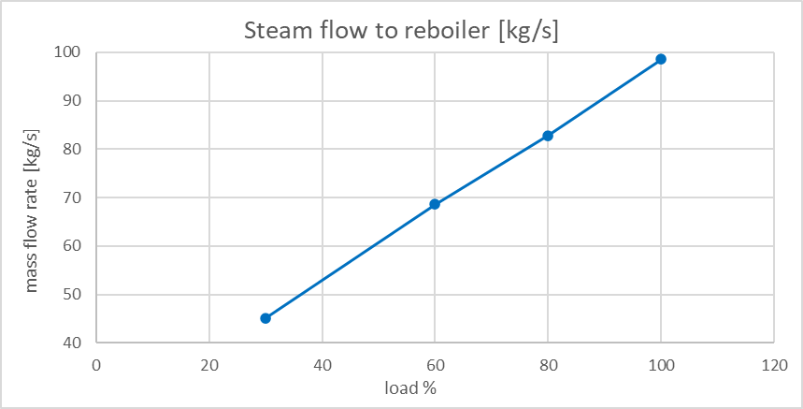
Appendix

Slide 37
Reference list
[1] K.Jordal, PA. Marchioro Ystad, R. Anantharaman, A. Chikukwa, and O. Bolland. “Design-point and part-load considerations for natural gas combined cycle plants with post combustion capture”. In: Elsevier (2012), pp. 271–282.
[2] E. S. Hamborg et al., “Results from MEA testing at the CO2 Technology Centre Mongstad. Part II: Verification of baseline results,” Energy Procedia, vol. 63, pp. 5994–6011, Jan. 2014, doi: 10.1016/J.EGYPRO.2014.11.634.
[3] P. Loldrup Fosbøl et al., “Results of the fourth Technology Centre Mongstad campaign: LVC testing,” International Journal of Greenhouse Gas Control, vol. 89, pp. 52–64, Oct. 2019, doi: 10.1016/J.IJGGC.2019.06.025.
[4] E. Gjernes et al., “Documenting Modes of Operation with Cost Saving Potential at the Technology Centre Mongstad,” SSRN Electronic Journal, Oct. 2020, doi: 10.2139/SSRN.3366235.

