Slide 1

Part-load performance of Natural Gas Combined Cycles integrated with post-combustion CO₂ capture
Master thesis – Project main features and design assumptions
Simona Calenda
Prof. Emanuele Martelli
Ing. Lorenzo Pilotti
Ing. Andrea Zelaschi
Dept. Of Energy

Slide 2
NGCC with Post-combustion CO₂ capture
Modelling

Slide 3
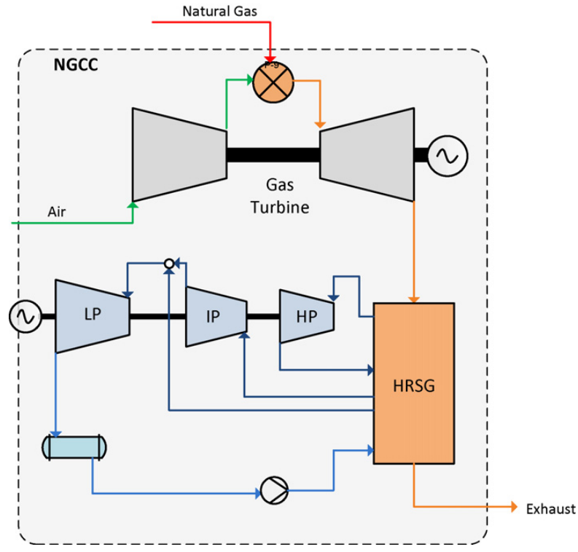
NGCC design
State-of-the-art Natural Gas Combined Cycle (NGCC) with three-pressure level HRSG
H-class Gas Turbine technological level (different sizes may be considered starting from a large-size model)
Two approaches considered for the design of the NGCC:
  Retrofit of H-class NGCC (conventional design)
  Greenfield H-class NGCC with post-combustion CO₂ capture and storage
Software: Thermoflex 31
Fig.1 Process layout, natural gas combined cycle (NGCC), without CO2 capture. [1]

Slide 4
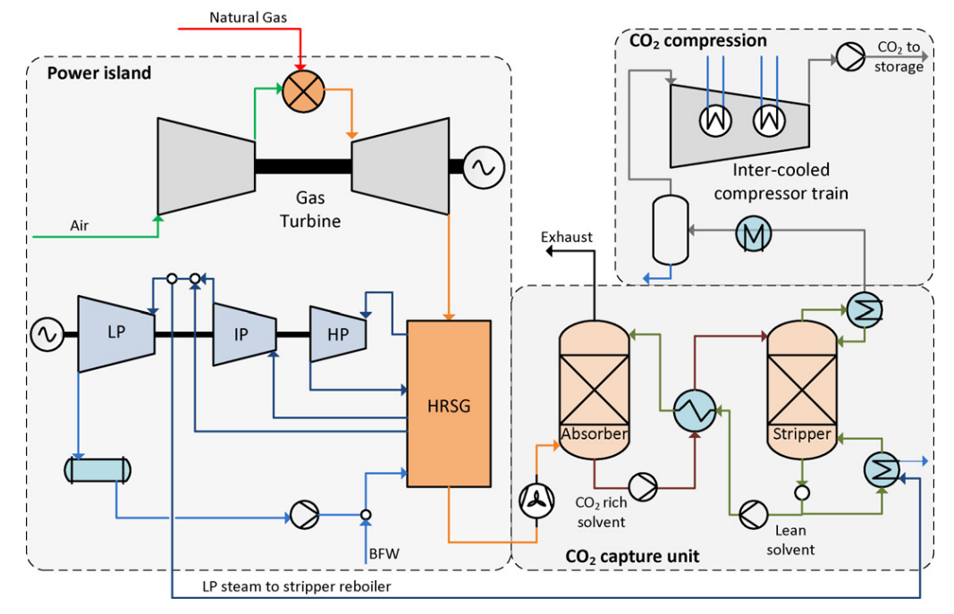
CO₂ capture and compression section design
State-of-the-art absorption process using monoethanolamine (MEA) as solvent
Model validated by researchers of GECOS group of Politecnico di Milano
Pressure needed for solvent regeneration: 3 bar (evaporation temperature: 133.5°C)
Software: Aspen Plus 14
Fig.2 NGCC with steam extraction for CO2 capture from the crossover between IP and LP steam turbines. [1]

Slide 5
Strategies for steam extraction
Retrofit of H-class NGCC:
Following the sliding pressure part-load regulation of the HRSC (design LP pressure level of 6 bar), we identifiy the minimum load of the NGCC with post-combustion CCS (load at which the LP pressure becomes 3 bar)
Greenfield H-class NGCC:
Increased design pressure for LP pressure level (example: 10 bar)
Throttling-valve at crossover section (fixed LP pressure level)
Controlled admission for LP turbine
Steam compressor
Steam ejector

Slide 6
Natural Gas Combined Cycle
Modelling assumptions
Design point results

Slide 7
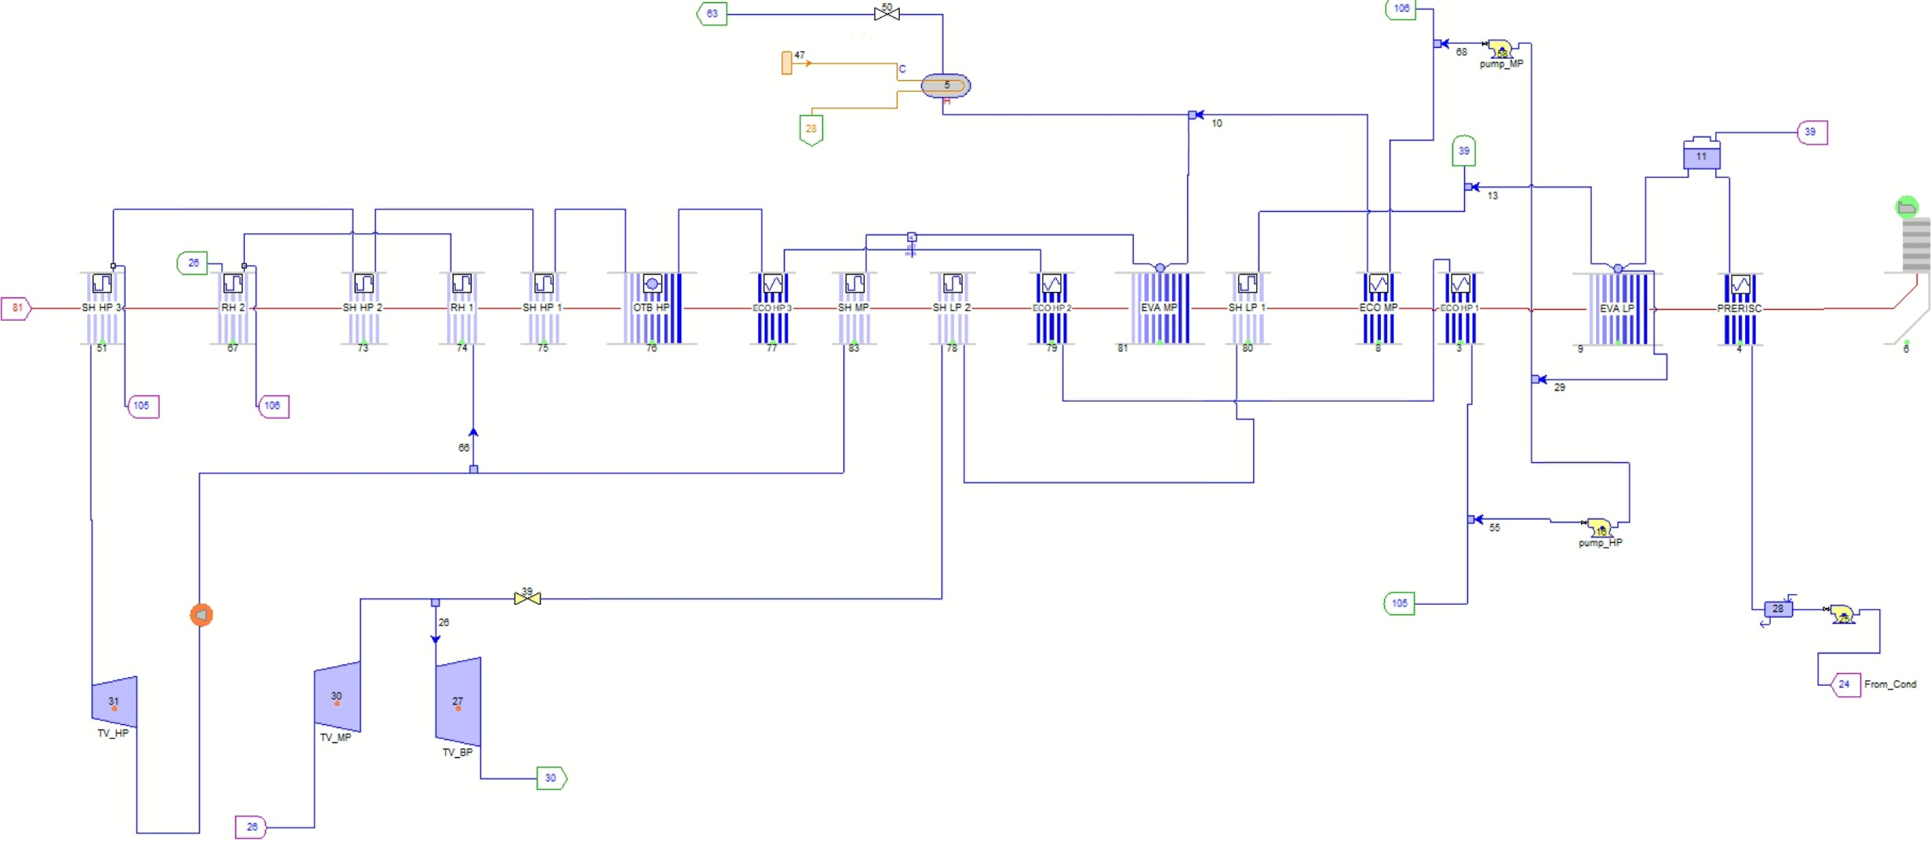
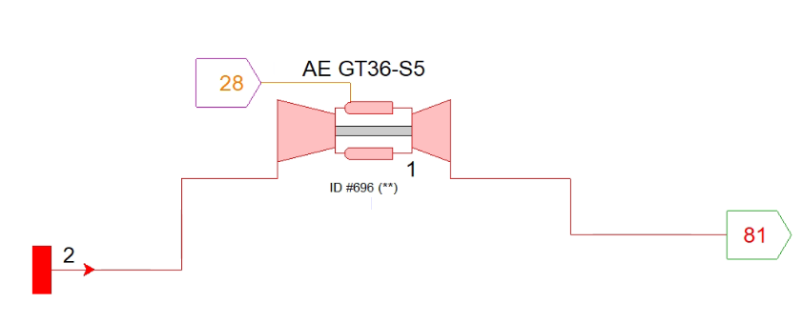
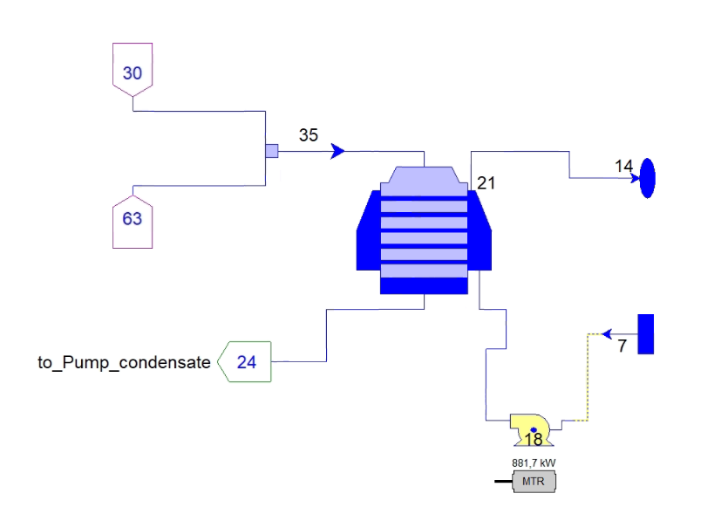
Power plant layout

Slide 8
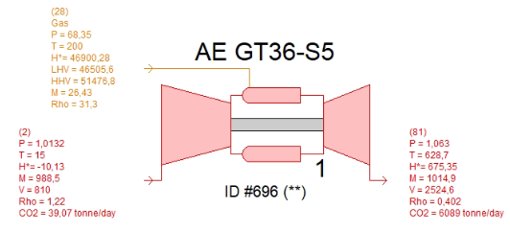
Input data Gas Turbine
H-class Gas Turbine model | Ansaldo GT-36-S5
Rotational GT speed [rpm] | 3000
Inlet air temperature [°C] | 15
Inlet air pressure [bar] | 1.013
Inlet air R.H [%] | 60
Fuel composition [mol%] CH₄ C₂H₆ C₃H₈ C₄H₁₀ C₅H₁₂ CO₂ N₂ | 89.0 7.0 1.0 0.1 0.01 2.0 0.89
Fuel LHV [MJ/kg] | 46.506
Fuel inlet temperature [°C] | 15
Fuel inlet pressure [bar] | 45
Fuel temperature [°C] | 200
Nominal Power output: 515 MW
Nominal exhaust gas mass flow rate: 1015 kg/s

Slide 9
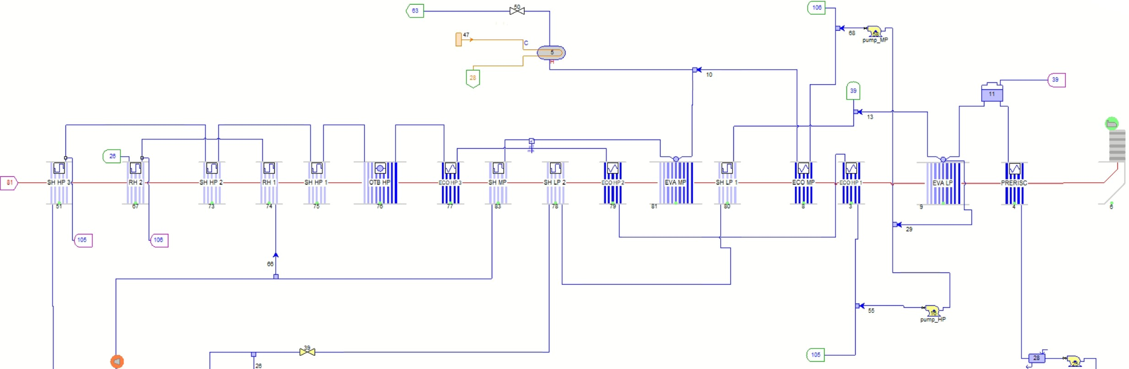
HRSG layout

Slide 10
HRSG layout
LP level: 1 EVA, 2 SH
Deaerator

Slide 11
HRSG layout
LP level: 1 EVA, 2 SH
IP level: 1 ECO, 1 EVA, 1 SH, 2 RH sections
Deaerator

Slide 12
HRSG layout
LP level: 1 EVA, 2 SH
IP level: 1 ECO, 1 EVA, 1 SH, 2 RH sections
Deaerator
HP level: 3 ECO, 1 EVA (Once Through Boiler), 3 SH sections

Slide 13
HRSG layout
Fuel preheated with IP water from ECO IP 2
LP level: 1 EVA, 2 SH
IP level: 1 ECO, 1 EVA, 1 SH, 2 RH sections
Deaerator
HP level: 3 ECO, 1 EVA (Once Through Boiler), 3 SH sections

Slide 14
Input data for HRSG
P condensation [bar] | 0.04
HRSG pressure drop [Pa] | 3500
Rotational ST speed [rpm] | 3000
HP pressure [bar] | 185
IP pressure [bar] | 43
LP pressure [bar] | 6
HP SH outlet temperature [°C] | 603.7
RH outlet temperature [°C] | 602
LP SH outlet temperature [°C] | 325
ΔT approach point [°C] | 25
ΔT pinch point [°C] | 8
ΔT sub cooling [°C] | 5
Some steam/water side outlet temperatures of HRSG banks have been assumed (see appendix)
Part-load regulation: sliding pressure
Steam turbines and pumps performance maps from Thermoflex
Water-cooled condenser

Slide 15
Design Results – Main output data
Parameter | Value
Fuel mass flow rate [kg/s] | 26.43
Exhaust gas mass flow rate [kg/s] | 1014.9
TOT [°C] | 628.7
T stack [°C] | 81.06
Condensate mass flow rate [kg/s] | 177.1
HP steam generated [kg/s] | 120.0
IP steam generated [kg/s] | 21.77
LP steam generated [kg/s] | 23.61
Exhaust gas composition [mol%] O₂ CO₂ H₂O N₂ Ar | 11.314 4.474 9.309 74.013 0.891
Parameter | Value
Gas turbine power output [MW] | 515.67
Gas turbine LHV efficiency [%] | 41.95
Steam turbine power output [MW] | 248.08
Steam cycle efficiency [%] | 38.45
Plant gross power [MW] | 763.75
Total auxiliaries and transformer losses [MW] | 18.08
Plant net power [MW] | 745.67
Net electric LHV efficiency [%] | 60.66

Slide 16
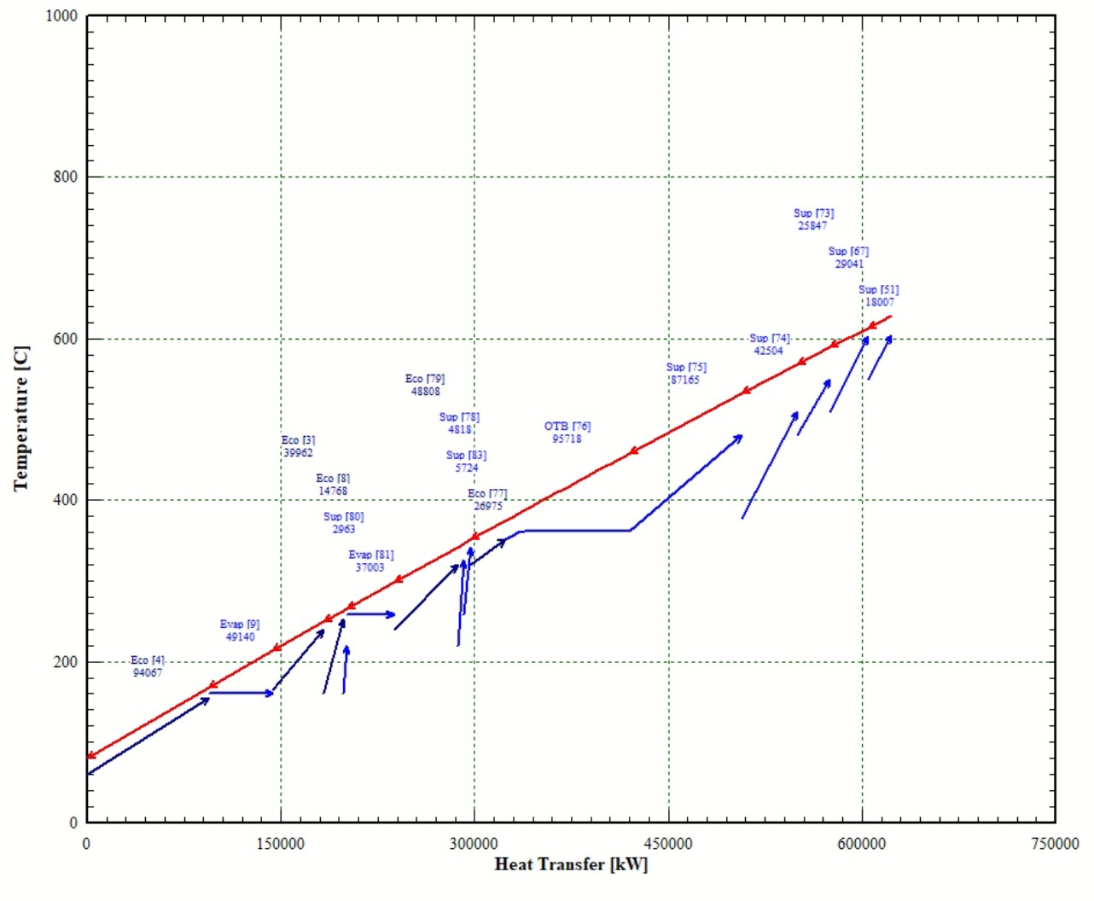
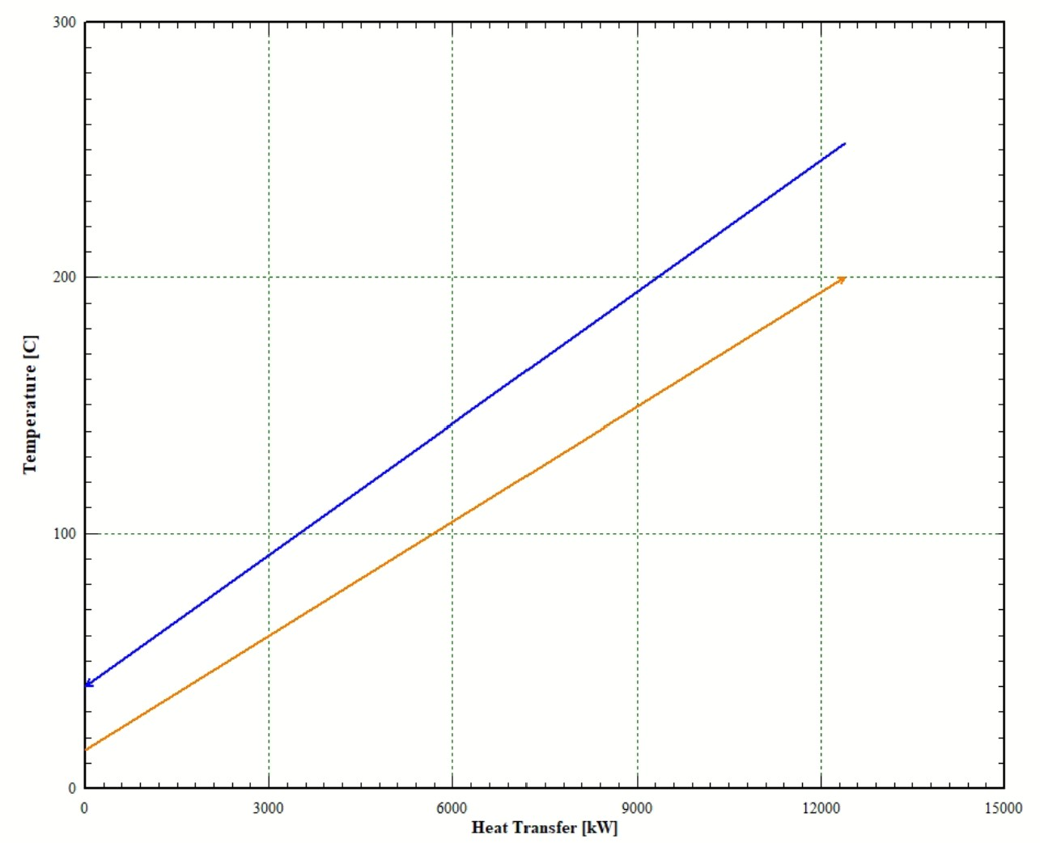
Design Results – Plots
Fig.4 Fuel heater T-Q diagram
Fig.3 HRSG T-Q diagram

Slide 17
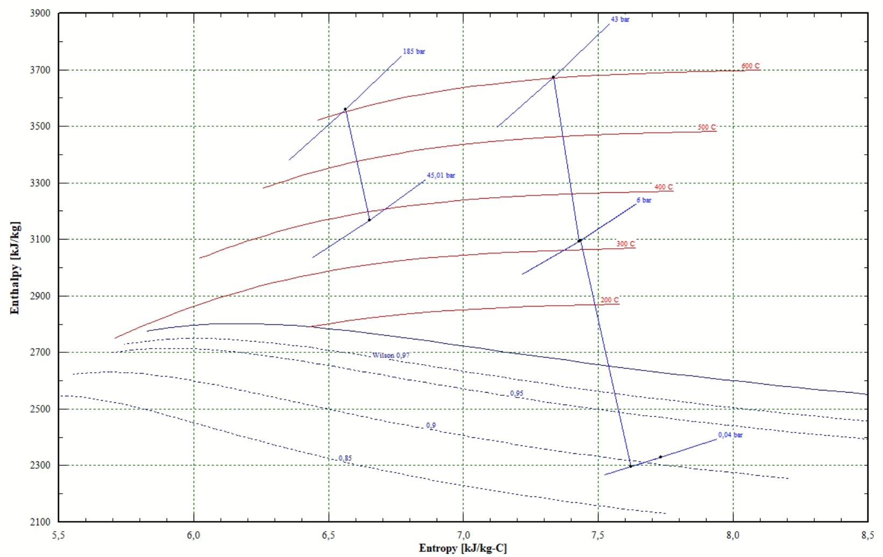
Design Results – Plots
Fig.5 Mollier diagram of steam turbine expansion

Slide 18
CO₂ capture and compression section
Modelling assumptions

Slide 19
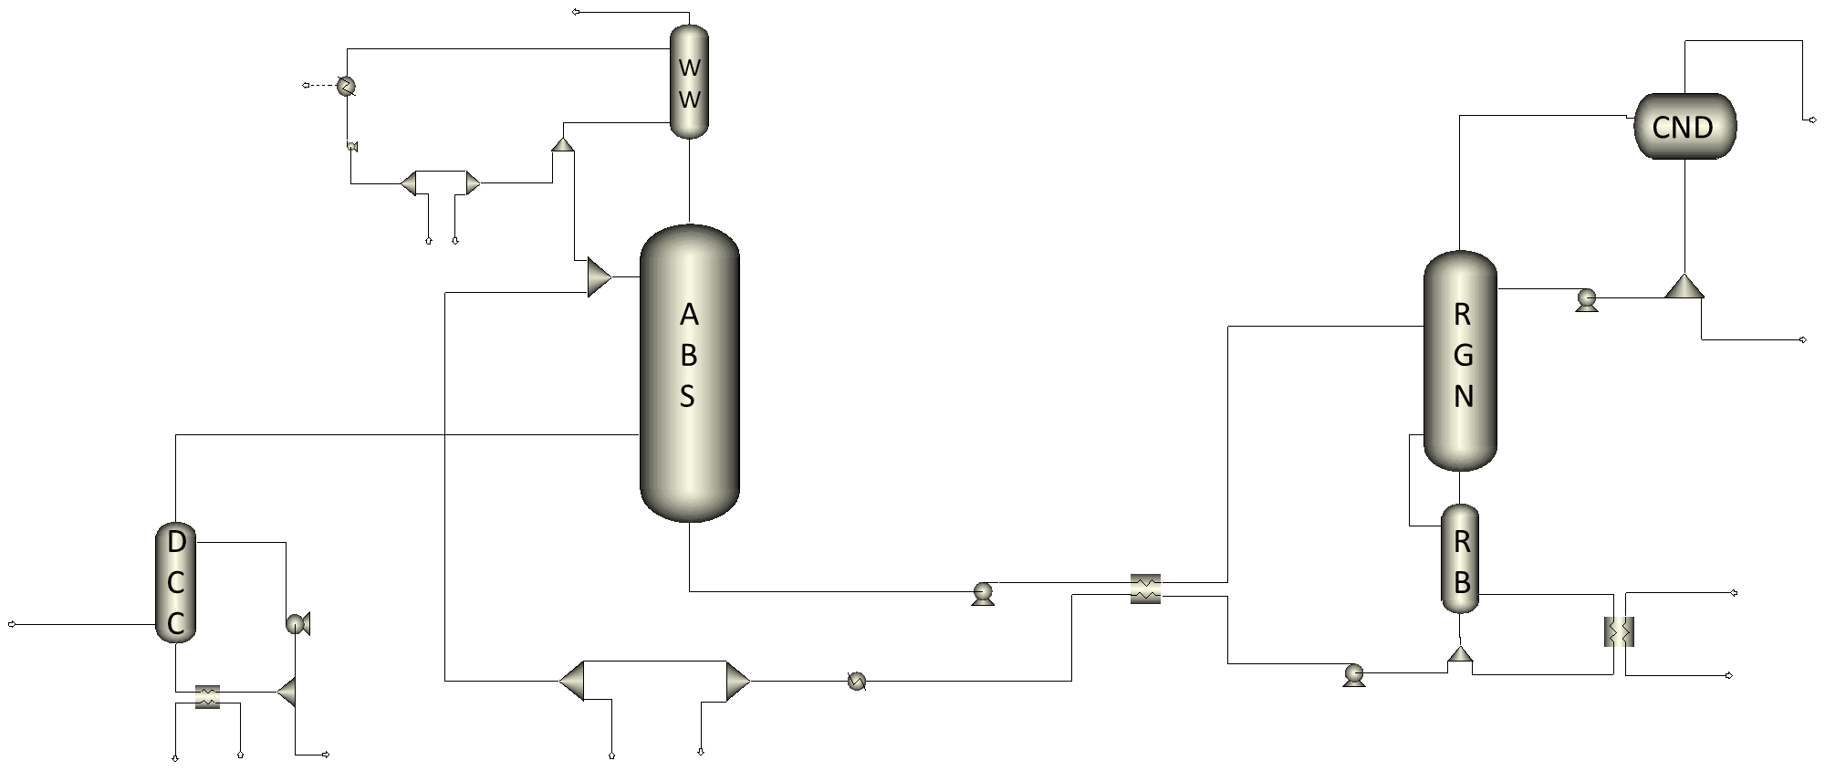
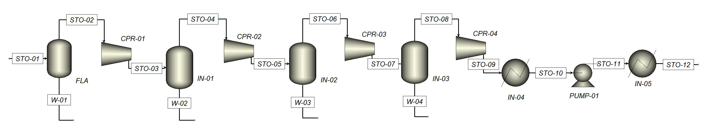
Power plant layout

Slide 20
Power plant layout
Direct Contact Cooler
Absorption column
Water wash section
Regeneration column
Reboiler
Condenser
CO₂ compression section

Slide 21
Input data CO₂ absorption process
Reboiler temperature [°C] | 120
Exhaust gas temperature at absorption column inlet [°C] | 33
Absorption column pressure [bar] | 1.1
Stripping column pressure [bar] | 2
ΔT minimum lean-rich heat exchanger [°C] | 8
Lean solvent composition [mass%] MEA H₂O CO₂ | 29.1 66.6 4.3
Absorption and regeneration columns type | Packed columns filled with Koch Glitsch Flexipac 2X
Absorption column height [m] | 20
Absorption and regeneration columns diameter | Set to avoid flooding
Carbon capture ratio [%] | 90
Model validated replicating three experimental runs from the Technology Centre Mongstad (TCM) [2], [3], [4].
e-NRTL thermodynamic model used for the electrolyte system
Rate-based approach for the absorption and regeneration column
Equilibrium-based approach for the wash section column and reboiler

Slide 22
Input data CO₂ absorption process
Reboiler temperature [°C] | 120
Exhaust gas temperature at absorption column inlet [°C] | 33
Absorption column pressure [bar] | 1.1
Stripping column pressure [bar] | 2
ΔT minimum lean-rich heat exchanger [°C] | 8
Lean solvent composition [mass%] MEA H₂O CO₂ | 29.1 66.6 4.3
Absorption and regeneration columns type | Packed columns filled with Koch Glitsch Flexipac 2X
Absorption column height [m] | 20
Absorption and regeneration columns diameter | Set to avoid flooding
Carbon capture ratio [%] | 90
Given the fluid model, the geometric characteristics of the column, pressure drops, temperature specifications of the heat exchangers, thermodynamic conditions of the absorption and regeneration columns, flue gas and lean solvent mass flow rate (or L/G ratio), and reboiler duty, the system returns mass flow rates and composition of the outlet flows (CCR)

Slide 23
Input data CO₂ compression section
Fluid model | Peng-Robinson EOS
Number of intercooled compressors | 4
Compressor isentropic efficiency [%] | 85
Intercooler outlet temperature [°C] | 40
CO₂ delivery pressure [bar] | 110

Slide 24
Next steps
Full-load simulation of the NGCC with post-combustion CO₂ capture (retrofit case)
Part-load analysis of the NGCC with post-combustion CO₂ capture (retrofit case) with identification of minimum load
Full-load and part-load analysis of the greenfield NGCC with post-combustion CO₂ capture (steam compressor)
Full-load and part-load analysis of the greenfield NGCC with post-combustion CO₂ capture (throttling valve at crossover section)

Slide 25
Thank you for your attention

Slide 26
Appendix
Tout steam SH_HP3 [°C] | 603.7
Tout steam RH2 [°C] | 602
Tout steam SH_HP2 [°C] | 550
Tout steam RH1 [°C] | 510
Tout steam SH_HP1 [°C] | 480
Tout steam SH_LP2 [°C] | 325
Tout water ECO_HP2 [°C] | 320
Tout steam SH_LP1 [°C] | 220
Tout water ECO_HP1 [°C] | 240
Steam/Water outlet temperatures assumed for the design of the HRSG banks

Slide 27
Reference list
[1] K.Jordal, PA. Marchioro Ystad, R. Anantharaman, A. Chikukwa, and O. Bolland. “Design-point and part-load considerations for natural gas combined cycle plants with post combustion capture”. In: Elsevier (2012), pp. 271–282.
[2] E. S. Hamborg et al., “Results from MEA testing at the CO2 Technology Centre Mongstad. Part II: Verification of baseline results,” Energy Procedia, vol. 63, pp. 5994–6011, Jan. 2014, doi: 10.1016/J.EGYPRO.2014.11.634.
[3] P. Loldrup Fosbøl et al., “Results of the fourth Technology Centre Mongstad campaign: LVC testing,” International Journal of Greenhouse Gas Control, vol. 89, pp. 52–64, Oct. 2019, doi: 10.1016/J.IJGGC.2019.06.025.
[4] E. Gjernes et al., “Documenting Modes of Operation with Cost Saving Potential at the Technology Centre Mongstad,” SSRN Electronic Journal, Oct. 2020, doi: 10.2139/SSRN.3366235.

