Slide 1












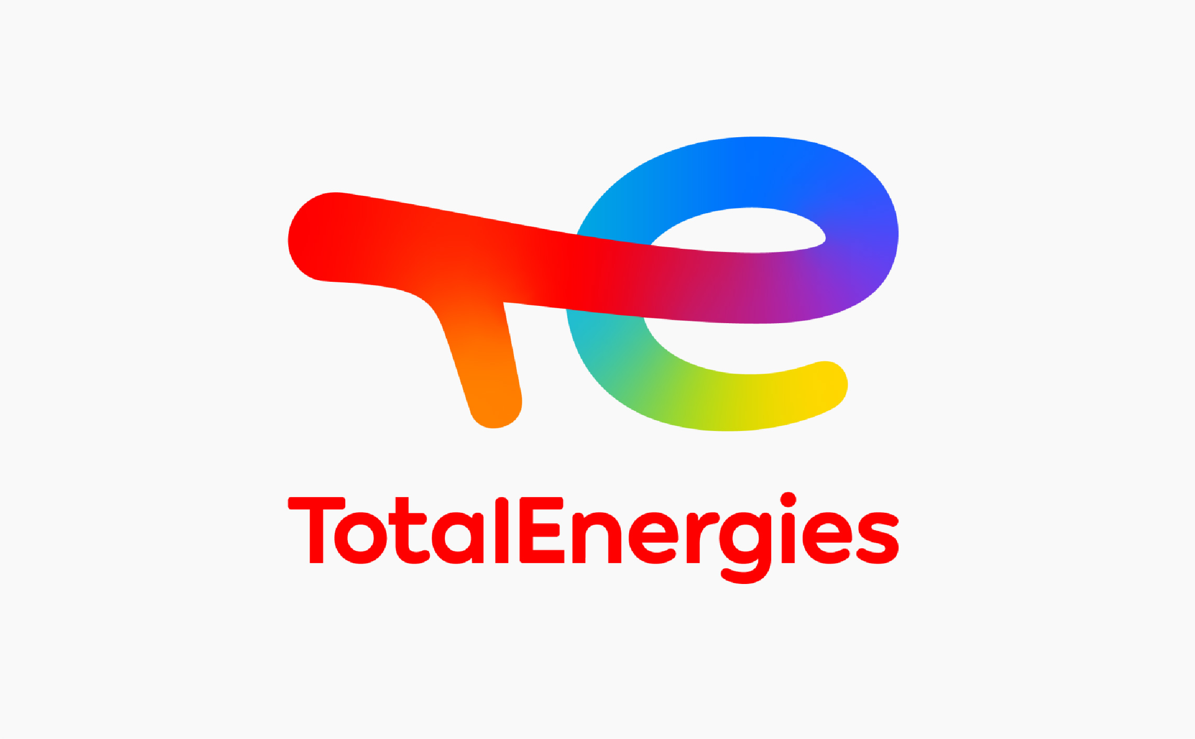



Outcome of High-Level User Meeting 2021

Slide 2
ETN’s High-Level User Meeting 2021 “Operational optimisation and technology development needs for the transition to a carbon-neutral society”
Key messages from ETN Users to accelerate the transition
Holistic approach in tackling barriers to develop a hydrogen economy
Development of trust for unlocking clean technologies potential
Clear decarbonisation roadmap with defined end goals
Market readiness:
Interconnected demonstration efforts of decarbonised solutions
Users call OEMs and the R&D community to join forces, contribute and continue enabling cost-efficient operations of the current asset base, while investing in solutions to respond to the decarbonization challenge – ETN as Key Enabler
GT’s an enabling technology of the energy transition
Enabling decentralised energy systems solutions
Optimising existing assets to meet decarbonisation demands with required security of supply
Favourable markets incentives and supportive policy frameworks
Key inputs into ETN strategy from ETN users
Vision for the Energy Transition
Energy Efficiency
Explore new and more efficient options
Decarbonisation
Improve the carbon footprint of new and existing assets towards carbon-free generation
Transition to new energy systems
Expand the solutions portfolio in the transition to new energy systems
Strategic Areas and Goals
Integrated and trustful cooperation among the sectors to achieve affordable and decarbonised gas turbine-based solutions
Decarbonisation and security of supply solutions through expanded fuel flexibility and system integration
Fleet improvements towards the most efficient and cost-effective solutions for the energy system

Slide 3
ETN’s High-Level User Meeting 2021 “Operational optimisation and technology development needs for the transition to a carbon-neutral society”
Vision for the Energy Transition
Decarbonisation
Improve the carbon footprint of new and existing assets towards carbon-free generation
Energy Efficiency
Explore efficient options
Better use of energy resources
Transition to new energy systems
Expand the solutions portfolio
Unlocking the Hydrogen Economy
In
What’s new?
Strategic Areas and Goals
Trustful and clear cooperation among the sectors to achieve an affordable and decarbonised gas turbine-based solutions
Fleet improvements towards the most efficient and cost-effective solutions for the energy system
System integration providing security of supply and decarbonisation through expanded fuel flexibility
Current Assets Needs and Requirements
Decarbonisation
Carbon footprint measurements
Large scale and post combustion CC(U)S
Operation with decarbonised fuels Flaring reduction
Competitiveness
CAPEX optimisation to support new investments
Low OPEX models
Affordable overhaul options
Short term overfiring for peak power
Economic viability of solutions
Remaining useful life of components
Remote assets solutions
System transition
Large demonstration project
Electrification
Energy Efficiency Improvements
Existing assets upgrades and new assets
Full and part load operation
Increase overhaul service options
Offshore OCGT to CCGT transition
Light and compact bottoming cycles
Emissions
NOx monitoring
NOx emissions with alternative fuels
CO2 catalysers efficiency
Hybridization
Reliability
Maintain availability and performance
Key Enablers
Hydrogen
Short-term retrofit to 20-30 vol.%
2030 target to 0-100 vol.%
Local, small scale (<100MW), intermittent power
Cooperation with TSOs and DSOs on infrastructure
Advanced Cycles
sCO2
GT hybridisation with decarbonized fuels, batteries, thermal storage
Standard package solutions
New technologies exploration
Servicing
Depot quality, diversity and capacity
Healthy competition
Lifecycle assessment
Policy and Regulatory
Market mechanism to reward transition
System actors collaboration
(TSO, DSO)
Legislation and Carbon tax
Certification
Additive Manufacturing
Product quality & Control
Circular Repair
Advanced Control Systems / EMS
Shorten lead time for spare parts
Digitalisation
Unmanned plants
Data analysis
Remote monitoring
Digital warehouse
Workforce
Develop and retain existing skills
Attract new talents

Slide 4
Identified technology development requirements
Provide short-term engine specific retrofit solutions to enable a safe, flexible and reliable operation with fuels that contain up to 30% hydrogen. Launch a gas turbine specific upgrade package to operate with 100% H₂ in 2030 without significant increase in the NOx emissions and maintaining the plant’s performance.
Provide a life time extension programme for plant specific gas turbines guaranteeing safe operation and optimised performance. It will involve life time assessment of critical components including advanced component repair to reduce material resources and costs of ownership.
Optimise power plant operation and maintenance through better use of digitisation and analytics. Combine analytics with engineering knowledge to reduce the operational costs and increase of plant’s overall performance.
Develop gas turbine specific upgrade packages enabling operation with other low carbon fuels: e.g. biofuel (short term) and ammonia (long term).

