Slide 1

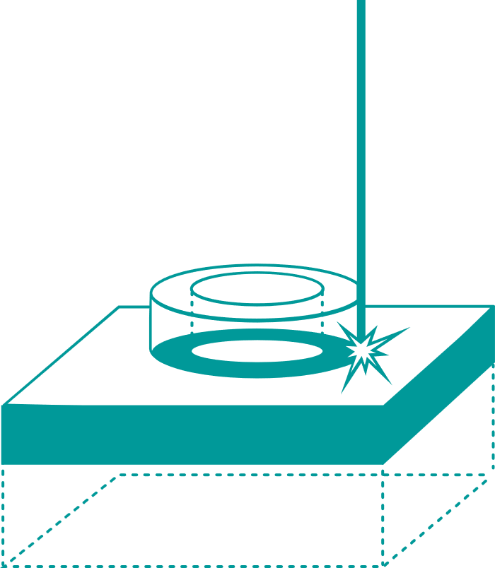
ETN Additive Manufacturing
(L-PBF) machines evaluation
Content
Scope Summary
Evaluation of L-PBF (*) machines
  Use case definition
  Print job summary
    Involved machine manufacturers
Value proposition for involved ETN Members
  Project Provisional Timeline
  Report content
  Assessment criteria & KPIs
  Technical equipment documentation & print job log information
  Testing scope of component, specimen and powder capsule
Budget & Costs
Next steps
(*) L-PBF = Laser Powder Bed Fusion

Slide 2
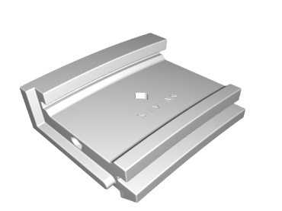
Scope Summary (1/2)
Task
Evaluation of available L-PBF machines, with proposal aligned with entire ETN AM working group
Target
Performance of L-PBF machines from different suppliers
L-PBF Evaluation project Core Team who prepared the proposal
ETN, Engie, Shell, Siemens Energy
Use case / L-PBF machine evaluation scope:
Material
Nickel Alloy 718 (ASTM F3055 - 14a)
Layer thickness
60 μm or 40 µm
No post processing
(HIP, surface treatment …)
Components
Test component : heat shield
IP-free design of a high criticality application
Charpy impact test specimen
Tensile test specimen:
Cubes for Archimedes relative density measurements
Powder capsule for powder monitoring
Process
Additive Manufacturing: Laser - Powder Bed Fusion
Evaluation of components in as-built conditions (with residual stress, etc.). The review will include material and process parameters
Target
Comparison of machine performance & productivity from different OEMs
Criteria
Process, material, build envelope, quality, productivity, digital integration, transferability, cost, etc.
Participants
Machine manufacturers only
Setup
Print defined geometry in defined material; tested by neutral organisation & data aggregated by ETN and independent third party
Result
Comparison of direct “off the shelve” capabilities of machines
Print job
Use Case : L-PBF machine supplier evaluation

Slide 3
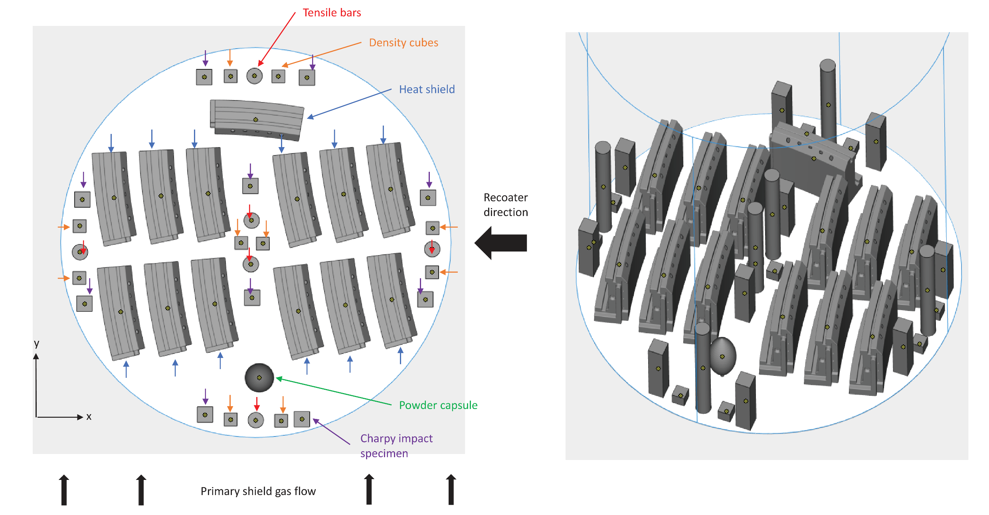
Print job

Slide 4







Scope Summary (2/2)
Machine manufacturers involved are major actors in the AM sector
Voluntary participation of machine manufacturers who can provide “in-kind” production of evaluation components
Currently involved machine manufacturers
Other invited machine manufacturers
Machine Manufacturers | Equipment Involved | Manufacturing Location
3D Systems | DMP Factory 500 | Belgium
EOS | EOS M290 | Germany
Farsoon | FS421M | China
Renishaw | Ren500Q | United Kingdom
SLM Solutions | SLM 500 | Germany
Trumpf | Truprint 5000 | Germany
Velo3D | Tbd | Tbd
Additive Industries The Netherlands
AddUpp France
Adira Portugal
Concept Laser / GE Additive US - Switzerland
DMG Mori Germany
Matsuura Japan
SISMA Italy
Sodick Japan

Slide 5
Value Proposition
The ETN L-PBF Machine Evaluation Initiative provides the ETN Participants with a unique holistic repository of machine’s productivity and quality information
Project value for involved ETN Members
Exclusive access for financers to the confidential report giving 100% transparency of the evaluation of 6 Laser Powder Bed Fusion machines
Unique report providing an overview of market-available equipment, with short project delivery time, based on a 5-month project timeline
Detailed insight in achieved results, which are in as-built condition, i.e. without post processing
Comparison of both Technical and Commercial KPIs, CAPEX and OPEX, including productivity
(based on established standards e.g. ASTM, ISO, NF)
Opportunity to compare results of machines which use equal powder, for identical topologies incl. test bars & test component
Baseline to potentially compare your machine performance to the 6 ones of this Initiative
Database to potentially compare your printing performance
Independent reporting (by impartial 3rd party) and independent testing (all testing by single sovereign contractor)
Enabling an informed decision for machine procurement or contractor selection
Access to detailed repository/overview of all machine’s technical details
Provides information to support qualification of the technology for users
Comparatively low participation cost if critical number of ETN financers is reached

Slide 6
Project Provisional Timeline
Short project delivery time, based on a 5-month project timeline
Commitment of ETN Members is key to run this initiative
Project start
Report delivery

Slide 7
Report content (1/2)
Unique report providing an overview of market-available equipment, with detailed insight in the achieved results
Complete transparency on the evaluation of Laser Powder Bed Fusion machines
Comparison of both Technical and Commercial KPIs, CAPEX and OPEX, including productivity
1/ Assessment Criteria & Equipment Evaluation Key Performance Indicators (KPIs)
Process basics | Machine handling incl. usability & preparation as well as change over time; Ergonomics, layer thickness, re-coater times, bulk parameters, contour parameters, powder utilization / losses
Material portfolio | Variety of materials including standard parameter sets available for machine; Single source vs. multiple suppliers
Build Envelope | in x/y/z determining maximal part size, that can be fitted on the build tray and productivity (maximum number of parts that can be printed in this envelope at one print job)
Digital integration & data access | standard interfaces & machine openness / influenceable variables
Quality Process and Manufactured part | Process: stability & repeatability influencing machine availability and yield; Manufactured part: observed defects, geometry, microstructure & mechanical performance KPIs Material properties: static, micro structure, micro grain structure, anisotropy, feature resolution & accuracy, dimensional tolerances, residual stress See also the testing scope
Productivity | Simulation & experiment in terms of time & costs per part (e.g. maximum number of parts that can be printed in the envelope at one print job, incl. with components stacking)
Transferability | of frozen build parameter sets from one machine to other of same type, same supplier, same technology
Costs | Cost for printed part, CapEx & OpEx
V. Moens

Slide 8
Report content (2/2)
Machine’s technical details
Access to detailed repository/overview of all machine’s technical details
Testing results
Opportunity to compare results of machines which use equal powder, for identical topologies
2/ Equipment technical documentation & Print job log information
Model
Process basics
Material portfolio
Build envelope
Digital integration & data access
Availability of quality monitoring system
Number of power sources (multi-laser allowed)
Cost of one machine (HW cost, maintenance cost, service costs; max running hours, guaranteed uptime)
Print job log information
3/ Testing scope & geometries
Mechanical testing |  |  |  |  |  |  | Metallurgical analysis and NDT
Tensile testing at room temperature | Bend testing | Bend test after corrosion test | Charpy impact testing at room temperature | Hardness measurement at room temperature | Archimedes relative density measurements | Powder capsule characterization | Destructive examination by optical microscopy | Destructive examination by scanning electron microscopy | Surface / Volumetric NDT
Powder
Chemical composition | Particle size distribution | Particle morphology | Flowability | Trace elements
Notes:
2/ Equipment technical documentation
Model
Process basics
Machine handling including usability & preparation as well as change over time;
Ergonomics
Layer thickness options available
Re-coater times
Bulk parameters, contour parameters, powder utilization / losses
Material portfolio
Variety of materials available for the machine
Availability of standard parameters sets per material
Allowed powder suppliers
Build envelope
Dimensions
Maximum part size
Maximum number of test components – cf. Geometry (a) – that can be printed in this envelope at one print job (components stacking allowed)
Information regarding exclusion zones in relation to overlap of lasers
Digital integration & data access
Standard interfaces & machine openness
List of influenceable variables
Availability of quality monitoring system
Number of power sources (multi-laser allowed)
Cost of one machine (HW cost, maintenance cost, service costs; max running hours, guaranteed uptime)
Print job log information
Effective print time,
Oxygen content during build job per layer,
scan time
…

Slide 9
Budget & Costs
Comparatively low participation cost if critical number of ETN financers is reached
Budget & Costs considerations
  Machine manufacturers to deliver evaluation parts on a voluntary basis (“in-kind” production of evaluation components) and thus use this evaluation initiative for business development purposes
  Third party
    project management and independent assurance that the participants adhere to the conditions and requirements of the initiative
    follow industry practices for the gathering and consolidation of data, and ensure traceability of results – standard ASTM F3303-2018
    witness of printing and/or testing activities
    provide a report of evaluation result
  Powder & Testing Program
  Neutral entity will carry out the assessment program and characterize the parts (universities, R&D centers…)
Individual financial contribution
Based on 6 machine manufacturers
ETN members | 1 job/participant with ETN powder | 1 job/participant with ETN powder + 3 extra jobs with OEM Powder (*)
1 | €122,986 | €158,890
5 | €24,597 | €31,778
10 | €12,299 | €15,889
15 | €8,199 | €10,593
20 | €6,149 | €7,945
  (*) 3DSystems, Renishaw, SLM Solutions

Slide 10
Next Steps
  Contact us
  ETN Members interested in joining this initiative are invited to contact Valentin Moëns (vm@etn.global). Clarifications on budget or time constraints are encouraged
  Follow-up meeting with ETN AM Working Group
  7 April (tbc)
  Dedicated meeting to discuss the topic in details
  Target date for commitment of ETN Members
  25 April 2021

