Slide 1
H₂ Deployment in Centralised Power Generation – An Economic Case Study
ETN Young Engineers Committee Sub-Group
Daria Bellotti, University of Genoa
Serena Gabriele, Baker Hughes
Jon Runyon, Cardiff University
Alireza Kalantari, Solar Turbines
Hydrogen WG Telecon
26th October, 2020

Slide 2
Preliminary Report work updates
Scope:
Evaluation of the technical feasibility and economics of hydrogen utilisation for large-scale, centralised power generation to deliver a business case to Hydrogen WG members and inform EC hydrogen strategies
Updates
Weekly jour-fixe team teleconferences – Thursday
The scope of work has been better defined highlighting the aspects to be evaluated
The table of content of the report has been outlined and some titles has been proposed
Preliminary analysis on the impact of using blue-green-grey H2 in different blends with NG to supply a NG-based plant has been evaluated in terms of NG consumption and CO2 global emissions
Request for Input/Open Discussion:​
Feedback/thoughts on work progress
Hydrogen WG member inputs/offers of support – publicly available, shareable, normalised​

Slide 3
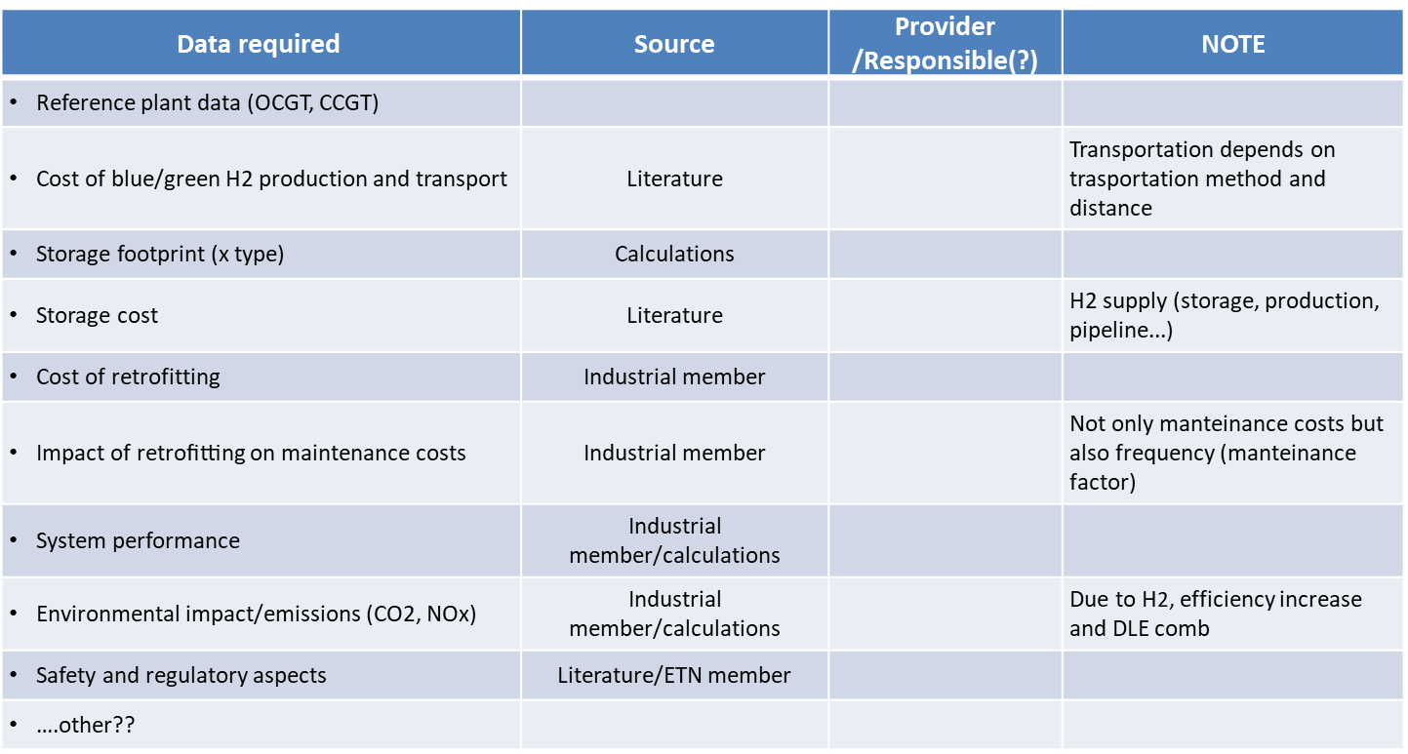
Preliminary Report work updates
1) Aspects to be evaluated:
Type of H2 | Fuel delivery | Case Study | Fuel blends
Green H2 Blue H2 Grey H2 | Storage system on site Pipelines | OCGT case study – small-medium plant size (20 – 60 MW) CCGT case study - large plant size (380-450 MW) | NG + 30% - 50% -70% -H2 100% H2
H2 cost (from literature)
Storage cost / footprint
Cost of retrofitting
Impact of retrofitting on maintenance costs
System performance (efficiency, NG-H2 consumption,…)
Environmental impact/emissions (CO2, NOx)
LCOE
Safety and regulatory aspects
Cost – Benefit analysis
….other??
Definition of a matrix of data/inputs and identify who could provide them

Slide 4
Preliminary Report work updates
2) Report Table of Content and Title:
Executive Summary
Brief introduction of the YEC and authors/their respective organizations
Stakeholders and contributors to the paper
Introduction
    Scope
    Timeframe covered
              Present day, 2030, 2050
    Aims of the paper
Literature Review
  Hydrogen Cost (Storage, Transportation, Production Green vs. Blue)
      And timescales for availability and in what amount
  Carbon Cost (current vs. projected)
    CO₂ emissions reduction with fuel switch from natural gas to hydrogen
  LCOE - Natural Gas Market Trend
  Analysis of the NG-based plant installed (i.e. in Europe) and classification per size (MWth)
  Hydrogen Gas Turbines
      Why centralized power generation? Why gas turbines?
          Stability, quality, safety of supply, reactive power
  DLN Combustion Systems
      Current hydrogen limits by machine/OEM
      Advantages for against vs. Conventional (Diffusion) which can do 100% today
  Ongoing Hydrogen Gas Turbines R&D
OCGT Case Study
  20 MW GT (x3 for 60 MW Power Island, e.g. Titan T250, Baker Hughes LT16,...)
  NG, NG+20% H₂, NG+50% H2, 100% H2 Reliability, Maintainability, Safety
  Retrofit vs. New Build
  Timescale: Present day, 2030, 2050
  Cost
CCGT Case Study
  380 MW GT (e.g. Nuon Vattenfall Magnum) in 440 MW CCGT using Mitsubishi M701F with diffusion combustion (per feasibility study), project underway
      Use existing studies, if available from Vattenfall
  450 MW GT (e.g. Uniper Irsching 4) in 578 MW CCGT using Siemens SGT5-8000H with DLN combustor
  NG, NG+20% H2, NG+50% H2, 100% H2 Reliability, Maintainability, Safety
  Retrofit vs. New Build
  Timescale: Present day, 2030, 2050
  Cost
Roadmap for Policy Support, R&D Funding, and Demonstration
Summary and Conclusions

Slide 5
2) Suggested paper titles:
Preliminary Report work updates
Centralized Hydrogen Power Generation: A techno-economic analysis of low-carbon gas turbine utilization in the energy transition and beyond
Cost-Effective Hydrogen Gas Turbine Power Generation: Enabling renewables now and delivering net-zero by 2050
Techno-Economic Analysis of Hydrogen Gas Turbines for Net-Zero Centralized Power Generation

Slide 6
Preliminary Report work updates
3) Preliminary analysis - Evaluation and comparison of the environmental impact of using blue - green – grey hydrogen as fuel (in different mixture with NG) in 100MW OCGT plant.
Base Case Main Assumptions
Plant installed power (OCGT) | MW | 100
Efficiency | % | 40
Thermal input | MW | 250
NG consumption [LHV 47M J/kg] | Nm3/s | 6.8
Annual operating hours | hr | 8000
NG annual consumption | Nm3/yr | 196,399,345.3
 | ton/yr | 153,191.5
Tot Energy production | GWh/yr | 800
Annual CO2 emission [@ 55.934 tonCO2/TJ] | tonCO2/yr | 387,299.51

Slide 7
NG – H2 mixture
 | 100%NG | NG + 30%H2 vol. | NG + 50%H2 vol. | NG + 70%H2 vol. | 100%H2 vol.
Natural Gas [ton/yr] | 153191 | 138402 | 119895 | 91383 | 0
Hydrogen [ton/yr] | 0 | 6946 | 14040 | 24970 | 60000
The amount of H2 and NG for the different mixtures is calculated to keep constant the thermal energy input
Annual fuel consumption [ton/yr]
Volumetric flow rate [Nm3/s]

Slide 8
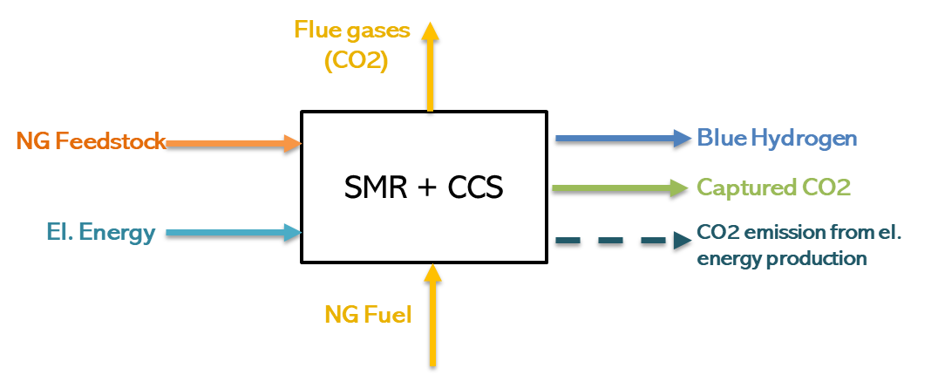
Blue Hydrogen analysis
Blue H2: Hydrogen produced via Steam Methane Reforming where the process CO2 is captured and storage
Main Assumptions
Total NG Consumption | 2.97 | kgNG/kgH2
NG as feedstock | 83%
NG as process fuel | 17%
El. Energy consumption | 0.58 | kWh/kgH2
CO2 capture rate | 90%
CO2 emission intensity for el. Energy production * | 296 | gCO2/kWh
* CO2 emission intensity for European energy mix in 2016 (www.eea.europa.eu)
In present analysis the energy consumption for the H2 storage compression and transportation is not considered

Slide 9
Blue Hydrogen - results
Total Natural Gas Consumption [kton/yr]
CO2 emissions [kton/yr]
153.2 | 158.2 | 160.1 | 163.5 | 178.1
In 30%H2– case the net CO2 emissions result even higher than 100%NG-case (+3%)
In 100%H2-case the net CO2 emissions are about 47% of those 100%NG-case. Not considering the CCS, the CO2 emissions would be 34% higher than the base case.
In 100%H2 – case , the amount of NG consumed to produce the hydrogen is +16% more than the NG consumed by the power plant in the 100% NG - case

Slide 10
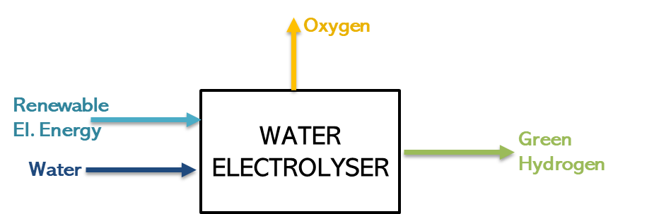
Green Hydrogen analysis
Green H2: hydrogen produced via water electrolyzer powered by renewable energy only
Main Assumptions
Electrolyser type | PEM
Electrolyser specific consumption | 4.05 | kWh/Nm3
Water consumption | 1 | liter/Nm3 H2
In present analysis the energy consumption for the H2 storage compression and transportation is not considered

Slide 11
Green Hydrogen results
 | 100%NG | NG + 30%H2 | NG + 50%H2 | NG + 70%H2 | 100%H2
PEM electrolyser size [MW] | 0 | 39 | 80 | 142 | 341
RES installed power required [MW] (@2400 heq as EU average) |  | 132 | 266 | 473 | 1136
El. Energy consumption [GWh/yr] | 0 | 316 | 638 | 1135 | 2727
Water consumption [kton/yr] | 0 | 78 | 158 | 281 | 674
Equivalent water consumption per capita [num. of persons] | 0 | 900 | 1800 | 3100 | 7400
In 100%H2 case,
The PEMEL required capacity is more than 3 times the nominal power of the NG-power plant
Considering an EU average of 2400 eq. operating hours for the renewable sources, the required RES installed power results about 3 times the PEMEL capacity and 10times the nominal power of the NG-power plant
The water consumption is equivalent to the annual water consumption of about 7400 people or is equivalent to the water contained in 270 Olympic swimming pools

Slide 12
Green Hydrogen results
 | Total Renewable energy sources |  | Wind Energy
Ref. year 2018 | Installed Capacity [GW] | Annual Production [GWh] | Installed Capacity [GW] | Annual Production [GWh]
Europe | 537 | 1297883 | 181 | 383587
France | 51 | 113397 | 15 | 28599
Germany | 119 | 224768 | 59 | 109951
Italy | 53 | 114427 | 10 | 17716
UK | 44 | 108131 | 22 | 56904
In 100%H2 case,
The annual energy consumption corresponds to about 15%, 10% and 5% of the annual wind energy production (in 2018) of Italy, France, and UK, respectively
The annual CO2 emissions of the power plant decreases with the increasing of the H2 content:
30% in H2 (vol.) content leads to a reduction of only 2% in total CO2 emissions.
70% in H2 (vol.) content leads to a reduction of about 35% in total CO2 emissions.

Slide 13
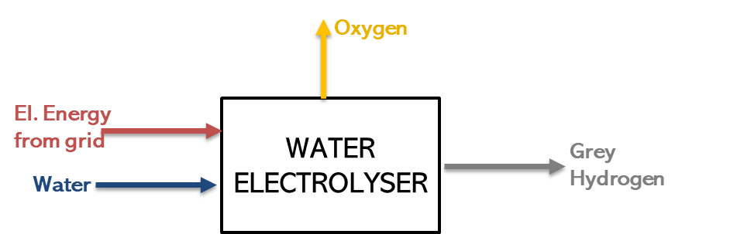
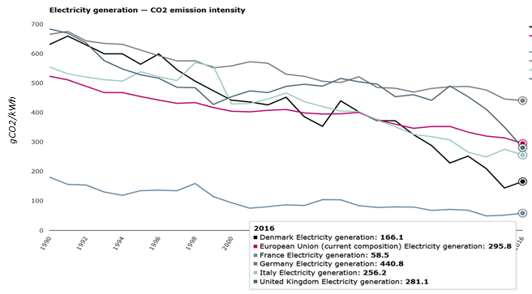
Grey Hydrogen analysis
Grey H2: hydrogen produced via water electrolyzer powered by electrical energy from the national grid (in this case the energy mix is a key factor)
Main Assumptions
Electrolyser type | PEM
Electrolyser specific consumption | 4.05 | kWh/Nm3
Water consumption | 1 | liter/Nm3 H2
In present analysis the energy consumption for the H2 storage compression and transportation is not considered

Slide 14
Grey Hydrogen results
 | 100%NG | NG + 30%H2 | NG + 50%H2 | NG + 70%H2 | 100%H2
PEM electrolyser size [MW] | 0 | 39 | 80 | 142 | 341
El. Energy consumption [GWh/yr] | 0 | 316 | 638 | 1135 | 2727
Water consumption [kton/yr] | 0 | 62.5 | 126.4 | 224.7 | 540.0
CO2 emissions [kton/yr]
Fuel Combustion | 387.3 | 380.6 | 329.7 | 251.3 | 0.0
H2 production | 0.0 | 93.4 | 188.8 | 335.7 | 806.7
The CO2 emissions increase with the H2 content due to the great amount of energy required by the PEMEL for the H2 production.
In this case the CO2 emissions correlated to the el. Energy production are calculated utilizing the European CO2 intensity value
*Based on the EU CO2 intensity value

Slide 15
Grey Hydrogen results
CO2 intensity [gCO2/kWh] | 295.8 | 58.5 | 440.8 | 256.2 | 281.1 | 166.1
The energy mix is different country by country, therefore, the impact on the total CO2 emissions is different.
France, thanks its very low CO2 intensity, seems the most promising area for this application

Slide 16
Next Steps
Weekly team teleconferences – Thursday
To replicate the preliminary analysis for a CCGT plant
To develop the OCGT case study
To develop the CCGT case study

Slide 17
H₂ Deployment in Centralised Power Generation – An Economic Case Study
ETN Young Engineers Committee Sub-Group
Daria Bellotti, University of Genoa
Serena Gabriele, Baker Hughes
Jon Runyon, Cardiff University
Alireza Kalantari, Solar Turbines
Hydrogen WG Telecon
11th September, 2020

