Slide 1
Header
bodytext

Slide 2


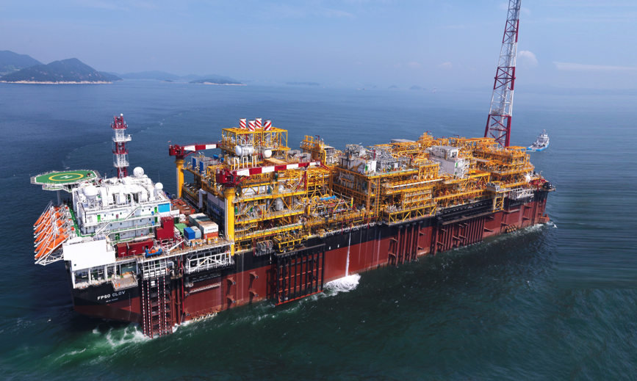
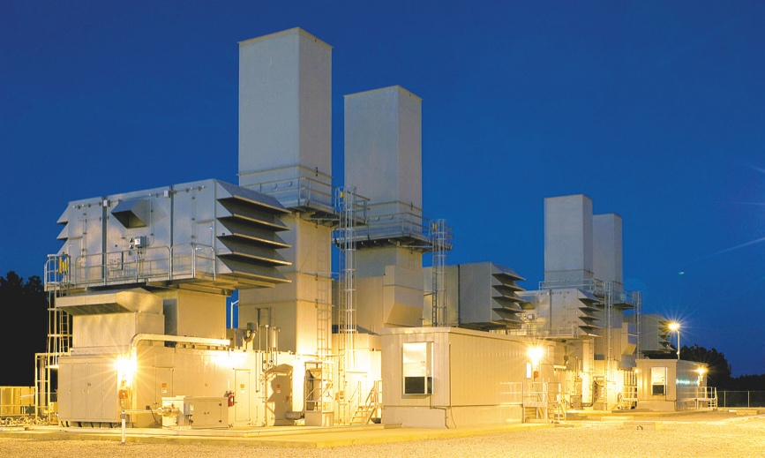
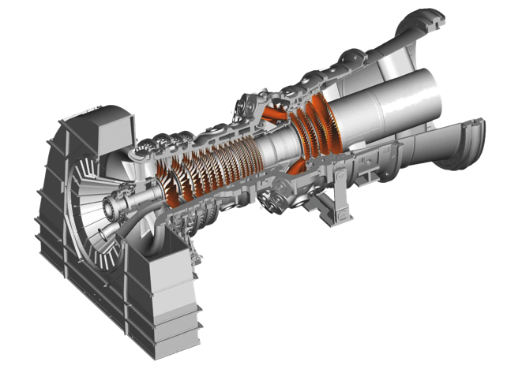

Header

Slide 3
Contact
^{ETN a.i.s.b.l}
Chaussée de Charleroi 146-148/20
^{1060 Brussels}
^{Belgium}
^{Tel: +32 (0)2 646 15 77}
^{info@etn.global}
^{www.etn.global}

