Slide 1

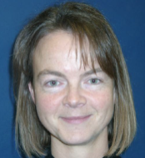
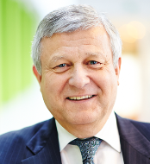
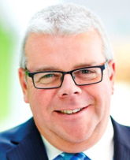
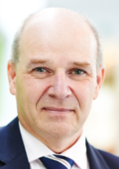
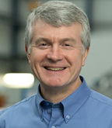


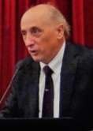
ETN Board of Directors 2018-2020
Catherine Goy
Uniper
Bernard Quoix
TOTAL
Gary Lock
Frazer-Nash Consultancy
Andy Williams
Chromalloy
Mick Conway
RWG Repair & Overhauls
John Oakey
Cranfield University
Manfred Aigner
DLR - German Aerospace
Center
Aristide Massardo
University of Genoa

