Slide 1

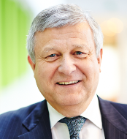
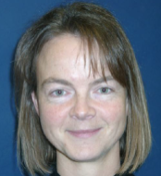
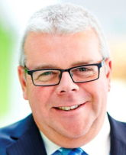
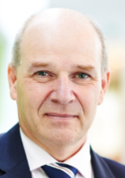
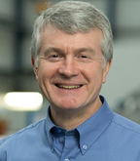


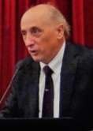
ETN Board of Directors 2018-2020
Bernard Quoix
TOTAL
Catherine Goy
Uniper
Gary Lock
Frazer-Nash Consultancy
Andy Williams
Chromalloy
Mick Conway
RWG Repair & Overhauls
John Oakey
Cranfield University
Aristide Massardo University of Genoa
Manfred Aigner
DLR

