Slide 1
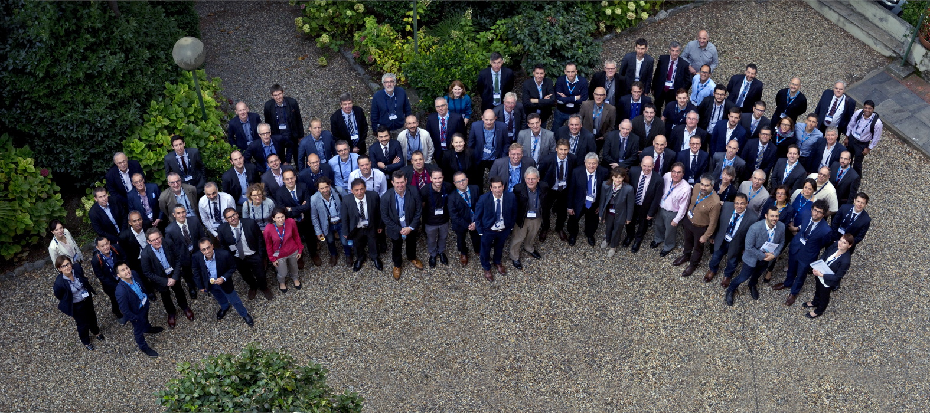
Welcome to ETN's
14th Annual General Meeting
& Workshop
14-15 March 2018
Bucharest, Romania

Slide 2


Approval of the AGM-2017
Meeting report

Slide 3

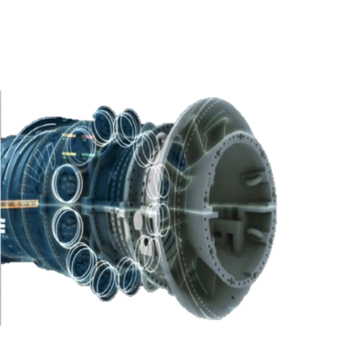
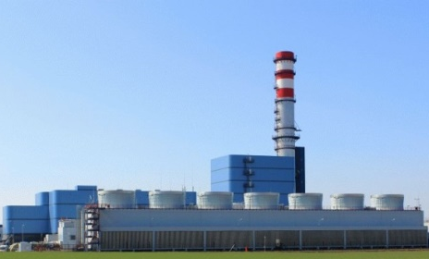
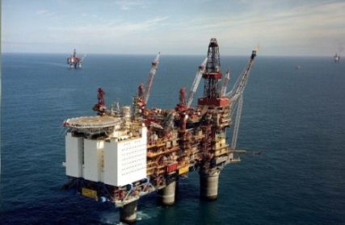
Christer Björkqvist
Managing Director
ETN Global
Activity and strategy report
Annual General Meeting, 14 March 2018

Slide 4
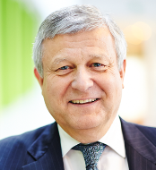
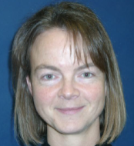
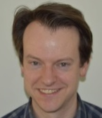
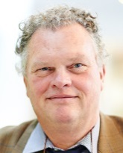

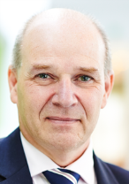

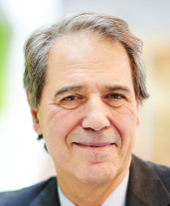


The Board of Directors 2016-2018
Bernard Quoix Catherine Goy Niko Cornelis
Robert Rijsdijk -2016
Adri Postema 2017
Thomas Volks Andy Williams Gary Lock
Giovanni Cerri Herwart Hoenen Pericles Pilidis

Slide 5
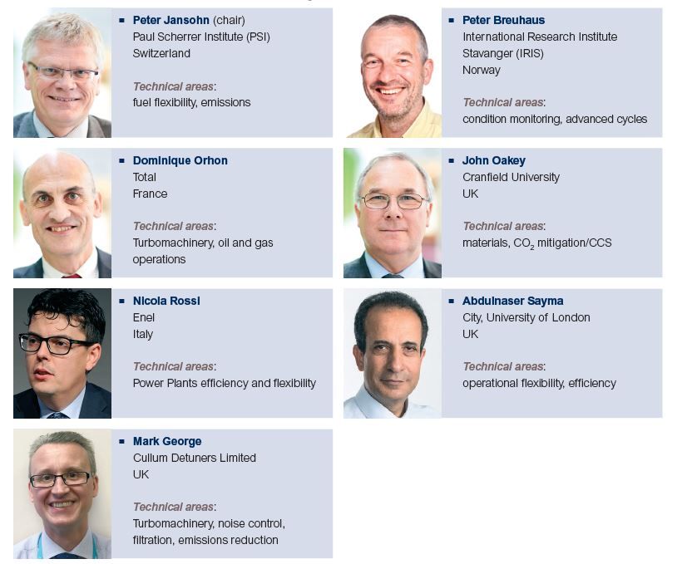
Project Board
2016-2018

Slide 6

IGTC-18 Conference Advisory Board
CAB
Reviewers
Rob Bastiaans, TU/e
Pablo Bellocq, Total
Roger Brandwood, Uniper
Fausto Carlevaro, BHGE
Catherine Goy, Uniper
Peter Kutne, DLR
Richard Marsh, Cardiff University
Jean-Louis Meyer, EDF
John Oakey, Cranfield University
Nicola Rossi, Enel
David Sánchez, University of Seville
Jan Slagter, VBR Turbine Partners
Peter Breuhaus, IRIS
Federico Cernuschi, RSE
Magnus Genrup, Lund University
Jean-Pierre Keustermans, Engie Laborelec
Jacques Maunand, ETN Emeritus Club Member
Ward De Paepe, University of Mons
Hatem Rashad, ADGAS

Slide 7

ETN Global 2018
  Coverage: Gas Turbine and Turbomachinery Technology
  110 member organisations
  23 countries: Europe, Middle East
  Asia, North America
  +700 persons from our member companies are following/involved in ETN activities
  International Cooperation with associations from Japan (GTSJ);
  USA (DOE, GTA and ASME); Canada (IAGT), China (NRC-GT, Nexturbine); UAE (ME Rotating Machinery Technology & Innovation conf.)

Slide 8

12 new members since last AGM
ACTE (Belgium)
Ahlstrom-Munksjö (Finland)
AkerBP (Norway)
AST Turbo (Switzerland)
Aurelia Turbines (Finland)
BP (United Kingdom)
Capstone Turbine (USA)
CERTH (Greece)
FAIST (Germany)
HiETA Technologies (United Kingdom)
Mälardalen University (Sweden)
TNB (Malaysia)
Members in 2018
110

Slide 9


Key focus from the power generation user community
Decarbonisation
Digitalisation
Decentralisation

Slide 10
Key focus from the oil & gas community
Low carbon operations
Digitalisation
RAM (CAPEX and OPEX)

Slide 11

The Energy Union
« To ensure that Europe has secure, affordable and climate-friendly energy »
One of the 10 priorities of the EC 2014-2019
5 dimensions
Energy security
Energy efficiency
Energy market
Climate action: decarbonising economy
Research, innovation and competitiveness
    Strategic Energy Technology Plan SET-Plan

Slide 12
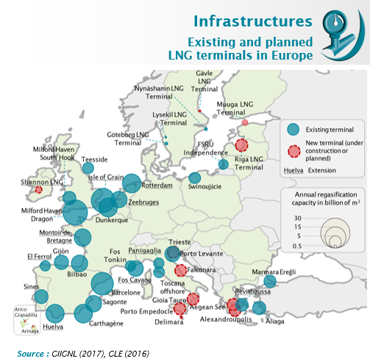
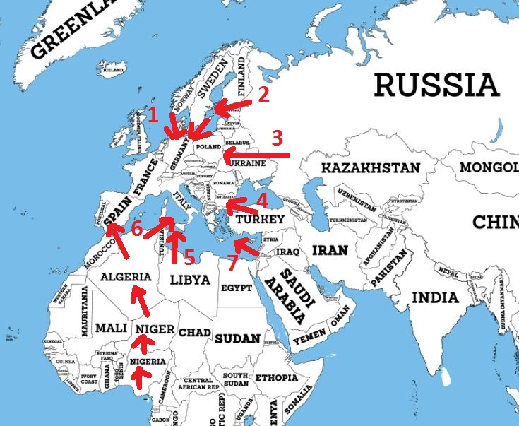
Natural Gas and LNG Outlook
increasing security of supply
LNG import terminals in Europe –Existing and planned
Pipeline NG Supply Routes

Slide 13
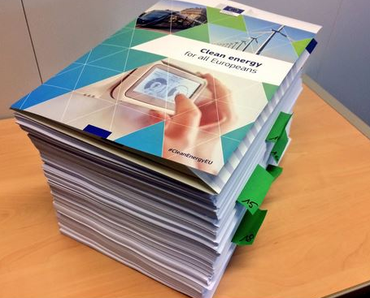
Clean Energy Package
10 aspects of the Energy Union addressed
  8 legislatives proposals
  1200 pages
  9 to 24 months of work?
  Started in 2017
“the proposal aspires to score a hat-trick on the three goals of achieving global leadership in renewables, putting energy efficiency first and giving a fair deal to consumers”.
Vice-President Maroš Šefčovič
Notes:
2nd group of legislative initiatives to implement and develop the Energy Union

Slide 14
Clean Energy Package
Content of importance to our industry
Unify the European electricity market
  Storage solutions needed? Power to gas, etc.
  State aid for emergency power plants
  Pushing coal out
Further integration of renewables
  2030 target: 27% - EP calls for 35%
Energy efficiency
  +1% gain = 2,6% reduction on gas importation
Energy efficiency of buildings
  Heating and cooling
  Micro gas turbine technology

Slide 15
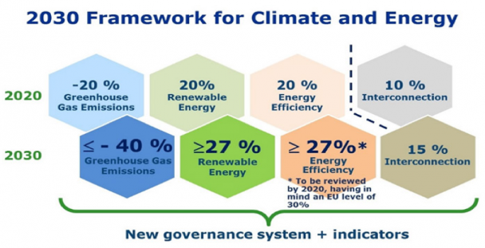
Clean Energy negotiations

Slide 16


Research and Innovation
ETN involvement in the EU Energy and Research Roadmap to a low carbon economy
Active involvement in EU Technology and Innovation Platforms (ETIP)
  Renewable Heating and Cooling Platform - RHC
  Smart Networks for Energy Transition – SNET
ETN provided comments and input to the Strategic Energy Technology Plan – SET-Plan
  Action 4 – Energy systems
  Action 5 – Energy efficiency in buildings
  Action 6 – Energy efficiency in industry
  Action 9 – CCUS

Slide 17
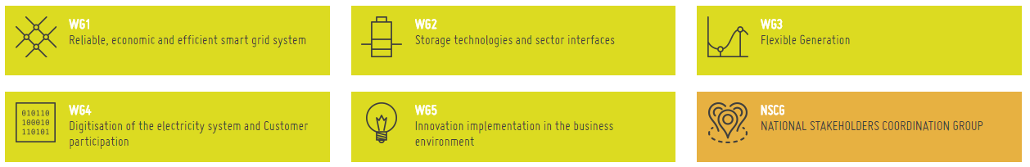
European Technology and Innovation Platform
“Smart Networks for Energy Transition”
ETIP-SNET Governing Board: ETN representative:
Sigrid Gijbels (ENGiE)
Working Groups
ETN representatives in ETIP-SNET
WG3 Flexible Generation
Peter Breuhaus (IRIS)
Peter Jansohn (PSI)
Iarno Brunetti (ENEL)
ETIP SNET Implementation Plan 2017-220
Topic 33 - Developing the next generation of flexible thermal power generation
Topic 34 - Adaptation and improvement of technologies to novel Power-to-Gas and Power-to-Liquid concepts

Slide 18


European Technology and Innovation Platform
“Renewable Heating and Cooling”
ETN ETIP RHC representative in the Biomass Panel
Peter Kutne (DLR)
ETN activities 2017-18
Provided comments on the Biomass Technology Roadmap
Provided comments on the Strategic Research Priorities for Solar Thermal Technology

Slide 19
Activities and
Projects
2017-2018

Slide 20
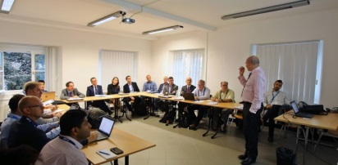
Meetings 2017-2018 since the AGM 2017
High Level User meeting: 3 October 2017, Genoa, Italy
Engine specific user Groups meetings: SGT-A35, LM2500
October Workshop: 4-5 October 2017, Genoa, Italy
IGTC-18 CAB meetings: 4 October and 24 January 2018, Brussels, Belgium
Board Meetings: 6 July, 24 Oct, 19 Dec, 21 February 2018
Project Board & TC Chair meeting: 23 January 2018, Brussels, Belgium
Individual project meetings: Air Filtration, MGT, OMSoP, Bearing project, Hot Corrosion
External Cooperation Conferences: NexTurbine, China; ASME IGTI, US; ME Rotating Equipment Conference, Dubai; AIGT, Canada

Slide 21
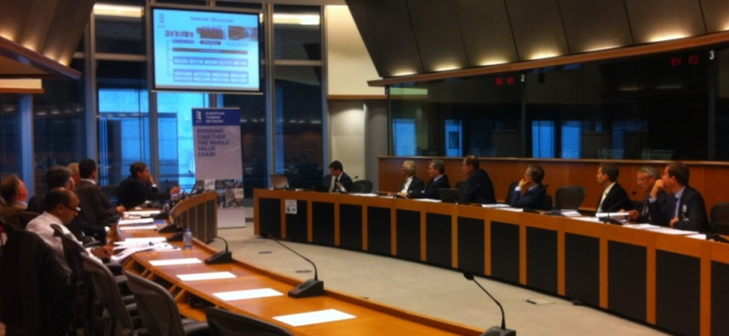
High Level User Meetings
3 October 2017, University of Genoa
Yearly strategic meeting for
coordination of priorities
and to review progress
Discussions
Topics of strategic importance
  Operational issues and needs for the current fleets
  requirements for the next generation GT fleets
Strategy to address issues of common interest and focus on the most relevant engines for the ETN user community

Slide 22
Engine-specific User Groups
Objectives:
Collect and select the most critical technical issues
Exchange experiences among the users
Trigger dedicated responses from OEM’s, ISP’s and R&D community
Identify generic issues to be discussed in technical committees to follow up on and explore potential solutions
Explore opportunities for standardisation and best practise
Define potential needs for educational courses

Slide 23


User Group Meetings
Issue collection
(in progress)
Reminder
Teleconference call
Steering committee Florence 31 January 2018
Sort the issues
Issues send to Siemens and ISPs
Siemens’ and ISPs answers to Users
Minutes
Reports from the issues
SGT-A35, Sitges,
26-27 April 2018
Sitges (Barcelona) Spain,
26-27 April 2018
Issue collection
(in progress)
Compilation of the data
Teleconference call
Steering committee
Florence 31 January 2018
Issues send to GE and ISPs
GE’ and ISPs answers to Users
LM2500 UGM 2018, Berlin, 20-21 June 2018
Sort the issues
Reports from the issues
Minutes
Berlin, Germany,
20-21 June 2018

Slide 24

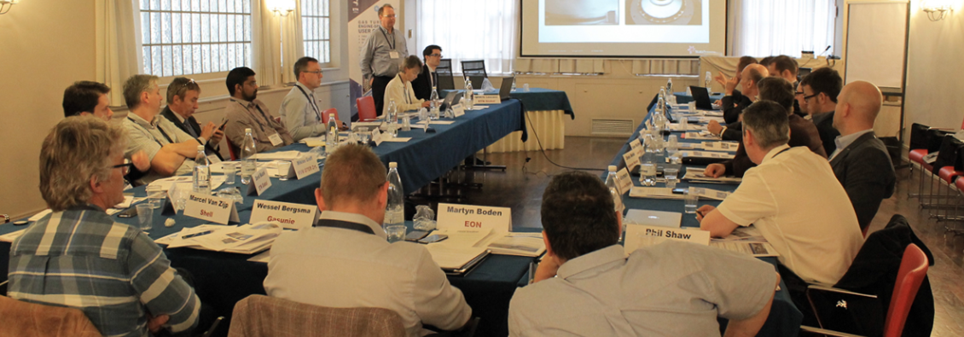
Now
SGT-A35
Content Wise
45+ issues in database
Answers from Siemens, TCT and RWG to the issues
14 main issues discussed
Questions Users to Users
Questions to Siemens
Questions to RWG & TCT
Attendance
21 Users Representatives
14 Users Companies
RWG
TCT
Siemens

Slide 25

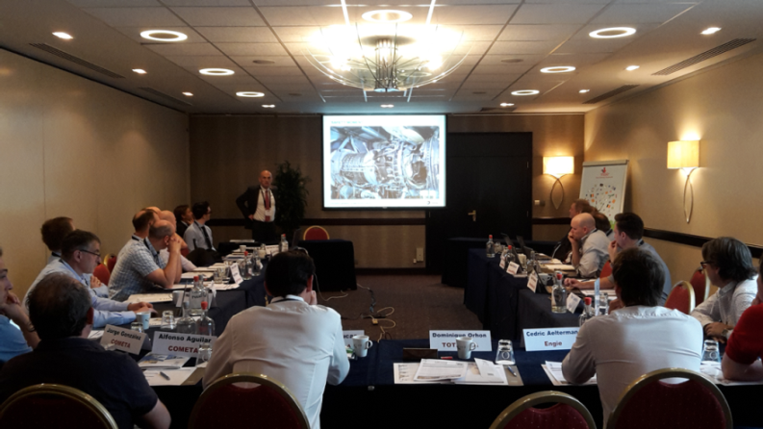
Attendance:
19 Users Representatives
11 Users Companies
BHGE
United Service Sweden
VBR Turbine Partners
MTU
Content Wise
70+ issues in database
Answers from GE
10 main issues discussed
individual reports for each top issue
Questions from Users to GE

Slide 26

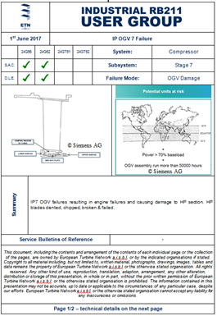
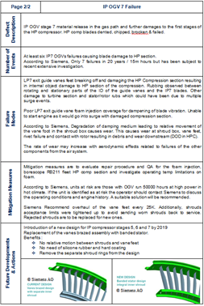
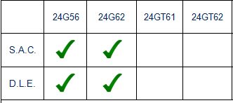
Issue database and summary report of top issues: Review and updated.
New:
June 2017: Specific detailed reports for each top issue with pictures /drawings for LM2500 User Group
July 2017: reports for SGT-A30-35 also available

Slide 27
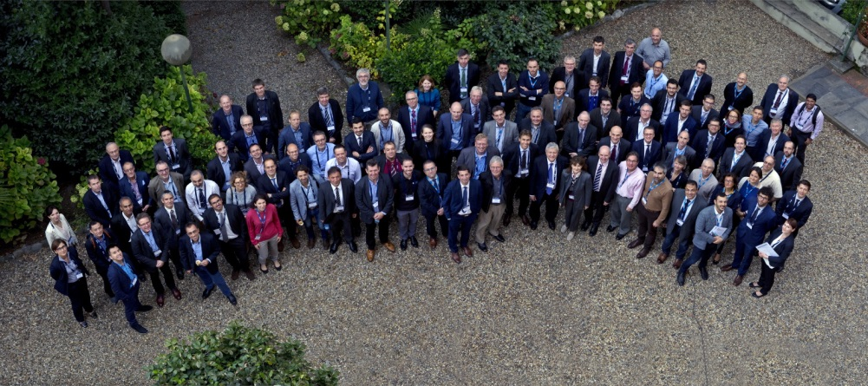
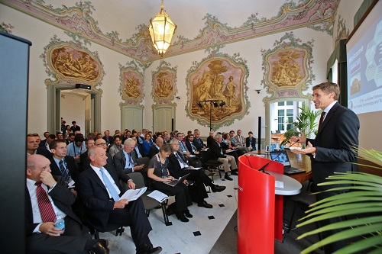
October Workshop 2017
4-5 October 2017 in Genoa, Italy, hosted by Ansaldo Energia
120 participants
Several side meetings:
  High Level User meeting, hosted by University of Genoa
  IGTC-18 Conference Advisory Board meeting
  Micro Gas Turbine standardisation meeting
  ETN-UK-US Department of Energy collaboration meeting
  Air Filtration Working Group meeting

Slide 28
ETN’s Industrial Emission
Directive (IED) Committee
IED Forum Member
  ETN is a recognised member of the IED Forum and a collection point for inputs from the User Community
  Large Combustion Plant Directive BREF
  Medium Combustion Plant Directive
CEN Sector Forum Gas Working Group on Gas Quality
  ETN is monitoring developments within the CEN Sector Forum Gas WG on gas quality (SFGas WG GQS)

Slide 29
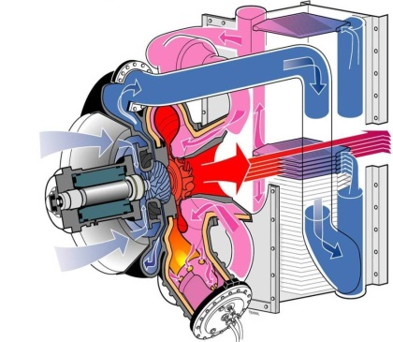

Micro Gas Turbine
Working Group
Objectives
Explore markets opportunities and solutions;
Implement cooperation projects in order to reduce cost and increase the Technology Readiness Level (TRL) of individual components and systems;
Set-up conferences and workshops to facilitate cooperation in both horizontal and vertical projects;
Pave the way for funding opportunities by highlighting the importance of the MGT technology development, contributing to the achievement of the 2030 climate and energy targets set by the European Commission.
Activities
MGT Technology Summary
ISO 19372 - Microturbines applications – Safety

Slide 30
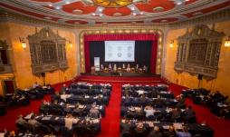
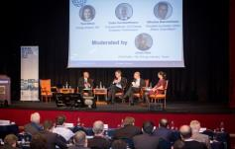

Preparations for IGTC-18
Call for Papers
Submitted abstracts in total: 69
Operations & Maintenance: 28
Manufacturing and Repair: 5
New Component Developments: 20
Next Generation Technologies: 16
→ 30 abstracts were selected

Slide 31

LM2500 Bearing project
projects
October - November
December - January
Parameters that can be provided by the Users
Final list of parameters
Collection of data
Parameters useful for GE to run the analysis
Compilation by ETN and send to GE for analysis
Meeting in Florence, 1st of February for GE results
GE Analysis: 3 types
Prognostics
See if the algorithm can predict the event
Try to forecast the event
Statistical
Find critical factors
Understand the physics behind
Critical sites
Identifying unusually vulnerable sites
Targeted measures

Slide 32
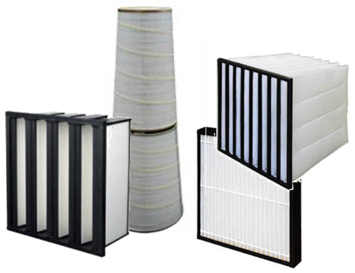

Air Filtration Project
projects
Objectives
Improvements of quality and flexibility of Air Filtration system
26 organisations
ETN liaison member of the ISO/TC142
Comments on ISO 29461 - Particulate Air Filters intake systems for rotary machinery
Drafting of a “Water/Salt test procedure for Gas Turbine/Compressor Air Inlet Filter Systems” to be part of ISO 29461
Testing activities:
To evaluate the aging effect of the filters
To evaluate the performance of the single filter in a multi-stage system
To perform an independent air filtration test on a model scale test rig to test filters in close-to-real GT operation conditions

Slide 33
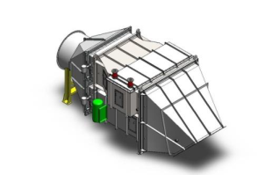
Exhaust System – WHRES Project
projects
19 organisations
ETN liaison member of ISO/TC192
ETN WHRES standard submitted to ISO/TC192 in February 2016
Activities
New Work Item in ISO/TC 192 to draft an ISO standard scheduled to be published in 2019.
3 ETN members actively involved in the ISO/TC 192 Working Group
ETN Exhaust System WG members will be involved to submit comments on the draft ISO standard.

Slide 34

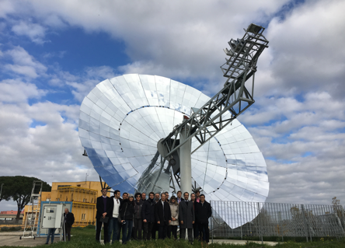
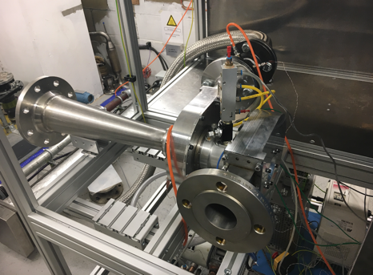
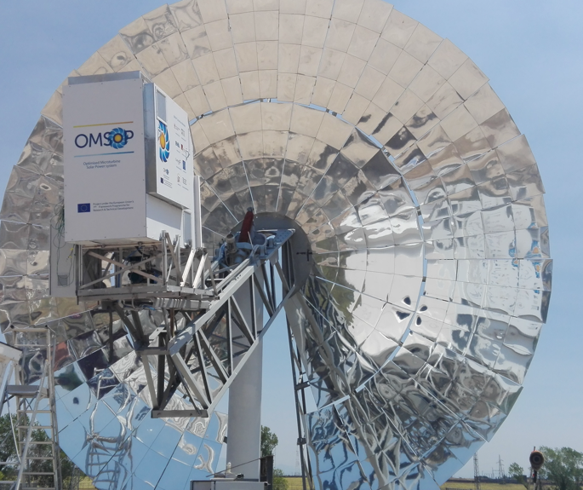
The Project
Optimised Micro Turbine Solar Power
Completed in Autumn 2017
projects
  Demonstration of concentrated solar power technology using a parabolic dish system powering a micro-gas turbine
  Demo facilities still operational at ENEA’s
  facilities in Rome Italy

Slide 35



Dissemination Activities by ETN
OMSoP website
  Regularly Updated Public Website
  Members-Only SharePoint
Printed Publications
  Project Leaflet
  Banner
  Demonstration Site Poster
  Two page project Update
Electronic Updates
Press releases
Article in Industry Magazines
Meetings and events
OMSoP video

Slide 36


PUMP-HEAT
projects
Objective
Demonstration of an innovative concept based on the coupling of a fast-cycling highly efficient heat pump (HP) with Combined Cycles.
The integrated system features thermal storage and advanced control concept for smart scheduling.

Slide 37

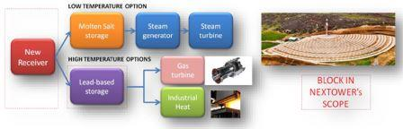
NEXTOWER
projects
Objective
Demonstration of high-performance durable materials for the next generation of concentrated solar power (CSP) air-based tower systems, making them commercially competitive in the energy market beyond 2020.

Slide 38
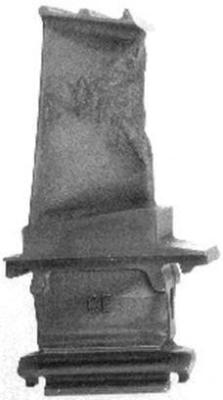
Hot Corrosion Project
projects
.
Collection of parts
Objective
Survey 1:
Find Users with Hot Corrosion issues
The objective is to run gas turbine at their expected life duration with sour gas containing Hydrogen Sulphide in salty environment.
Main GT Users’ costs due to hot corrosion on hot gas path components:
Gas treatment equipment
Down time inducing production losses overhauls
Numerous additional spare parts
Logistic cost
Survey 2:
Collection of details on their issues
(Type of engine, Location, fuel,…)
Hot Corrosion meeting (AGM)
Analysis of the damaged parts
Investigation for solutions
Notes:
Which parts could be advantageous to be manufactured with Additive Manufacturing.
Following the GT Failures questionnaire, hot corrosion on hot gas path (HGC) components (mainly type II) has been identified as one of the main GT issues to be addressed in TC3, with regards to HGP components’ material and coatings.

Slide 39
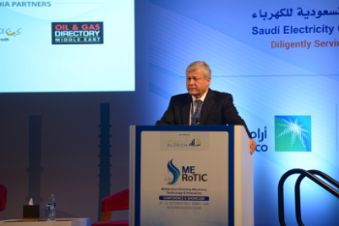
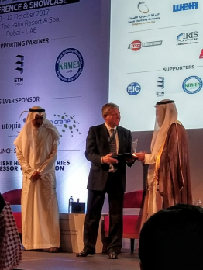
Cooperation Conferences
Middle East Rotating Machinery Technology & Innovation
10-12 October 2017, Dubai UAE
Bernard Quoix, ETN President delivered a keynote opening speech and highlighted:
Most important topics for rotating machinery in the Oil & Gas and power generation industry.
Key requirements in terms of technology and innovation.
ETN and our activities, and invited the local user community to join our Network.

Slide 40
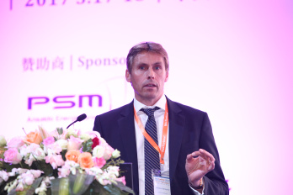
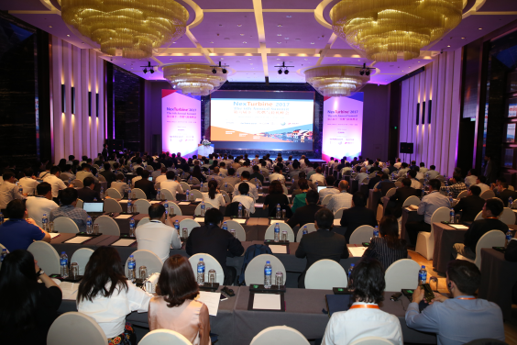
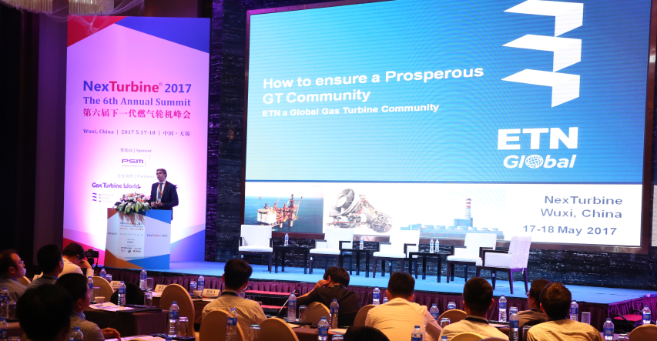
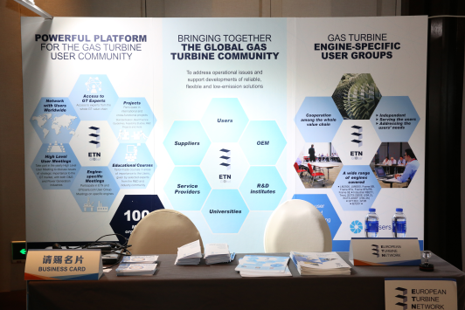
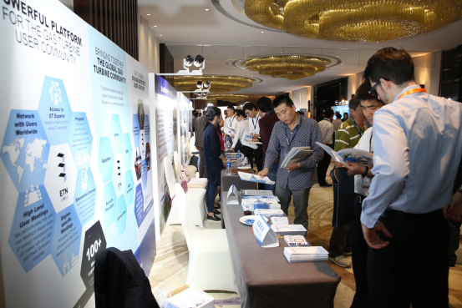
Cooperation Conferences
NexTurbine 2017
17-18 May 2017, Wuxi, China
ETN keynote speech
ETN stand at the conference
Opportunity to connect with the Chinese user community and to explain about ETN’s activities

Slide 41


IAGT Symposium 2017
23-25 October 2017
Cooperation Conferences
ASME Turbo Expo, 26-30 June 2017

Slide 42

ETN Best Practise Award
Opportunity for members to improve their expertise through interactions with other peers.
Starting with two major areas
    EHS: Environment, Health and Safety
    Workforce development
Award and recognition to the winners

Slide 43
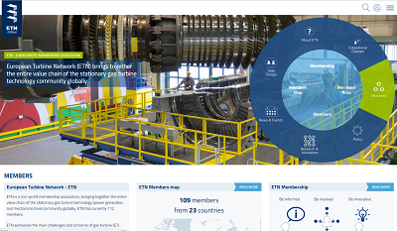
Communications
New www.etn.global website
Main communications platform and database for member information
New feature: event registration
Social media
ETN accounts on Twitter (@etngasturbine) and Linkedin (ETN – European Turbine Network)
ETN publications
Monthly News Summary: distributed internally to ETN members every month
Quarterly Newsletter: sent to more than 1500 contacts (members and external contacts) four times a year

Slide 44

Upcoming Meetings

Slide 45
User Group Meetings
Issue collection
(in progress)
Reminder
Teleconference call
Steering committee Florence 31 January 2018
Sort the issues
Issues send to Siemens and ISPs
Siemens’ and ISPs answers to Users
Minutes
Reports from the issues
SGT-A35, Sitges,
26-27 April 2018
Sitges (Barcelona) Spain,
26-27 April 2018
Issue collection
(in progress)
Compilation of the data
Teleconference call
Steering committee
Florence 31 January 2018
Issues send to GE and ISPs
GE’ and ISPs answers to Users
LM2500 UGM 2018, Berlin, 20-21 June 2018
Sort the issues
Reports from the issues
Minutes
Berlin, Germany,
20-21 June 2018

Slide 46
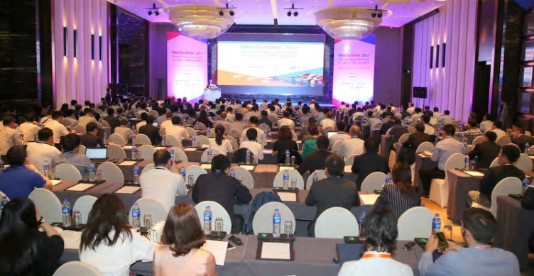
NexTurbine 2018
“Fight a good fight, for the blue-sky”
The 7th Annual Summit
  24-25 May 2018
  Crown Plaza in Kunshan, Jiangsu, China
23rd (PM) Inlet Air Filtration & Cooling Workshop
24th Plenary
25th GT O&M Track || Gas-powered DE Track || GT R&D Track
20 Exhibitors
54 Speakers

Slide 47

Middle East RoTIC
“Achieving Asset Integrity & Reliability Excellence”
2nd Annual
MIDDLE EAST ROTATING MACHINERY
TECHNOLOGY AND INNOVATION
CONFERENCE & SHOWCASE
  25-27 September 2018
  Dubai, United Arab Emirates
Call for papers open
26 Exhibitors
Registrations open (by invitation only)

Slide 48

IGTC-18
“The Future of Gas Turbine Technology”
The 9th International Gas Turbine Conference
  10-11 October 2018,
  Le Plaza Hotel in Brussels, Belgium
4 keynote sessions: speakers from the European Commission, International Energy Agency, US DoE
6 technical sessions: 30 technical papers to be presented
Registrations will open 1 May 2018

Slide 49



Education/Training Platform
Involvement of the ETN community
ETN is collecting Turbomachinery related educational courses
from Members
Please send us relevant courses with a short description and link to be displayed on our website

Slide 50


Questions?
ETN Global
Chaussée de Charleroi 146-148, 1060 Brussels, Belgium
Tel: +32 (0)2 646 15 77, info@etn-gasturbine.eu

