Slide 1
Typical bearing distress modes
Mode | Cause | Effect | Preventive Actions
Transportation | Non-air ride trailer transportation | “false brinelling” on bearings (fretting motion) | Always use air ride equipped trailer or air ride kit for universal container (PN 00202050000)
Preservation | No Preservation Loss of Preservation Integrity | Loss of protective oil film on bearings leading to corrosion | Preserve and inspect per O&M WPs
Cleanliness | Oil supply outside of GE specifications | Corrosion or Hard particle contamination of bearings | Maintain oil per GE specification MID-TD-0000-6
Operation | Incorrect orifice plates | Bearing loads (4B & 7B) outside of limits | Review HP Recoup/Thrust Balance Worksheets per O&M
  Always monitor chip detectors, vibration levels, and scavenge temperatures as indication of bearing health.

Slide 2
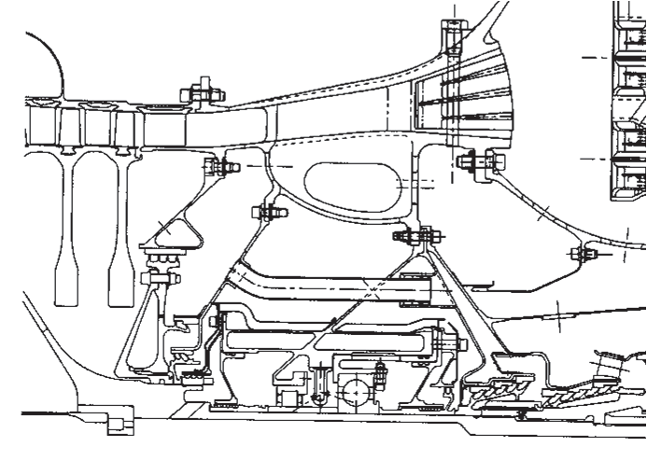
HP Recoup Pressure Setting
4B is gas generator rotor thrust bearing
  GG rotor subject to fwd. load from HPC & aft load from HPT
  HPC and HPT forces are balanced by HP Recoup cavity pressure on rotating CDP seal - control pre-load on 4B bearing
HP Recoup pressure set by selecting orifice size using selection algorithms
  Algorithms based on tests with strain gages
  Goals → avoid overload and no-load on 4B
HPC Load
HPT Load
To TMF for Liner Cooling
(2) HP Recoup Orifice Plates
Net 4B Load FWD
100

Slide 3
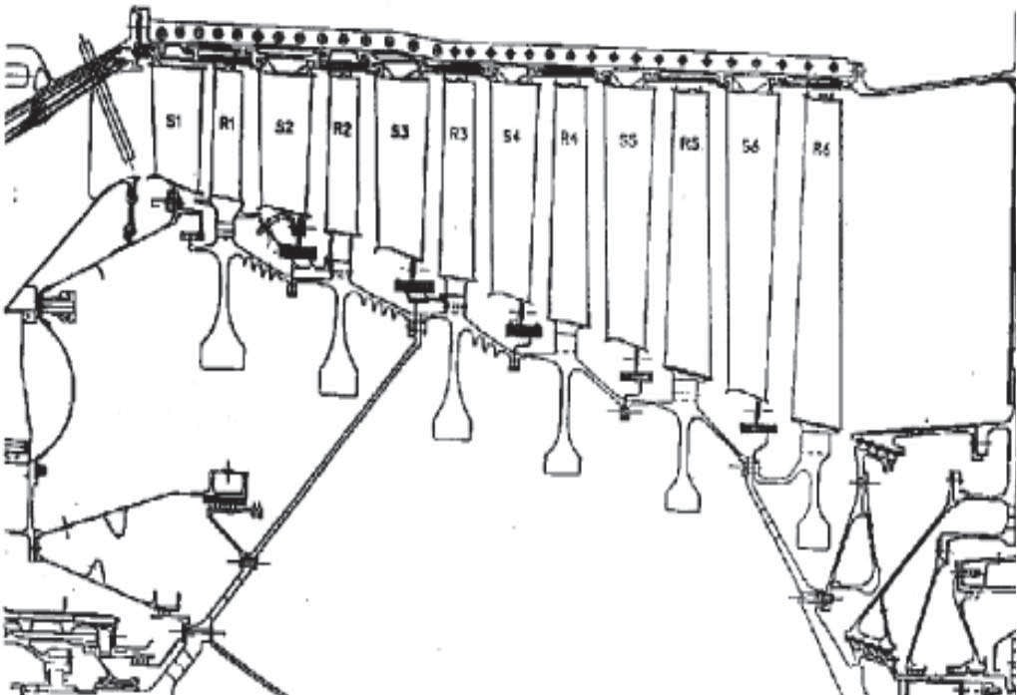
PT Balance Piston Cavity Pressure Setting
7B is Power Turbine Rotor thrust bearing
  PT rotor subjected to operating load in aft direction
  Aft load is balanced by piston load in forward direction – maintains net load on 7B in aft direction
PT thrust balance cavity pressure set by selecting orifice size using selection algorithms or preferred operating range curve
  Algorithms & POR curve based on tests with strain gages
  Goal is to avoid overload, no-load or forward load on 7B ball bearing
  Forward load condition can buckle 7B bearing housing
HPC stage 13th air
7B Thrust balance orifice
Net 7B Load AFT by Adjusting PTB Cavity Pressure
Thrust Balance
Piston
Thrust Balance Cavity
101

Slide 4
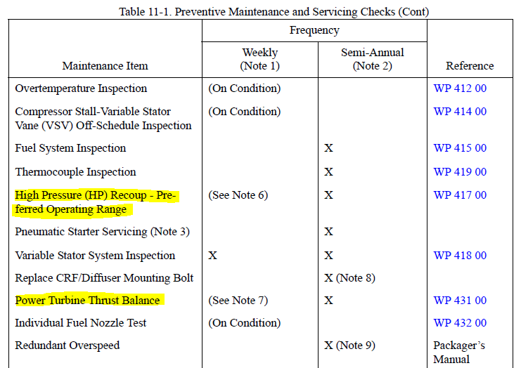

Slide 5
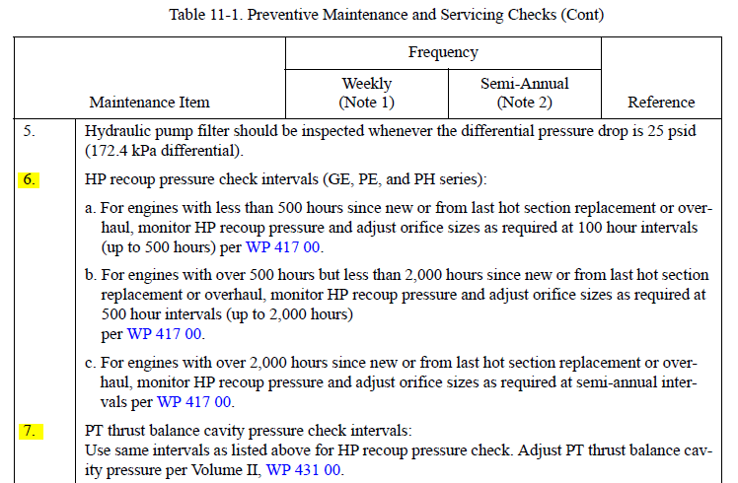

Slide 6
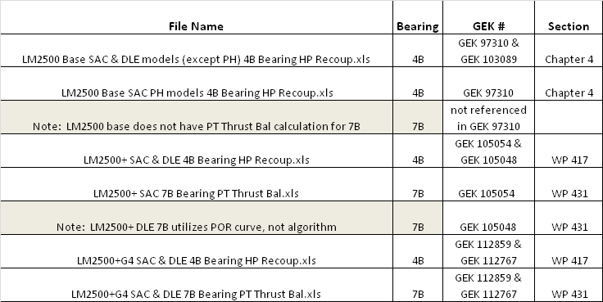
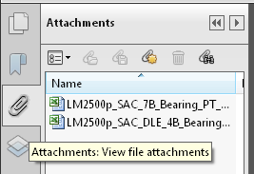
HP recoup orifice selection worksheet updates
O&M manuals updated via Interim Change Notice (ICNs)
Embed Excel worksheets

Slide 7
TS guidance if in doubt
Use latest spreadsheet
    The spread sheet gives slightly different answers at different speeds and ambient temperatures. This mainly is due to the fact that the load on 4B bearing is non-linear. At speed set point of 9200 RPM gives us best compromise of the load on 4B throughout the operating range
Instrumentation
    Check PS3, P2 lines for clogging and leakage (PSE weep hole)
    Calibrate P2, PS3 pressure transmitters
    Make sure all pressures are in PSIA (not psig) in the calculation sheet
    Check range of the pressure instruments used

Slide 8
TS guidance if in doubt
Data gathering
    All parameters should be taken as a snapshot.... and not at appreciable time apart
    Let unit sit on point condition for at least 30 min before gathering data
HP recoup piping
    Check for leakage in the HP recoup piping (flanges, cracks, etc…)
    Remove sensing line from recoup pipes and clear hole from obstructions
Measure recoup pressure on both recoup lines to confirm it’s the same
Orifices
    Never change more than two sizes in one go
    Never go below P03

Slide 9
TS guidance if in doubt
Orifices
    Never change more than two sizes in one go
    Never go below P03
    If recommended operating point cannot be reached
      For Base engine, install P05 orifice
      For Plus engine, install P03 orifice
      For +G4 engine, leave orifice installed during Factory Acceptance Testing in Evendale

